Slide 1
JEFERSON TAVARES BRAZIL ABC Region Inter-Municipal Consortium office Professor of Centro Universitário das Faculdades Metropolitanas Unidas
BRICS + CITY LAB II COLLOQUIUM
Adaptive and Transformative Governance for Large City Development
Moscow - 2016

Slide 2
THE EXPERIENCE OF THE REGION OF ABC A TERRITORIAL ASSOCIATION IN WITH INTERMUNICIPAL COOPERATION NETWORK

Slide 3
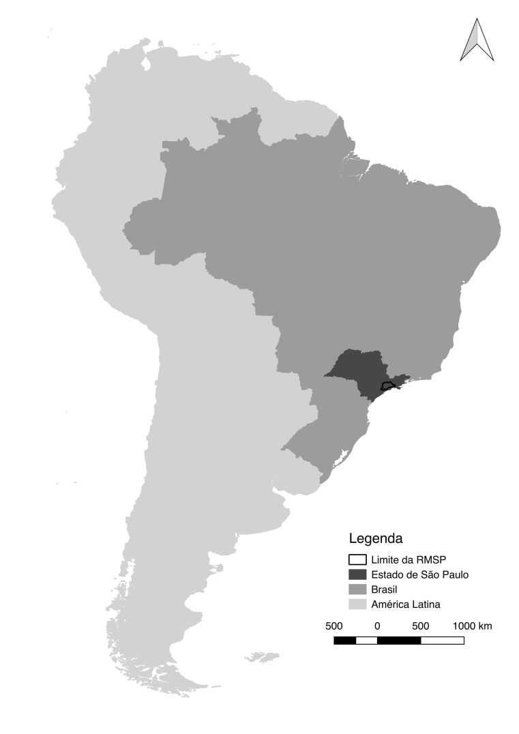
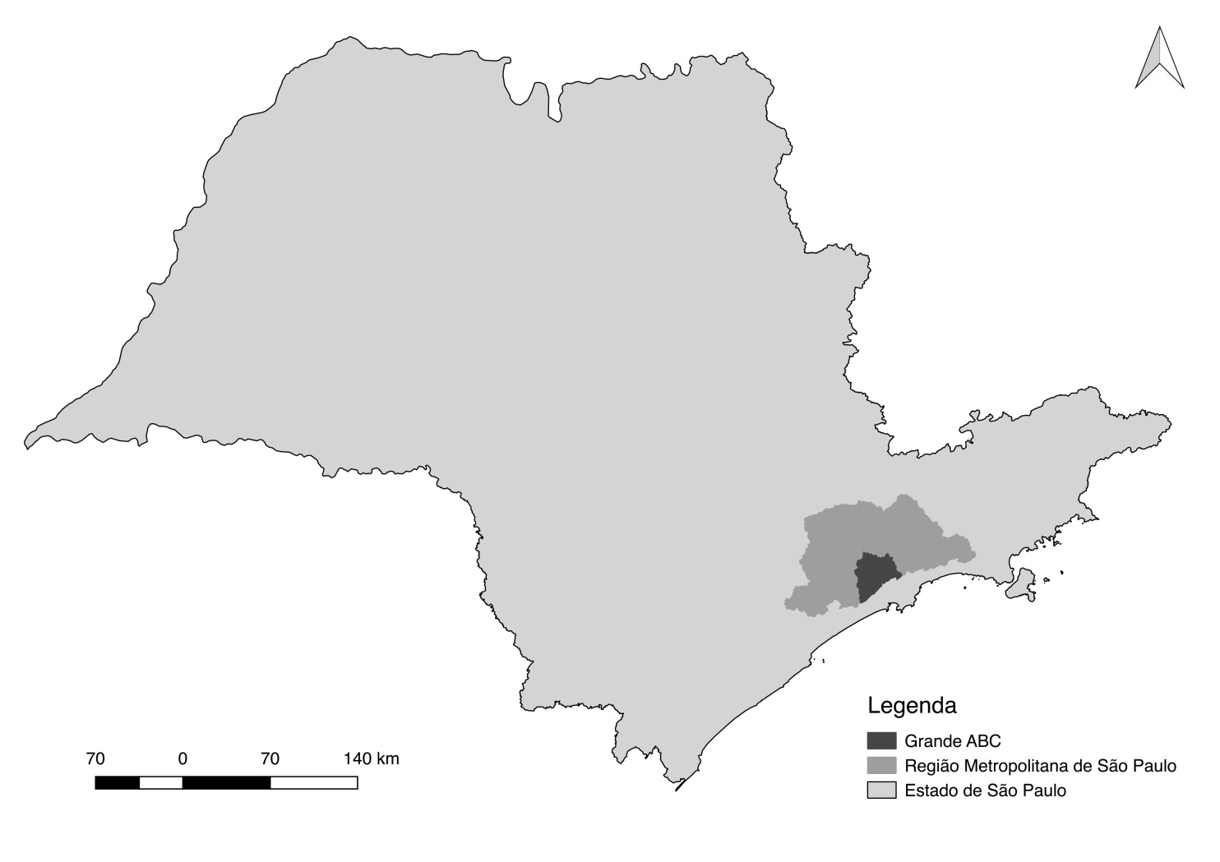
What is the formal position of region government within the broader governance framework?
How autonomous is it of levels of government (including in relation to finances)?
GEOGRAPHICAL AND ADMINISTRATIVE CONTEXT
Region of ABC
in Brazil
Region of ABC
in the state of Sao Paulo

Slide 4
What is the formal position of region government within the broader governance framework?
How autonomous is it of levels of government (including in relation to finances)?
GEOGRAPHICAL AND ADMINISTRATIVE CONTEXT
Brazil is a federation decentralized since the Constitution of 1988, formed by three federative entities:
Federation
States
Counties
The three units have political, administrative and budget autonomy.
However, there is a lack of an intermediate scale of governance (with attribution of responsibilities for planning actions) that legitimizes new territorial arrangements, in the Regional Scale, between states and municipalities.

Slide 5
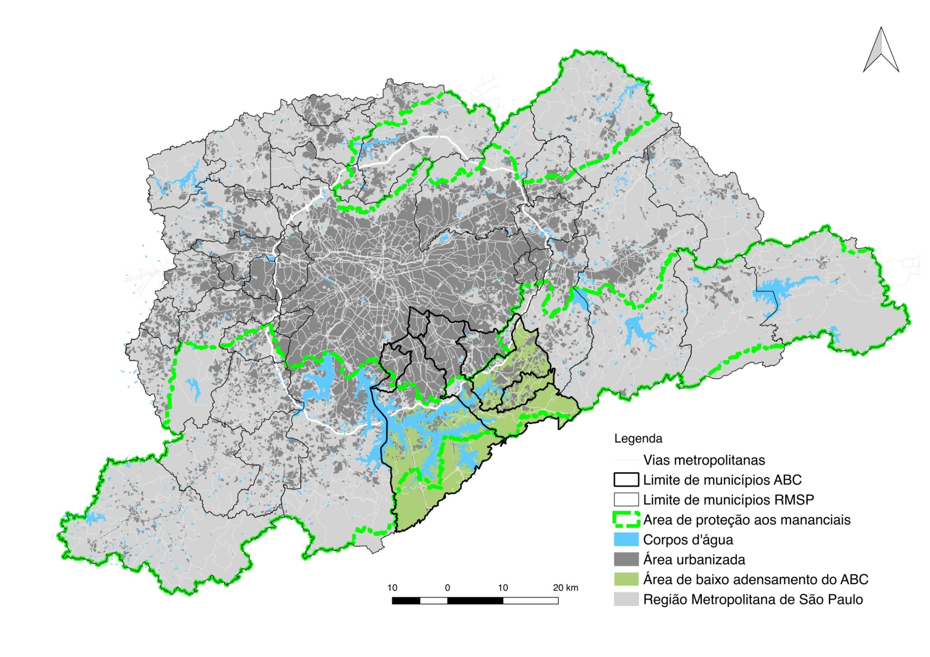
What are the intentions/preoccupations/aspirations of regional government?
What are the stated objectives of regional government in relation to urban futures?
Metropolitan Region of São Paulo and THE REGION OF ABC

Slide 6
What are the intentions/preoccupations/aspirations of regional government?
What are the stated objectives of regional government in relation to urban futures?
Metropolitan Region of São Paulo and THE REGION OF ABC
The Metropolitan Regions are territorial organizations, but they do not have autonomy for decisions.
In 2015, at the federal level, the Metropolis Statute was approved, which requires the elaboration of the PDUI (Integrated Urban Master Plan) that will attempt to integrate unique guidelines for the municipalities of the Metropolitan Regions.

Slide 7
What are the relational capabilities (“embeddedness”) of regional government?
What is the history and background to these? Which of them does city government pay most attention to?
THE REGION OF ABC
The Region of ABC was formed by seven municipalities: Santo André, São Bernardo do Campo, São Caetano do Sul, Diadema, Mauá, Ribeirão Pires and Rio Grande da Serra.
It currently has a population of 2,544,554 inhabitants and has

Slide 8
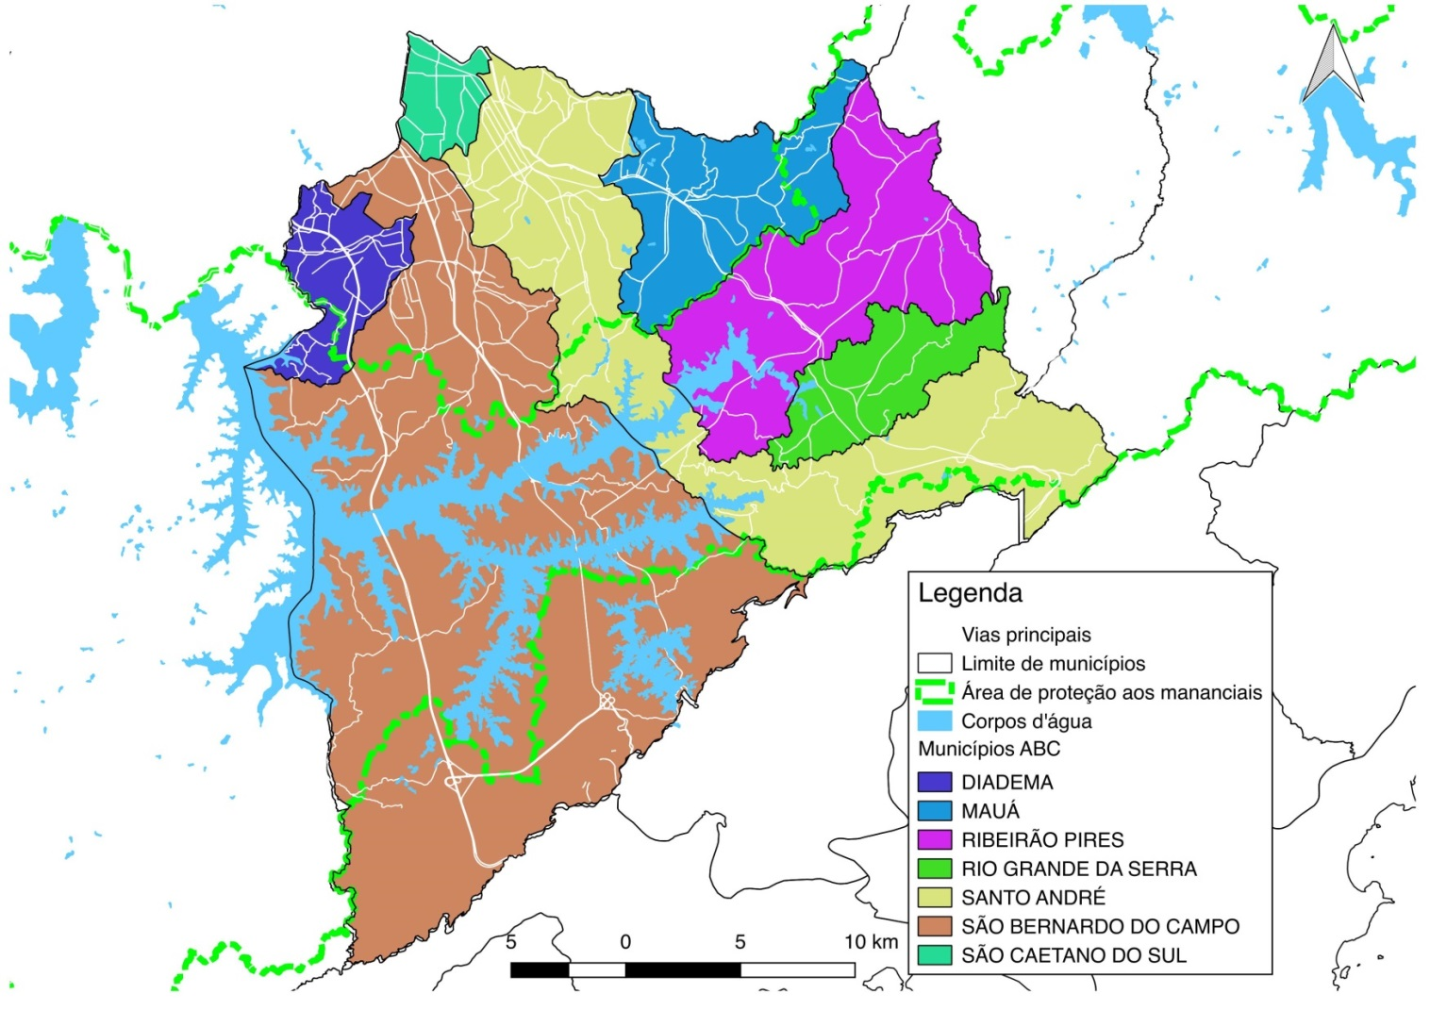
What are the relational capabilities (“embeddedness”) of regional government?
What is the history and background to these? Which of them does city government pay most attention to?
THE REGION OF ABC
The Region of ABC was formed by seven municipalities: Santo André, São Bernardo do Campo, São Caetano do Sul, Diadema, Mauá, Ribeirão Pires and Rio Grande da Serra.
It currently has a population of 2,544,554 inhabitants and has HISTORICAL affinities
All municipalities were formed from:
São Bernardo do Campo
and Santo André

Slide 9
What are the relational capabilities (“embeddedness”) of regional government?
What is the history and background to these? Which of them does city government pay most attention to?
THE REGION OF ABC
The Region of ABC was formed by seven municipalities: Santo André, São Bernardo do Campo, São Caetano do Sul, Diadema, Mauá, Ribeirão Pires and Rio Grande da Serra.
It currently has a population of 2,544,554 inhabitants and has TERRITORIAL affinities
The Region is divided among:
Urbanized area
Springfield area

Slide 10
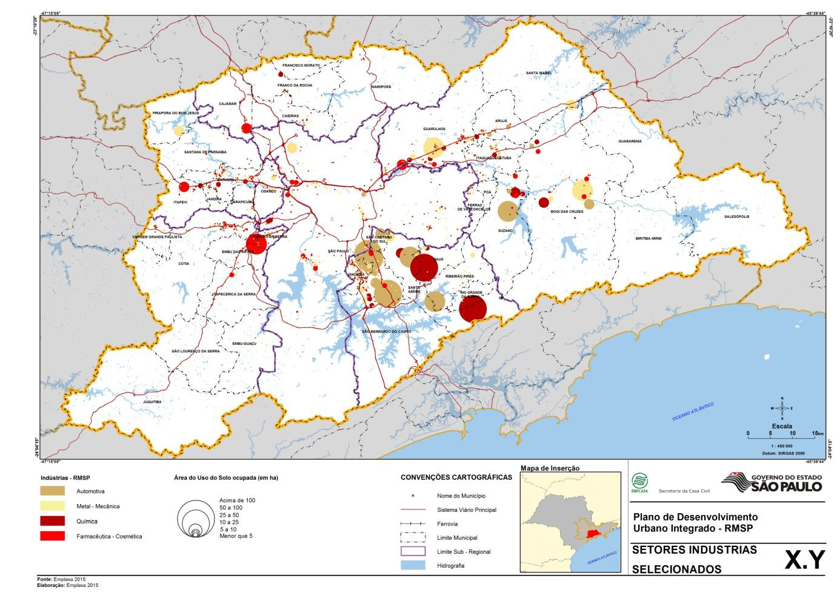
What are the relational capabilities (“embeddedness”) of regional government?
What is the history and background to these? Which of them does city government pay most attention to?
THE REGION OF ABC
The Region of ABC was formed by seven municipalities: Santo André, São Bernardo do Campo, São Caetano do Sul, Diadema, Mauá, Ribeirão Pires and Rio Grande da Serra.
It currently has a population of 2,544,554 inhabitants and has ECONOMIC affinities
The Region forms a national INDUSTRIAL CLUSTER
Área (em m2) com uso do solo industrial na RMSP
Região com maior concentração de área industrial da RMSP

Slide 11
What are the relational capabilities (“embeddedness”) of regional government?
To what extent is there coherence or divergence in the visions/policies/strategies for the region across the levels?
MUNICIPAL POLICIES X REGIONAL CONFLICTS
There is unity in historical formation, but there is no unity in territorial management.
Each city adopts a specific zoning that results in conflicts between uses
Industrial area x residential area
Preservation area x industrial area
Border conflicts
MAPA DO ZONEAMENTO DE CADA MUNICÍPIO E SEUS CONFLITOS

Slide 12
What are the relational capabilities (“embeddedness”) of regional government?
To what extent is there coherence or divergence in the visions/policies/strategies for the region across the levels?
In short, we have territorial and management conflicts on a regional scale.
The region is not treated as a federative entity, that is, it does not have the autonomy to respond to these problems.
What paths have been adopted?

Slide 13
What are the adaptive capabilities of regional government?
Does the region government incentivise innovation within the bureaucracy?
In 1990, the Consortium of ABC was created and became the first multisectorial consortium of public law and autarchic nature of the country in February 2010. It influenced the formulation of the Federal Consortia Law, Law no. 11,107, of April 6, 2005.
Currently, it is consolidated as a regional-local strategy for spatial planning and funding for the financing of sectoral public policies
Consortium of ABC is a voluntary form of collaboration between municipalities

Slide 14
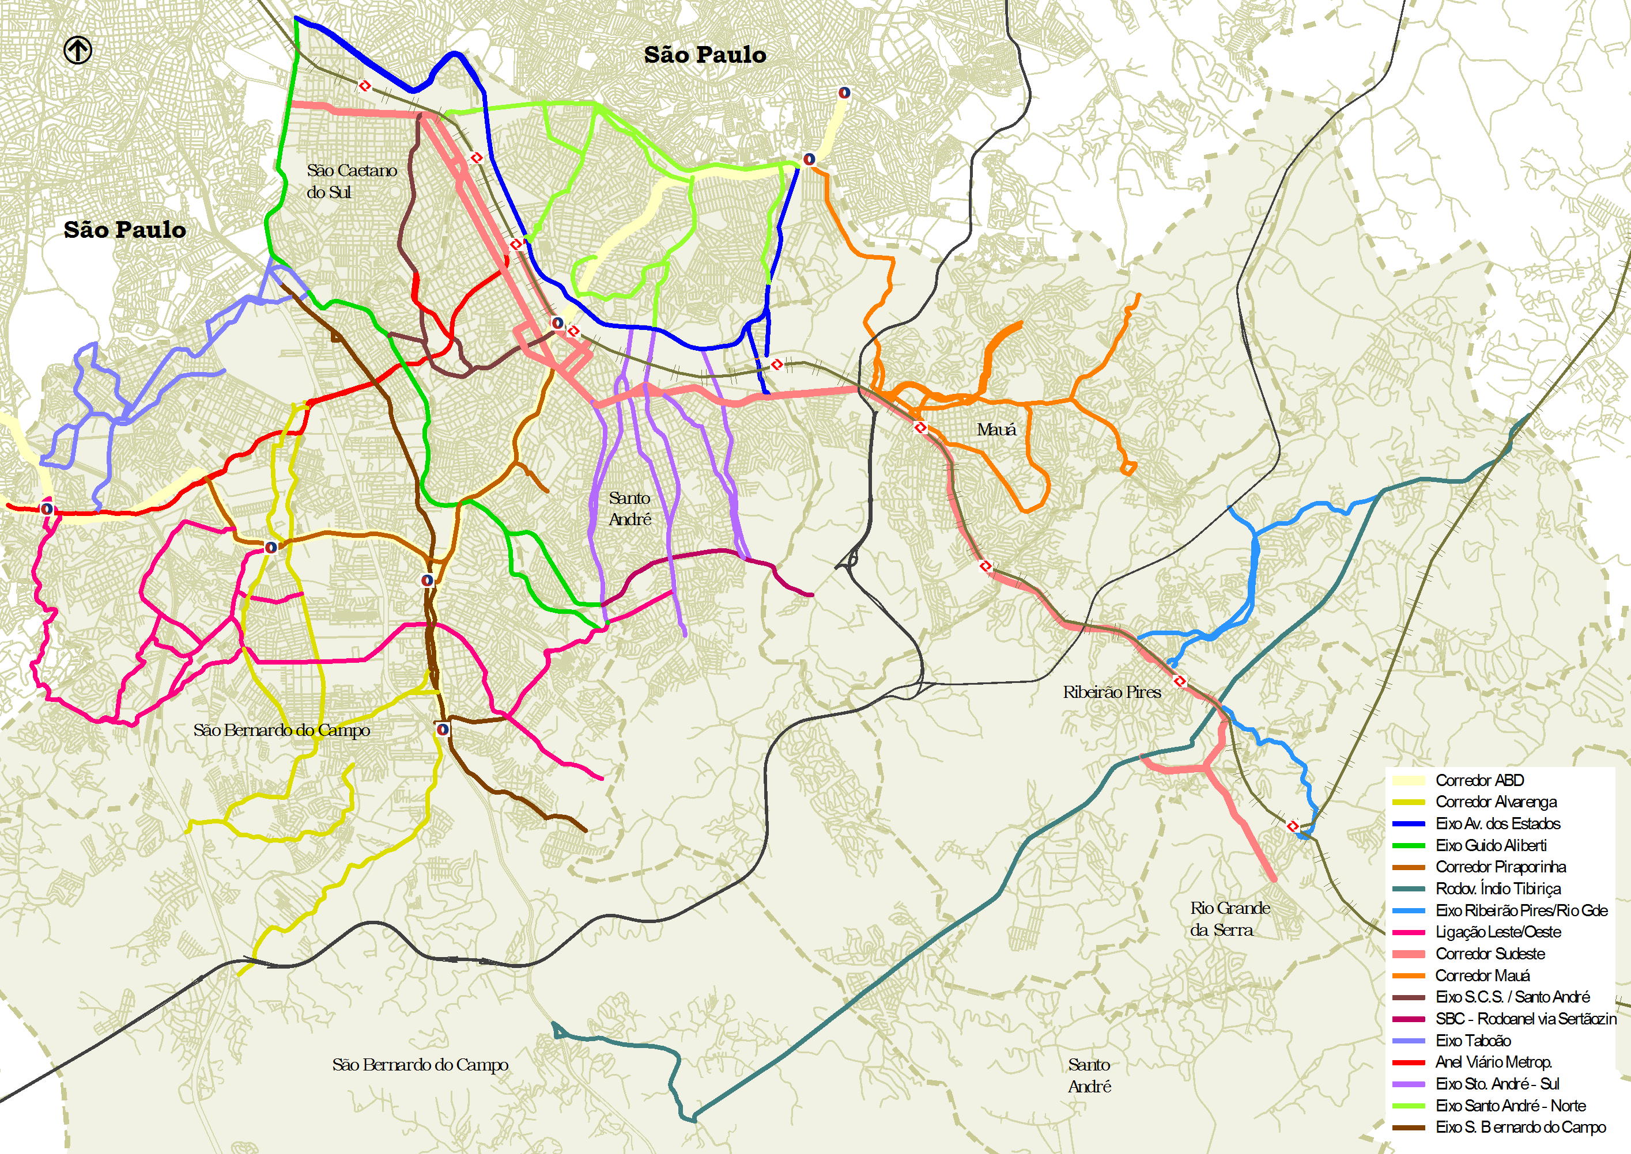
Capacities for Planning and Managing the Built Environment
How effective is regional government in financing and delivering infrastructure?
In 2013 the Consortium contracted the Regional Mobility Plan to raise federal resources for the construction of integrated bus corridors.
In isolation, the smaller municipalities did not have indebtedness capacity.
The solution: the Consortium requested resources for the seven municipalities and the larger and more developed municipalities assumed the largest fraction of the debts, allowing the release of the entire resource
MAPA DOS CORREDORES DE ÔNIBUS DO GRANDE ABC

Slide 15
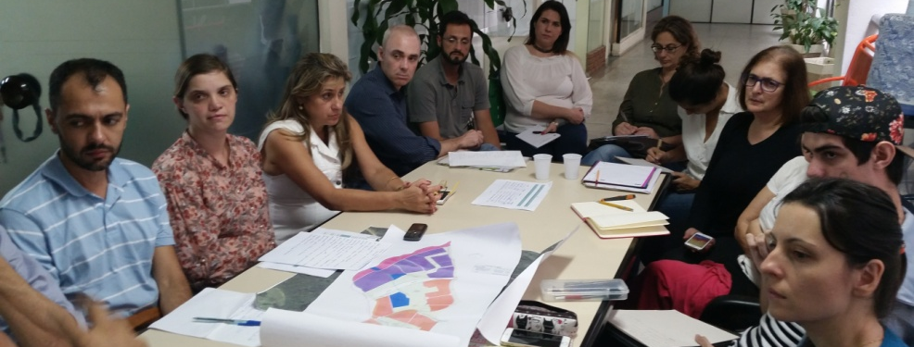
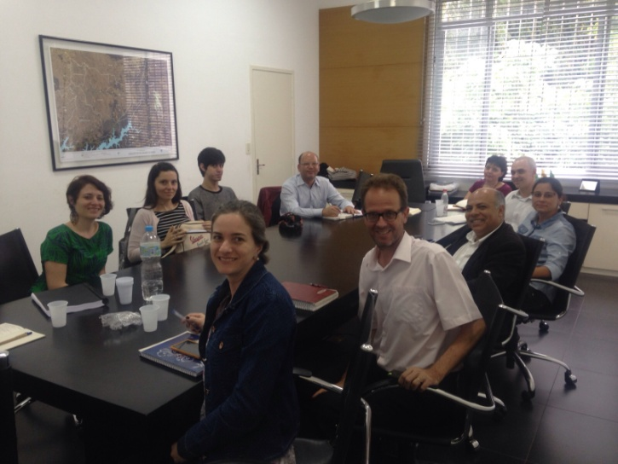
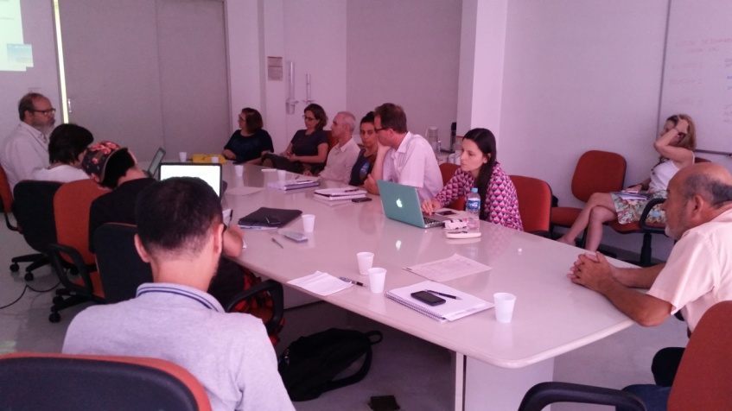
How effective is regional government in coordinating built environment functions?
What mechanisms and capacities are available to achieve coordination?
REGIONAL MASTER PLAN
Attempt to overcome sectorial policies and municipal autarchy with a Regional Master Plan.
In progress, since 2015, by the Consortium, the seven municipalities and the Federal University of ABC

Slide 16
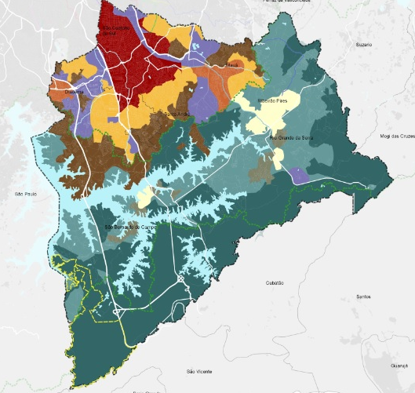
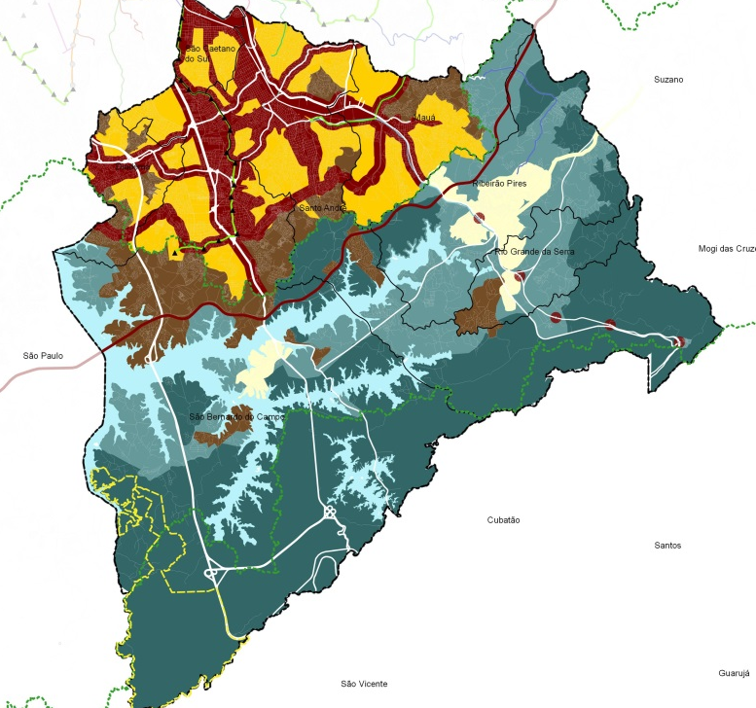
How effective is regional government in coordinating built environment functions?
What mechanisms and capacities are available to achieve coordination?
REGIONAL ZONING
Technical and political action to transform the territory
Existing zoning in each municipality: land use conflicts
Proposal of territorial compartments: groupings of areas with similar characteristics
Unified zoning: avoid conflicts of land use between municipalities and integrate public policies

Slide 17
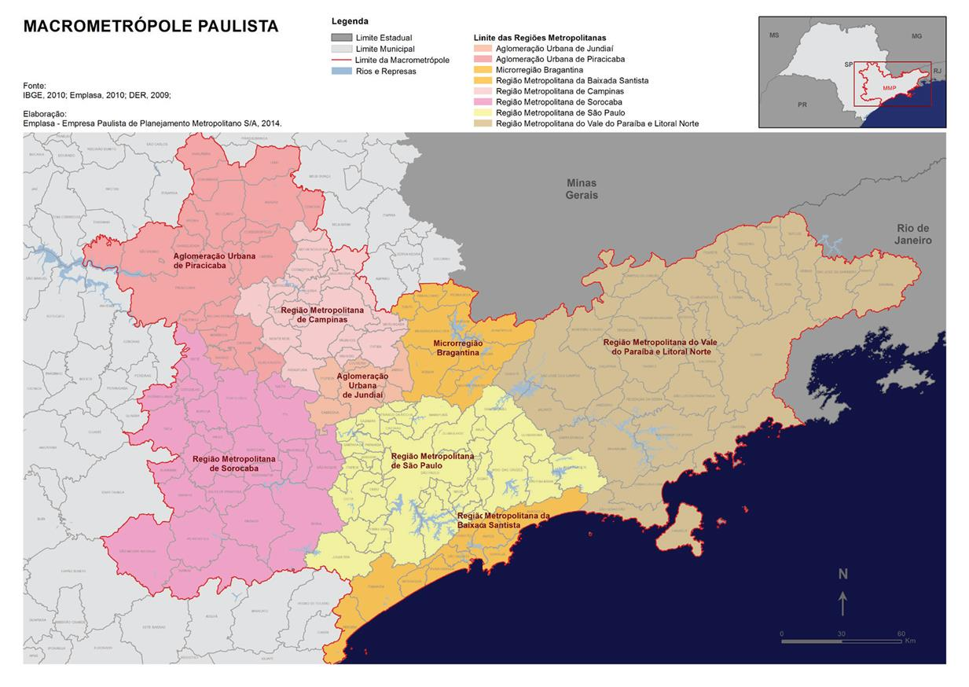
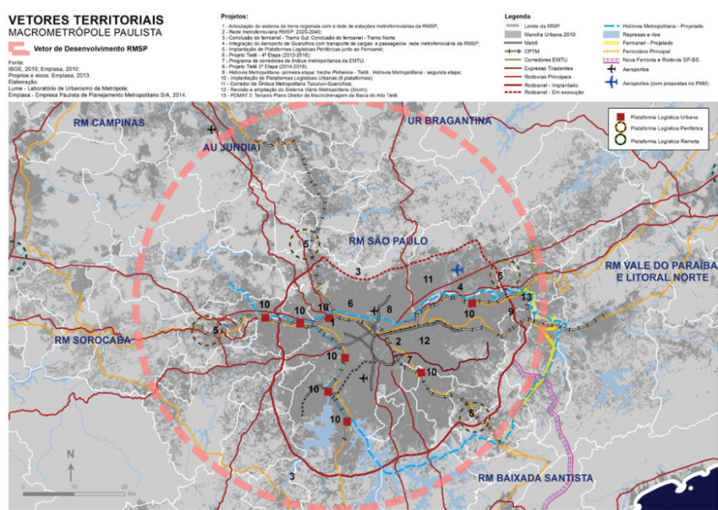
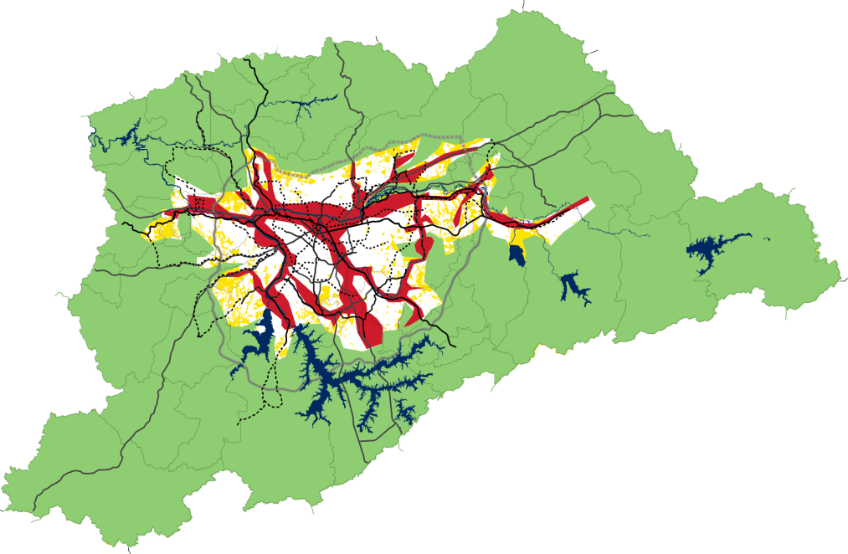
How effective is regional government in coordinating built environment functions?
Where are the critical points where co-ordination is required?
Main challenges
1. Overcoming the localist tradition
Municipalities concentrate decision and investment power, because all financing is municipalized.
2. Build a new governance standard that integrates territory beyond administrative boundaries and sectoral policies
Mediating the conflict between industrial X environmental X urban interests.
3. To strengthen the relation between the different scales (federal, metropolitan and municipal state)
Currently, the PDR tries to dialogue with the Plan of Action of the Macrometropole and the Integrated Urban Master Plan

Slide 18
How to develop adaptive and transformative capacities of the region?
BUILD A NEW AGENDA TO REVIEW THE INSTITUTIONAL ARRANGEMENT
Redefine how to make new territorial associations
To value the intermunicipal relations
Adopt a new model of interfederative governance
To legitimize the regions as a federative entity
Prioritize a metropolitan fund or regional investment fund
Inserting the civil society debate into regional and metropolitan plans

Slide 19
JEFERSON TAVARES BRAZIL ABC Region Inter-Municipal Consortium office Professor of Centro Universitário das Faculdades Metropolitanas Unidas
BRICS + CITY LAB II COLLOQUIUM
Adaptive and Transformative Governance for Large City Development
THANKS
Moscow - 2016

