Slide 1
Adaptative Governance in São Paulo Responding to demands of Youth Teo Butenas Santos BRICS+ City Lab | Moscow 2016

Slide 2
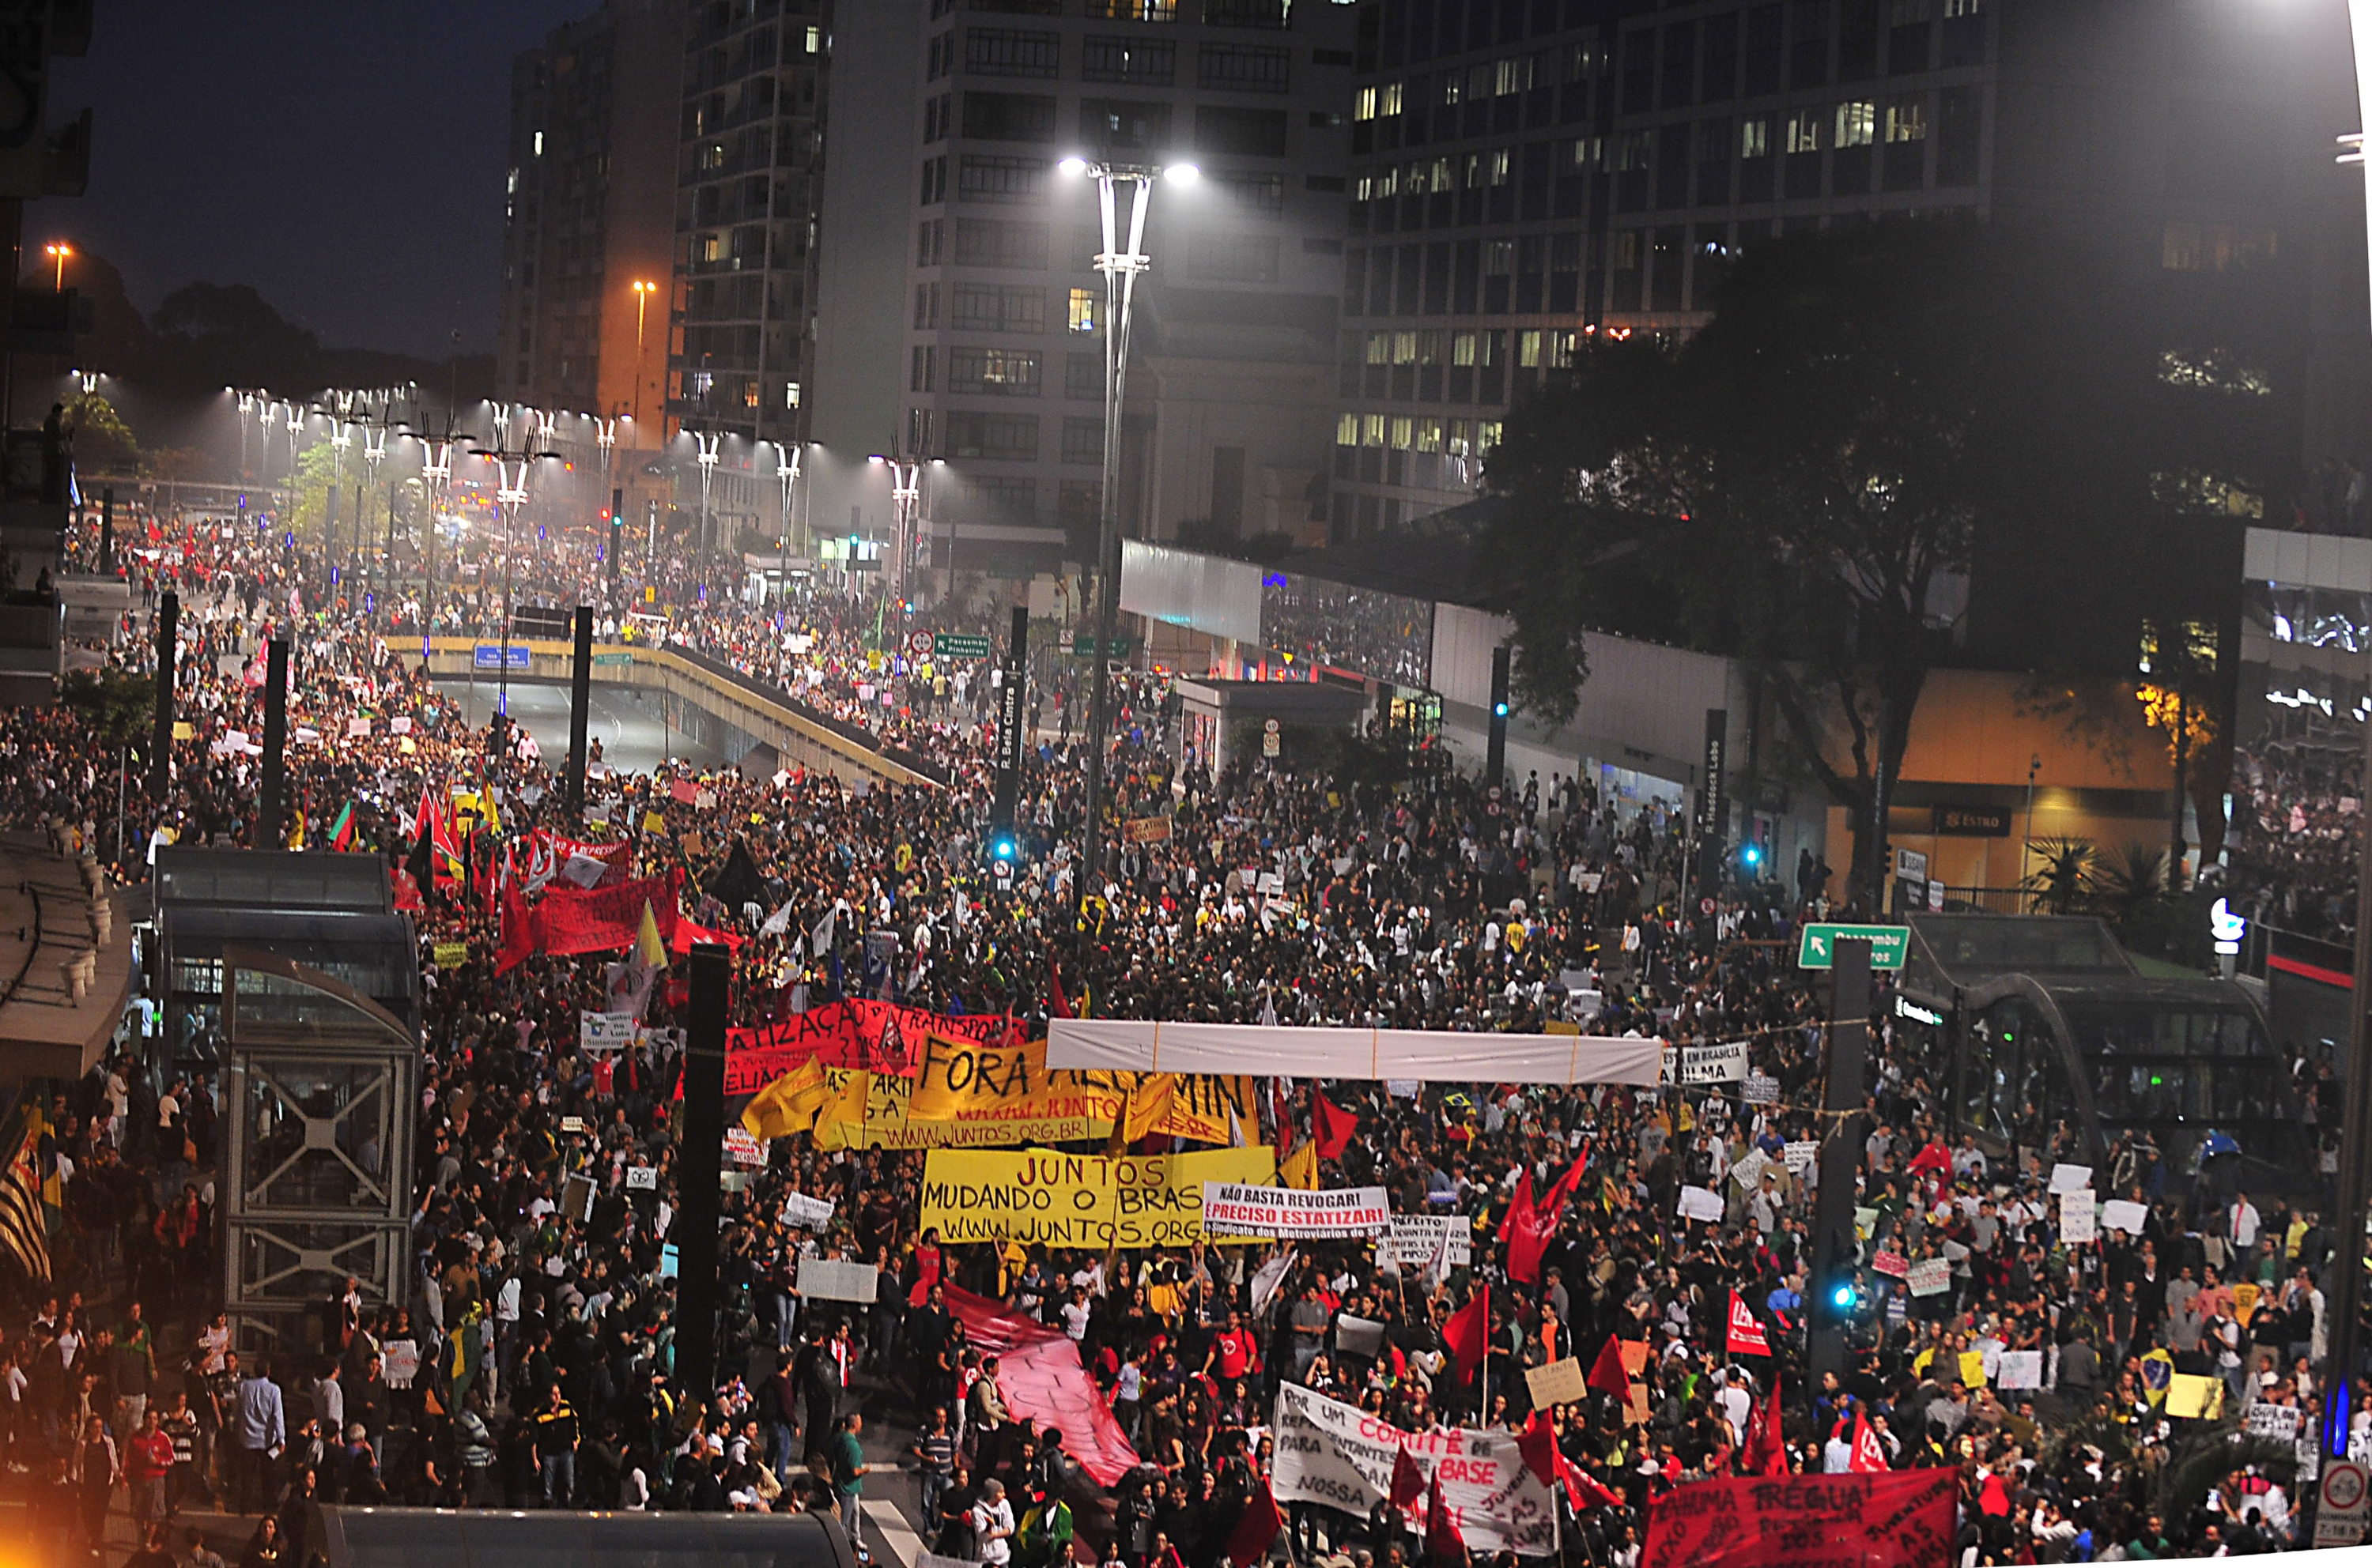
Notes:
One of the responses of the Municipality for the giant protests of 2013 was the acceleration of the building of bike lanes in the whole city.

Slide 3
1

Slide 4
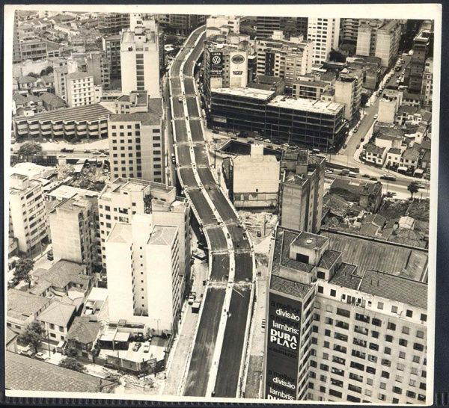
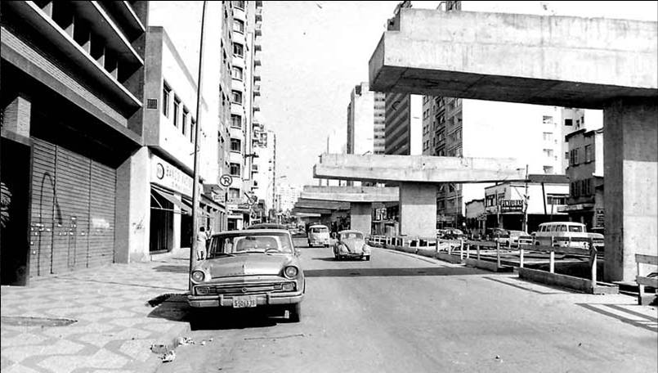
Notes:
Our first story starts in 1969, when during the dictature an ugly and massive highway wa sbuilt in São Paulo. It was named ëlevado Costra e Silva”, after Brazilian president, but everyone knows it as the Minhocão, or Big Worm.

Slide 5
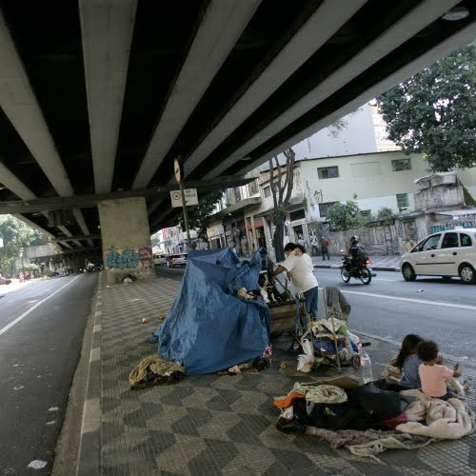
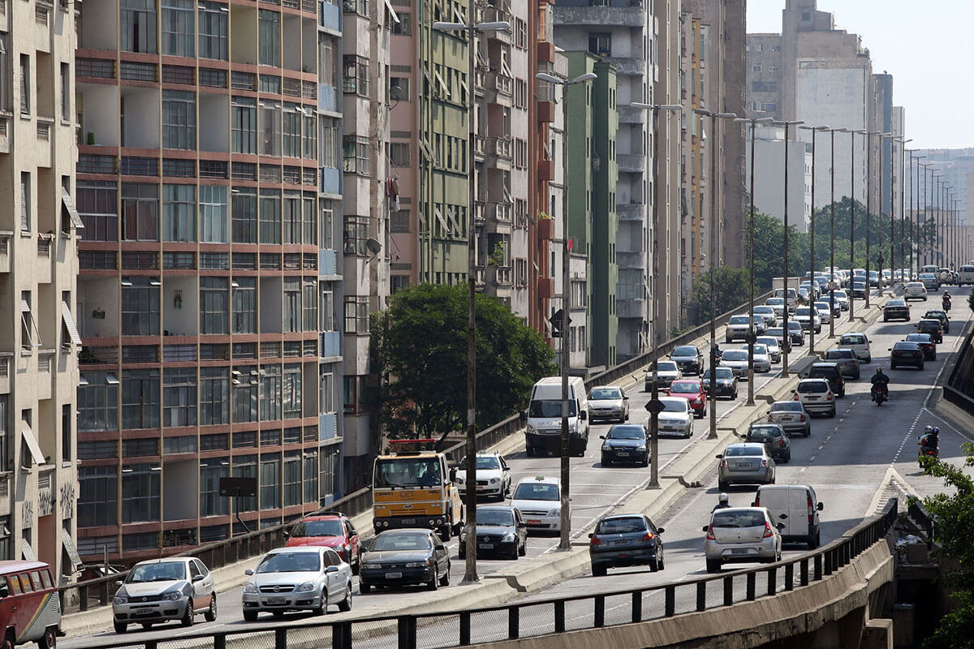
Notes:
The building of the minhocão has of course not solved the trafic problem in the city, and has also created a space of very bad quality benoeath the highway, dark and difficult.

Slide 6
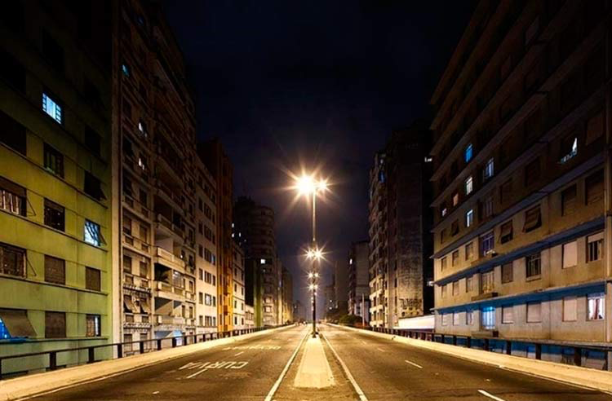
Notes:
Of course the neighbors suffered, The ones who could moved out, the ones who were left and the new inhabitants, much poorer than the former ones, suffered from the noise of the cars running in the highway a few meters from theirs windows. In 1989, after prostest, the municipality decided to clse the highway from 9:30 PM to 6:30 AM and on sundays, exclusively for noise reasons.

Slide 7
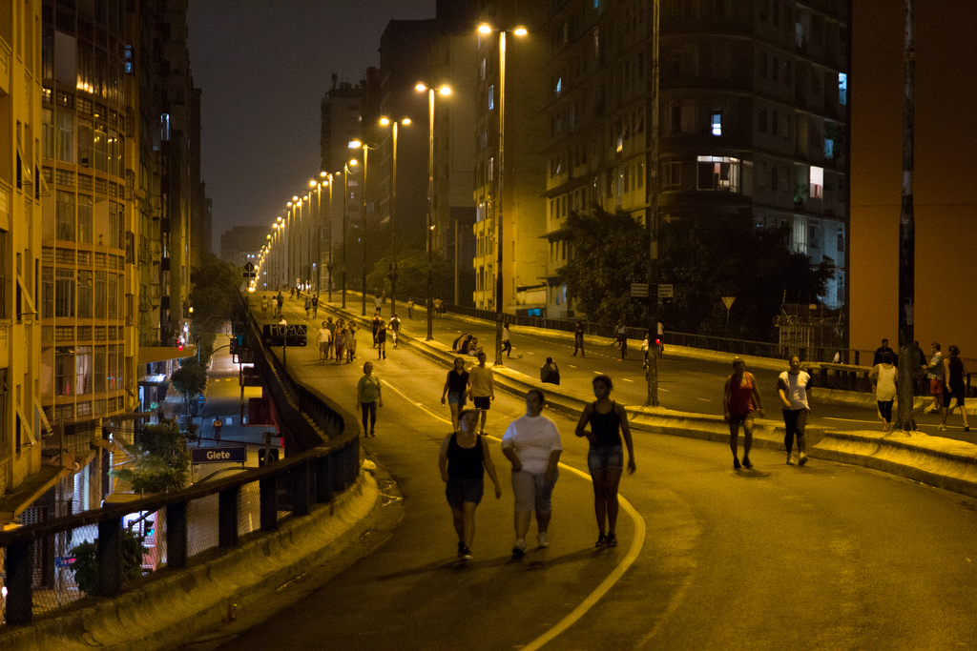
Notes:
And then, informally, people from the surrounding areas started to use it as a leisure area when it was closed.

Slide 8
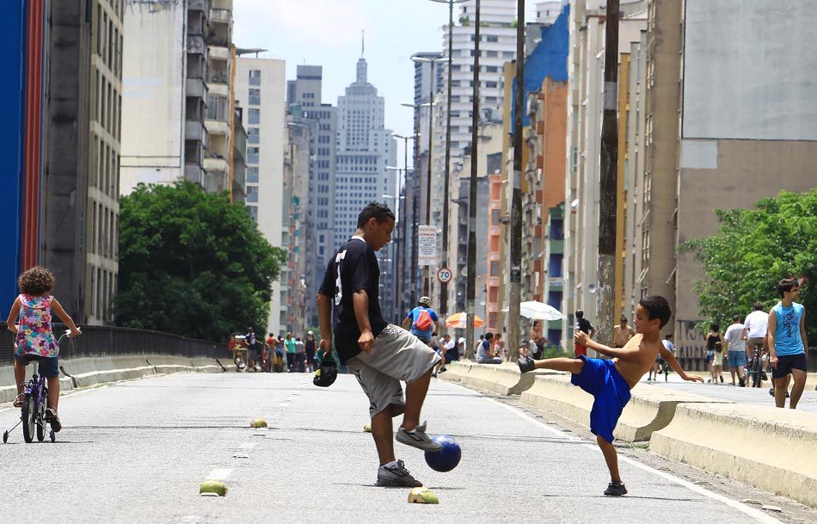
Notes:
With the years, uses intensified

Slide 9
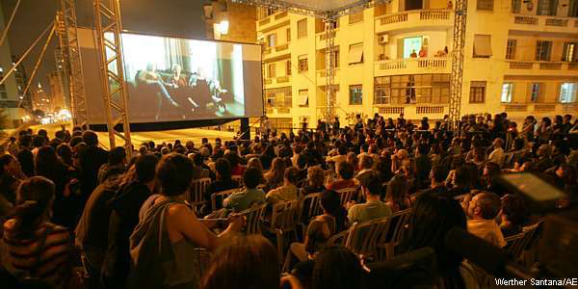
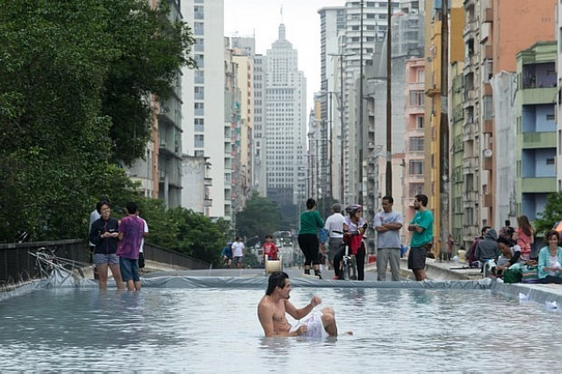
)
Notes:
And got more creative

Slide 10
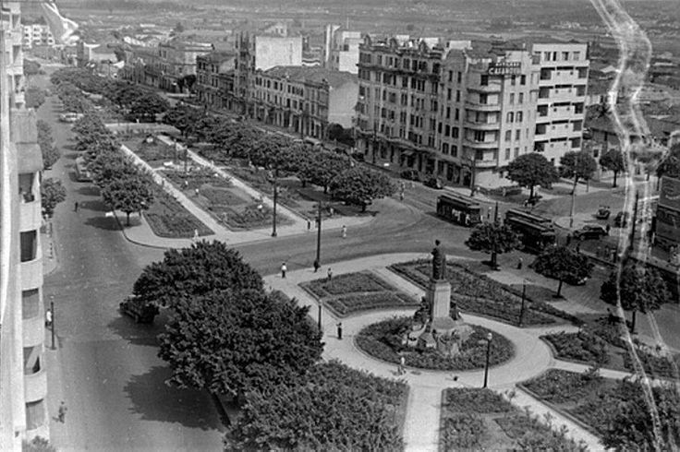
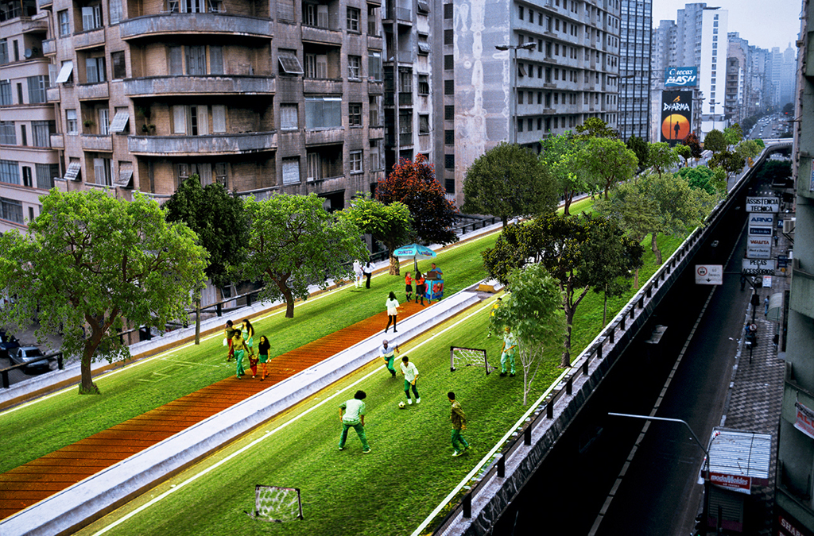
Notes:
With the intensification of the uses, the future of the Minhocão became an object of conflict. In the 1990s, the dominant view among urbanists was that the highway had to be destroyed, giving place to a more traditional urban tissue. But in the 21st century, other groups started to organize for the idea of turning it into a park, also influenced by images of transformation such as the high line parke in NY ad the Promenade Plantee in Paris.

Slide 11
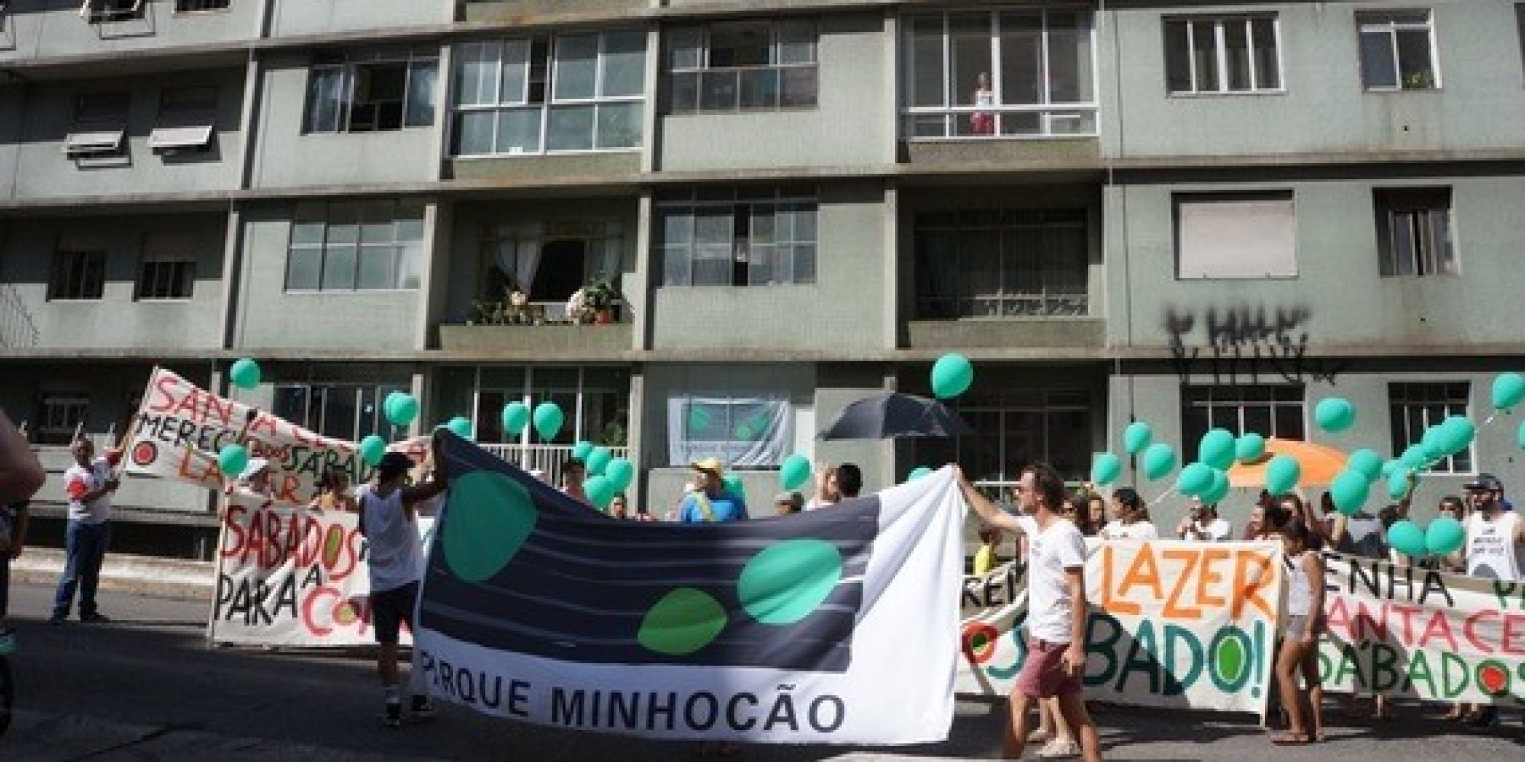
Notes:
The conflct is still going on, but the groups defending the park are gaining ground in the last years. They protested for the opening of the highway also on saturdays, and they got it: the municipality anounced in july 2015 that it would be pedestrianized on saturdays from 3PM on, untli Monday morning. Now they are demanding it to be closed for cars after 8PM, and nor 9:30 PM.
But the other side has also its victories: in january 2015 , the Police has forbidden parties and loud music have been in Minhocao, in order to protect the silence of the neighborhood, and also for safety reasons.

Slide 12
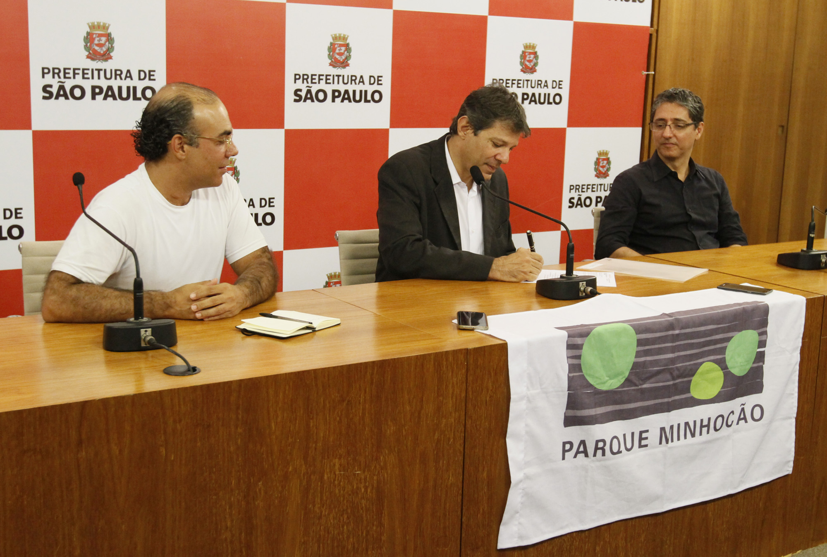
Notes:
Another victory for the ones defending the park happened on 9 march 2016: the municiaplity has officially created Parque Minhocao, a park that exists when the street is closed for cars.

Slide 13
Notes:
That means, since march this year, this area is called a park. It looks as if it as simple marketing trick, but is it not. Indeed, it opens a series of very exciting perspectives. Officially, a park in São Paulo, is entitled to have its own independent management; a budget, hiring staff, having a participatory management including the civil society. I don t know of any other on-and-off park in the world, but I think it is a tremendous challenge. And of course there are some administrative quesdtions. In the weekdays and during the day, Minhocão is under the juristiction of the city’s traffic company. But when it is open for people, under which jurisdiction should it go? All the parks of the city are under the jurisditcion of the Municipla Secrevary for the Environment and green Areas, should it fall under this jurisdiction? But there is not a single tree in this park. Anyway, I am curious how the city will managem this issue of having a park which opens for some hours a day, how will it be administrered anf furnished. And how will it solve its issue with the aging neighborhood. And another layer of problems has to do with social class: by now, the bad phisical conditions have enabled a very popular use of the surroundings, with a significant population of poor people, transversites and other minorities. Park or destruction will possibly mean the eviction of these groups of this very entrally located area.

Slide 14
2
Notes:
Our second history concerns cycloactivism

Slide 15
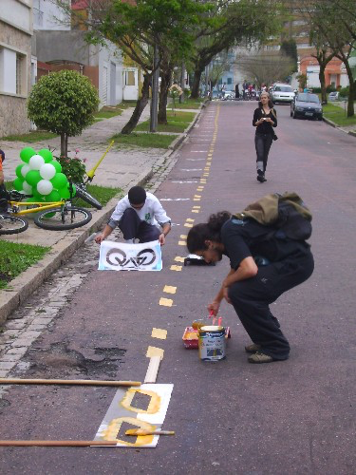
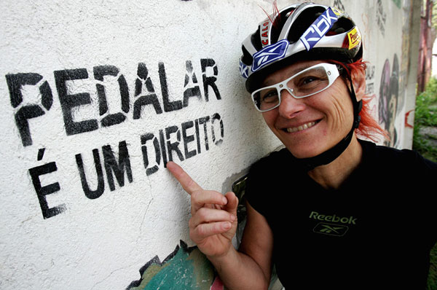
Notes:
Slide 14 – As you know, São Paulo was never a bike-friendly city. In the recent years , the cycloactivist movement has been gaining momentum, including building some “pirate bike lanes” (a da eaquera é de curitiba)

Slide 16
Notes:
One of the responses of the Municipality for the giant protests of 2013 was the acceleration of the building of bike lanes in the whole city.

Slide 17
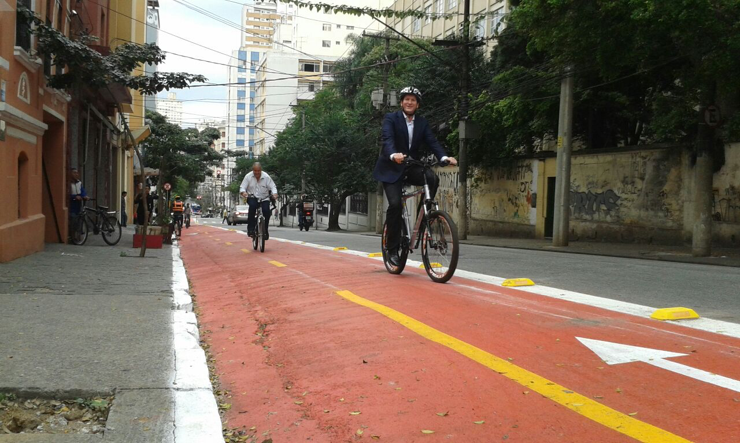
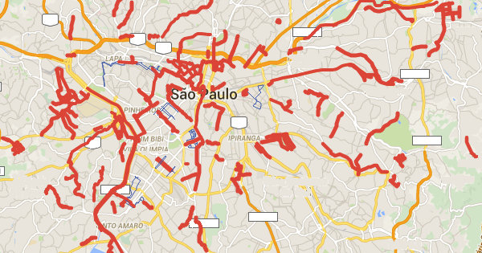
Bike Lanes (km)
2012 – 64km
2016 – 380 km

Slide 18
3

Slide 19
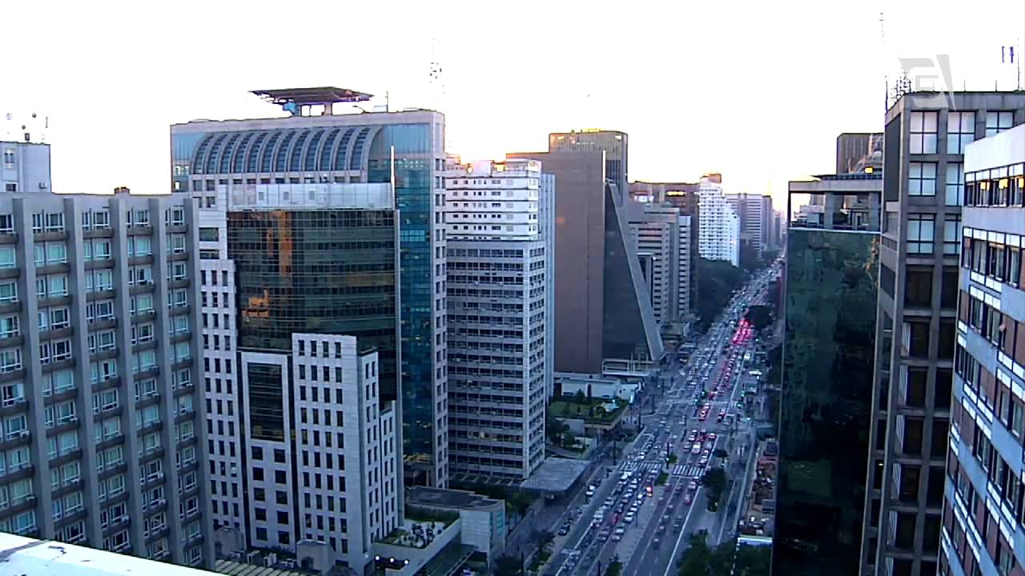
Notes:
Our thir little story concerns São Paulo ‘s moste famous street, Avenida Paulista, a place hwere once the wealthiest families of the city lived, and that in the 1970 became the financial center of the whole country, called the Brazilian 5th Avenue.

Slide 20
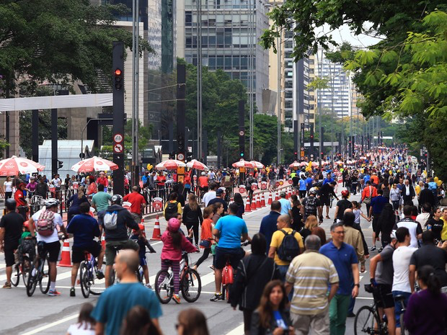
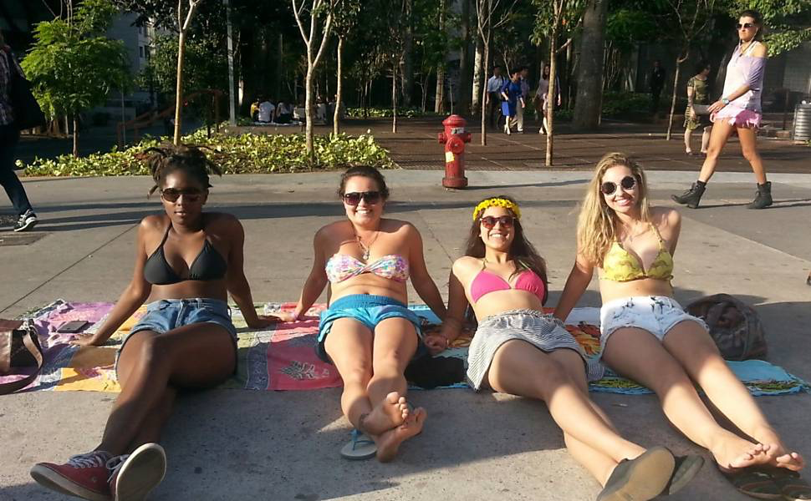
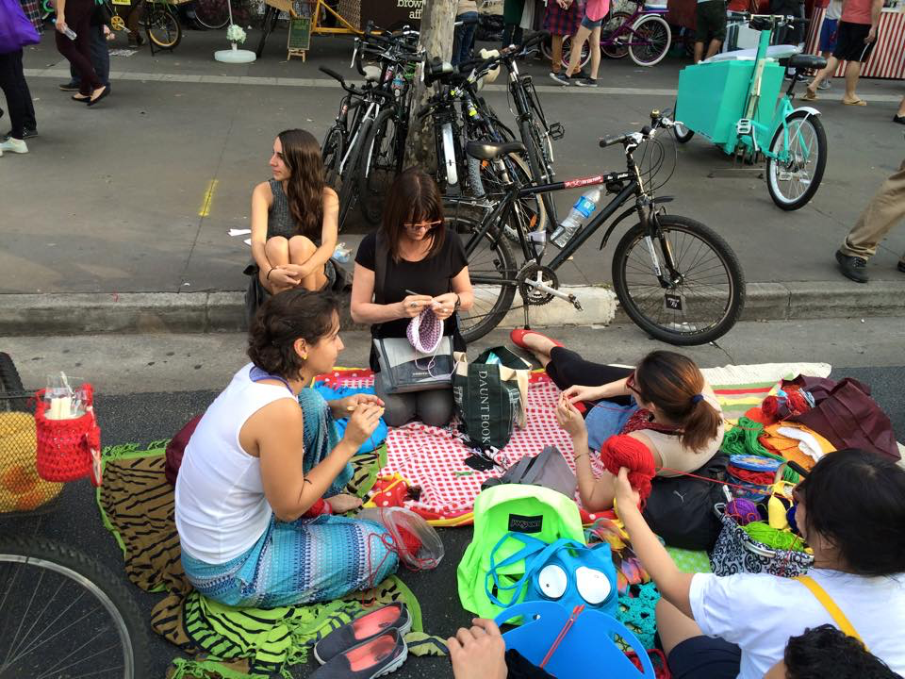
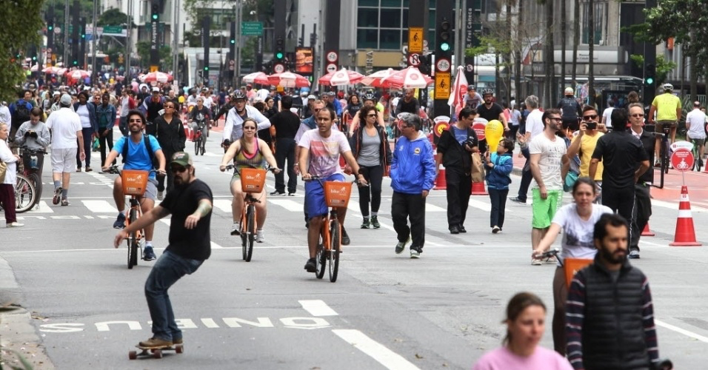
Notes:
in order to intensify the uses of Paulista for leisure, the municipality offered it to the poulation on a Sunday, 6th of june 2015, day of the inauguration of the bike lane passing through the avenue. It was a great success, and the avenue was opened again in 23 august of the same year. In october 2015, the municipality announced that it would aopen the avenue to pedestrians every Sunday.

Slide 21
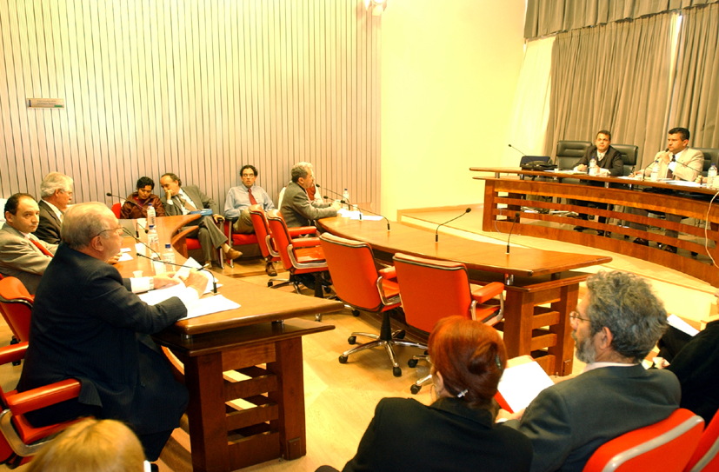
Notes:
Introducing another character. Another public prosecutor, José Fernando Cecchi, not just forbade the opening of the avnue on sundays, but even fined the municipality of São Paulo for making it. Mr. Cecchi recalled an agreement between the Municiplaity and the Public Attorney from 2007, in which there was a commitement to clode the avenue for the traffic just 3 timas a year – the GLBT Parade, the Ecvangelic Church parade and new year s eve. Acording to the public attorney, the municipality had done it already three times that year (June – inauguration if bike lane, june – glbt parade and august, another closing).

Slide 22
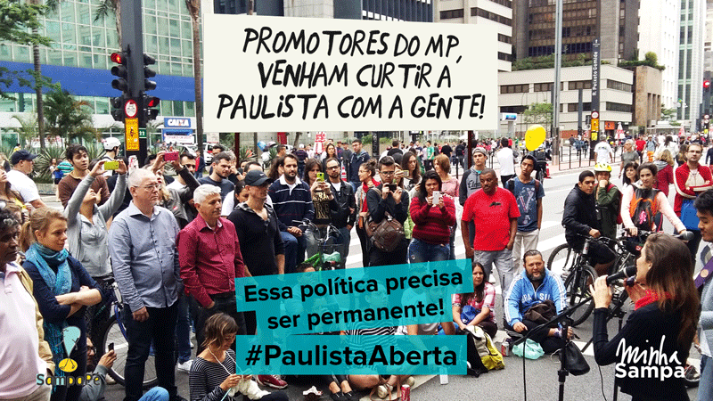
Notes:
Again, protests against the public attorney,

Slide 23
Notes:
The municipality answered the public attorney: we are not closing the avenue for car traffic as an event. We are keeping the deal. What we are doinf is opening it to the pedrestrians as a public policy, a program called Ruas Abertas, or open streets, and avenida paulsita is just one of the around 30 streets that we are pedestrianizing on sundays. Are you against this program? Public attorney backed off, and allowed it to be pedestrianized on sundays, what is a great success to this day.

Slide 24
4

Slide 25
Notes:
Again, protests against the public attorney,

Slide 26
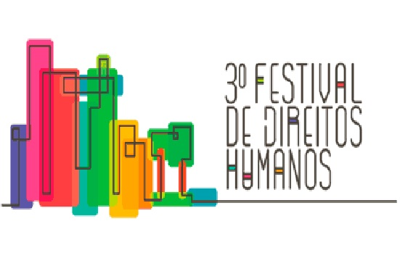
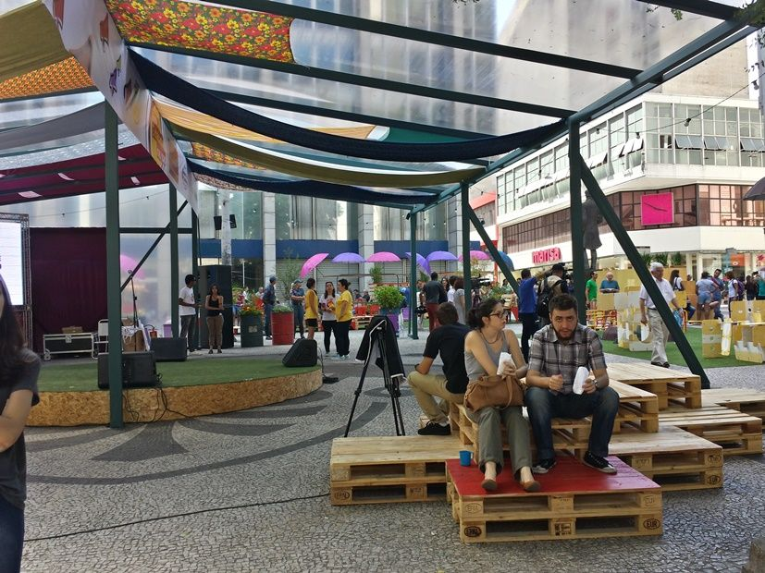
Notes:
Marilia jahnes
Coordination of the right to the city
Municipal secretary human rights
Mirror in the municipal structure of the demands of the new social movements, basead upon the idaea of the right to coupy public space as a humen right, it meansÇ not needed permission, authorization. It is being very effective because it responds to the demands of the groups of youth.
Importnant it is not in the secretry for urban developmente.

Slide 27
Public Space as a contested Space
Lack of government?
State X Society?
Progressive recognition of youth in public policies
Notes:
The third comment: based in São Paulo’s example, state itself is a highly contested territory, at least as contested as society itself. In my opinion, the urgency is to build new administrative and institutional forms that will allow the ones in the state who are working hard to make this new city real. A temporary park, or framing the opening of avenida paulista as a part of a public program , and not a party or an event, are some of the solutions, and if I had more time I could give you may more examples of how the city is busy trying to fulfill the gap between the existing city and the desired city, specially for young people.

Slide 28
Thanks! Contact: teobsantos@gmail.com

