Slide 1
The Role of Youth Social Organization in Shanghai Urban Governance
Ning Su
Shanghai Academy of Social Sciences
2016-12-9

Slide 2
Shanghai
Metropolitan Area:
Metro--6340 (km²)
Inner City—2057(km²)
Suburb—4283(km²)
Population:
24.25 million for long-term residents (2014)
14.29 million for permanent residents , or 1% of China’s population(2014)
Density:3,825 long-term residents per square kilometer of land.

Slide 3
Shanghai Youth Population
Youth Population (14-35 yrs)
8.91 million for total(38.7%,2010)
3.88 million for permanent residents(43.5%,2010)
5.03 million for long-term residents(56.5%,2010)

Slide 4
The Development Phase of Shanghai Youth Social
Phase 1: starting phase, 2004-2006
Phase 2: registration phase, 2006-2010
Phase 3: development phase. 2010-now

Slide 5
The overall scale of Shanghai Youth Social Organization
By 2013, The whole registered social organization in Shanghai reach 11607
( 13355 in 2016, with asset 34.4 bn RMB or $ 5.1bn)
---Social groups-3789
---Private non-enterprise organization-7666
---Foundation-152
About half organizations is Youth social organization, around 5000.

Slide 6
The Function of Shanghai Youth Social Organization
Education Development
Sport and Tourism
Life and Health
Aiding for Unavailable and Aging Citizen
Urban Integration
Ecology and Environment Protection
Culture Promotion
Entertainment and Friendship development
Public Security
Maintenance of rights and interests

Slide 7
The Main Types of Youth Social Organization
“Hub”Organization
Charity
Hobby Promotion
Aid and Assistant
Social Services

Slide 8
Sources of Funds
Major sources of funds of youth social organization
Depend on the founding member and group members, the percentage around 44%. Funds by application and fund-raise account for 52%.
Minor part of source of funds
Paid social services: 2%

Slide 9
The inter-action way between government and YSO
Government purchases: For commissioning, contracting, procurement some part of the youth services to the social organizations
Subsidize: Local government department and community issue special funds to purchase youth social organization services, some enterprises established social responsibility funds for youth social organization activities
Platform Building: Shanghai Youth Public welfare League, the Shanghai Youth Social Organization Alliance and various public service centers as platform for public resource sharing, public service project incubation

Slide 10
Main Form of Activity
Funding and Material assistance
Social Education and Enlightenment education
Public welfares services
Survey and research
Main Percentage of Activity:
Public welfares services:18.75%
Ideals and Public welfares Publicity:14.06%
Traning:9.82%.

Slide 11
The Cases for Shanghai Youth Social Organization
Environmental protection and low carbon activities : Shanghai JiaSu Bicycle Cultural Development Center launched the “World Car Free Day-Bicycle Slow ride”. More then 500 local residents attended.
Innovation and Entrepreneurship : Shanghai Association for Magnetic Youth Development took responsible for district-level youth center and Jiading District youth create space for daily operations from 2015.

Slide 12
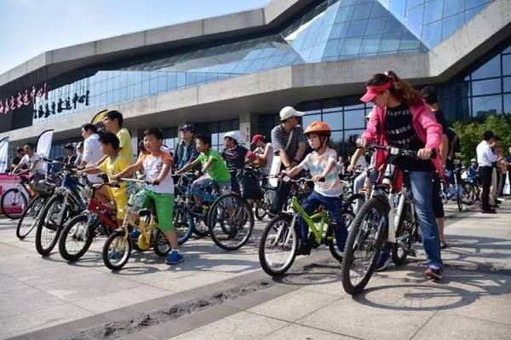

Slide 13
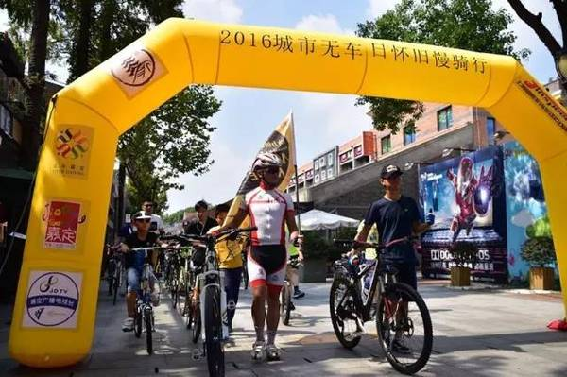

Slide 14
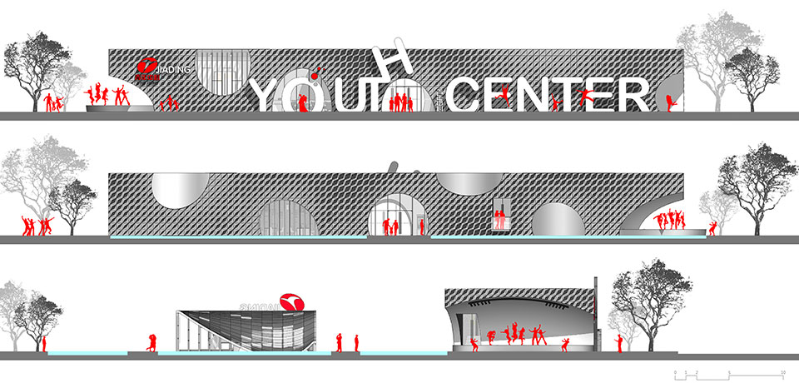
Jiading Youth Center

Slide 15
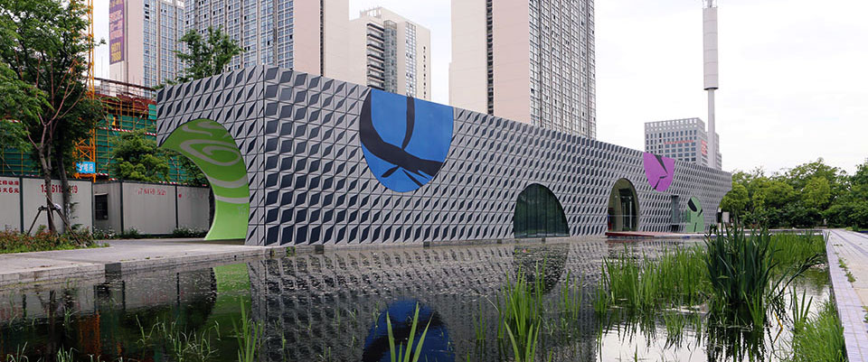
Jiading Youth Center

Slide 16
Challenges for Youth Social Organization
Admission issues
Activity space
Financial Issues
Talent resources

Slide 17
Admission issues
Improve the process of registration
Making more Youth Organization take part in the Urban Government
Providing more preferential financial support, personnel subsidies, and project

Slide 18
Activity Space
More Space in central city for Youth Social Organization Activity
The making of Youth Social Organization Incubation Center
The integration between makerspace and Youth Social Organization activity space

Slide 19
Financial Issues
More Channel of Financial Resources
Public Welfare Venture capital projects
The financial cooperation with enterprise

Slide 20
Talent resources
Attracting more youth talent for the public welfare activity
Professional Management talent for running the Youth social organization
The training for Youth Social Organization leaders and members

Slide 21
Thank You!
suning@sass.org.cn

