Slide 1
Rreorganization of City District case of Beijing and Shanghai

Slide 2
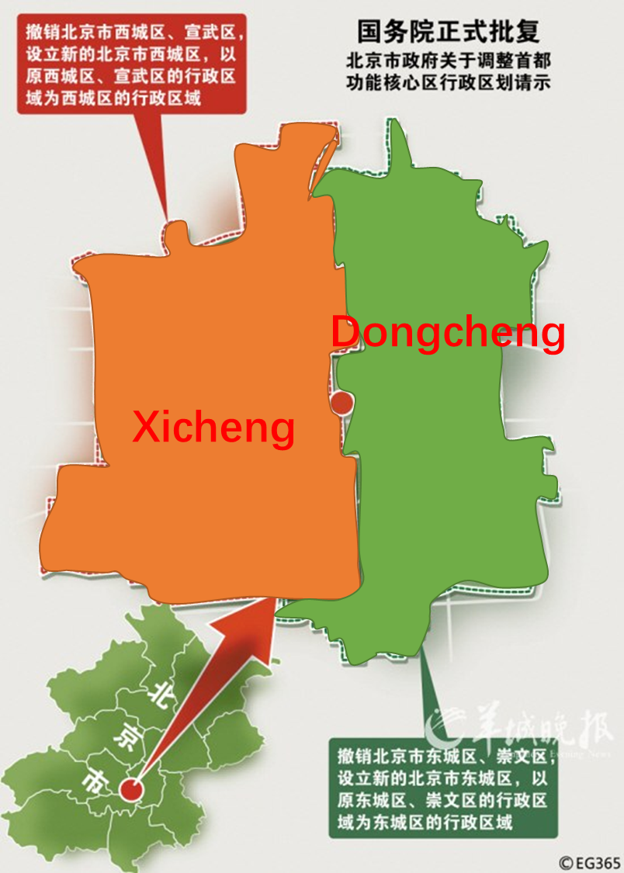
Beijing
2010
4 districts were merged into 2 districts
May face another round of merge of district in very near future

Slide 3
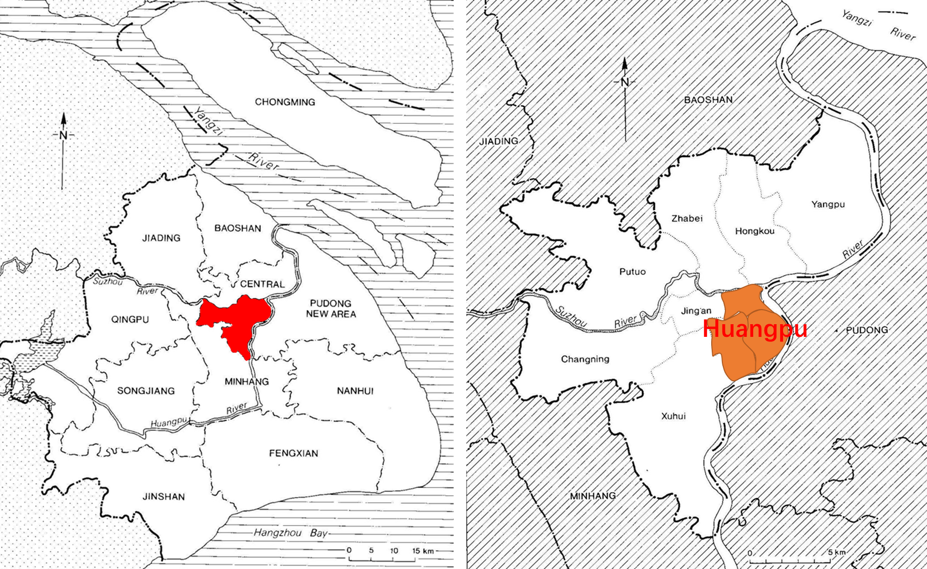
SHANGHA I

Slide 4
Balancing fiscal capacity of difference districts
Providing the urban space for well developed districts
Branding exporting: Bond, North Bond, South Bond
But still challenge the political wisdom of city politician
the well developed side may not always take over the power

