Slide 1
Use of Technology in City Governance: Lessons from BRICS
Rumi Aijaz
Observer Research Foundation, India

Slide 2
Contents
Modern Discourse on Urbanism
Technology Driven Approaches
Key Areas of Concern

Slide 3
Urban Population in BRICS
Source: UN Population Division. World Urbanisation Prospects: The 2014 Revision.

Slide 4
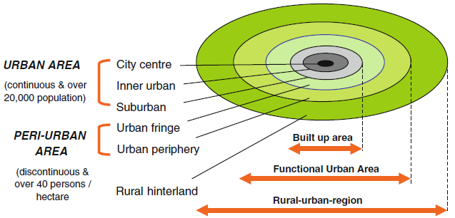
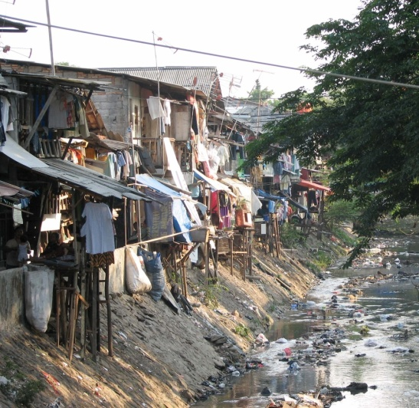
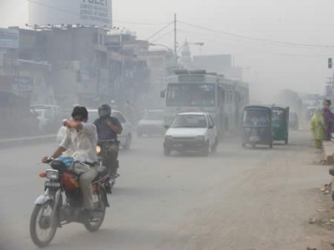
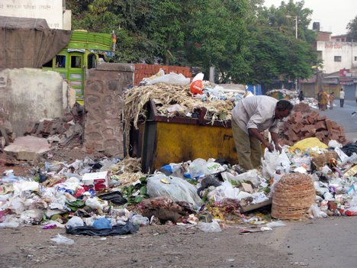
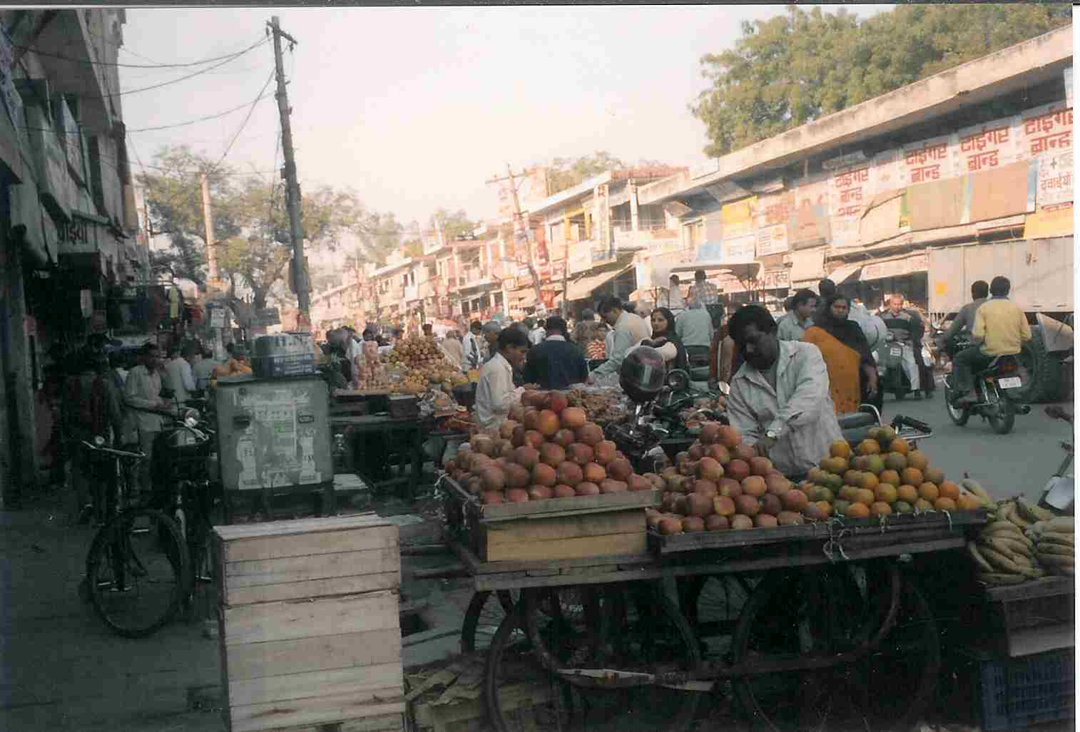
City - Region Challenges
Informal Growth in Peri-urban Areas
Social Exclusion
Informal Sector
Waste Disposal
Emissions & Pollution
Lack of Disaster Preparedness

Slide 5
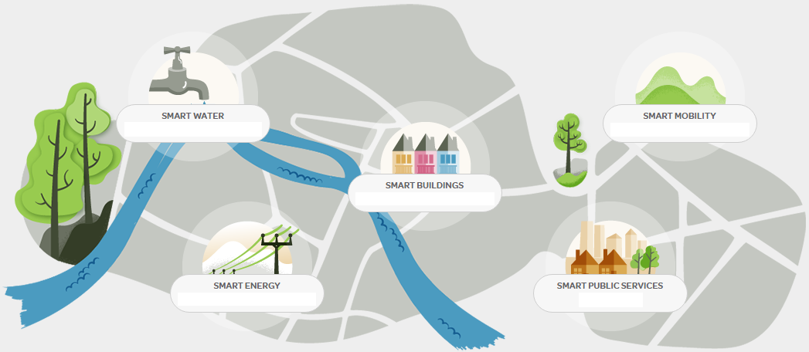
An Idea of a Smart City
Source: Schneider Electric.

Slide 6
City Management
Decision, policy making, planning
Problem solving & reporting
Activities
Data collection, analysis
Government responsibilities
Locate facilities
Map infrastructure
Water & sanitation
Housing & energy
Mobility
Health & education
Safety & security
Environment
Disaster management
Requirements of municipal offices
Info & service requirements of citizens

Slide 7
Role of IT Companies
Big Data Platforms

Slide 8
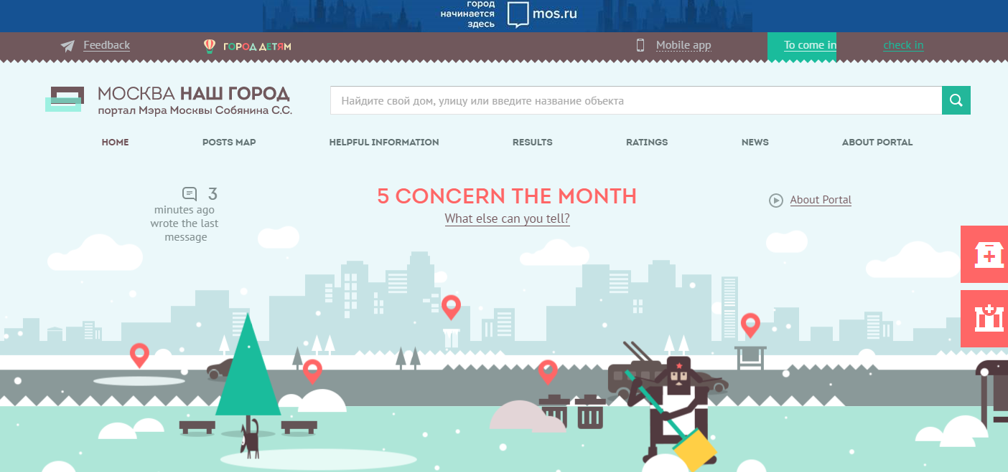
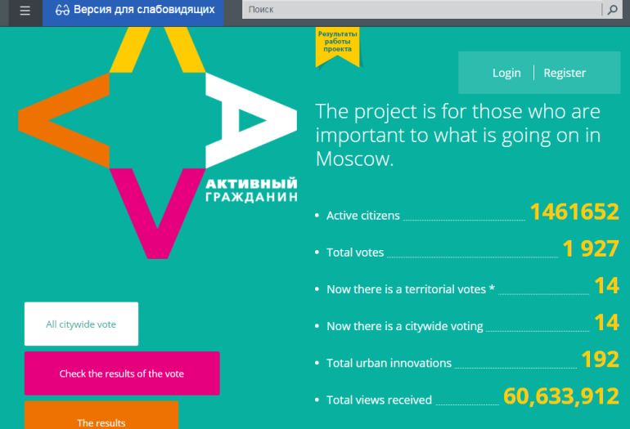
Web & App based Platforms
Our City
Active Citizen
WeChat

Slide 9
Next Level of Digitalisation
Moving beyond increasing access of users to internet
connectivity (primary digitalisation)
Building more advanced digital systems & networks
(allows for better demand & supply assessment of
various city aspects)
IEMS, Moscow studies level of penetration of digital
technologies into the life of modern cities

Slide 10
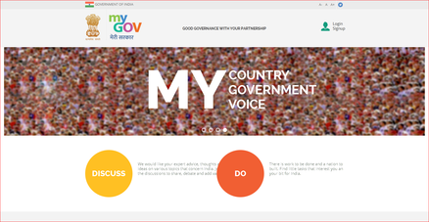
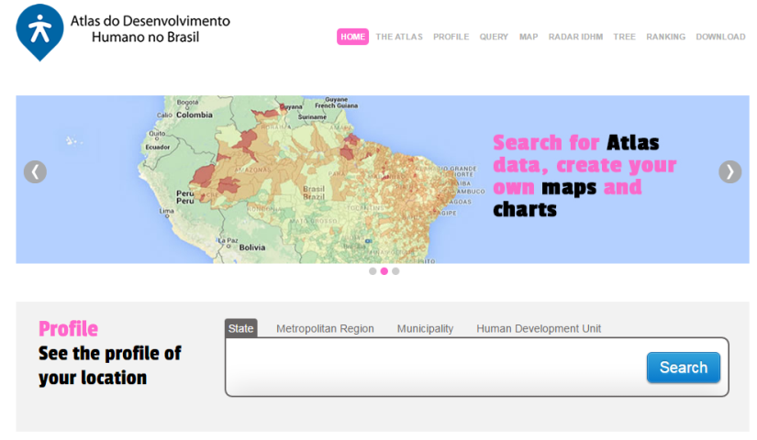
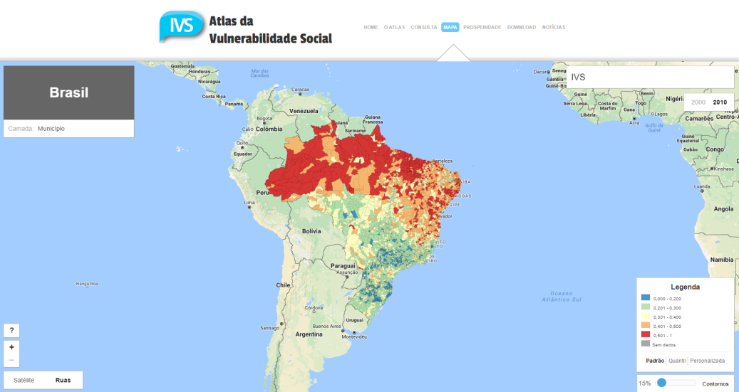
Technological Platforms
MyGov. India
B r a z i l
Human Development Atlas
Social Vulnerability Atlas

Slide 11
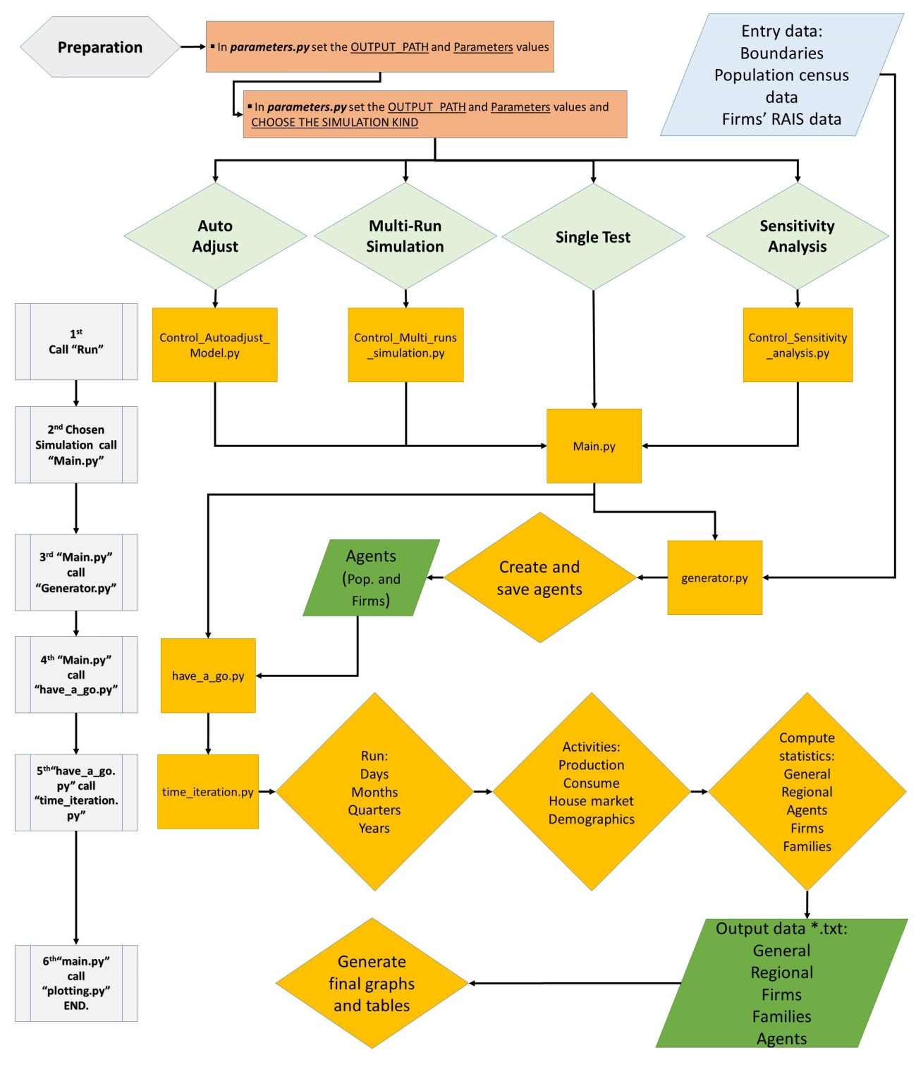
Agent-based Modelling Framework
Source: IPEA, Brazil.

Slide 12
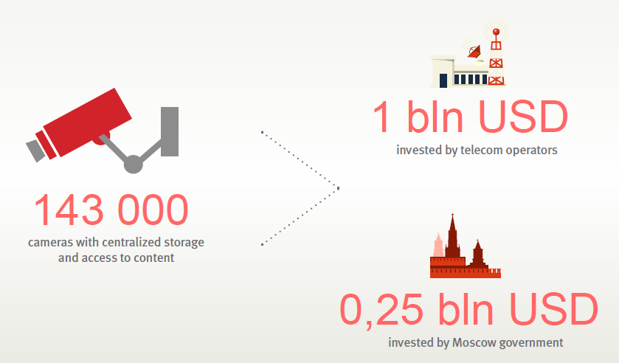
Video Surveillance System

Slide 13
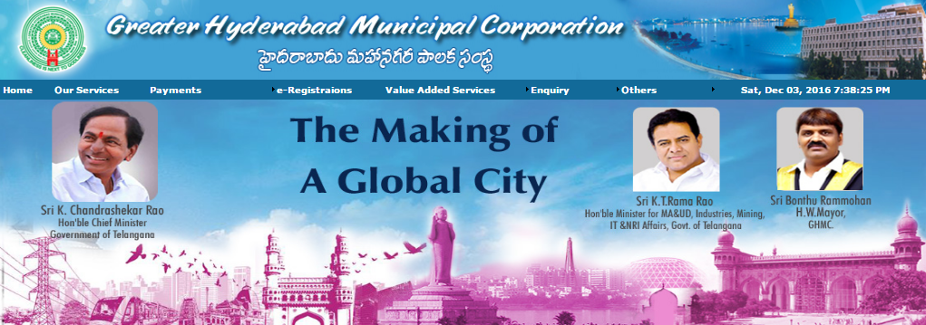
Municipal Websites

Slide 14
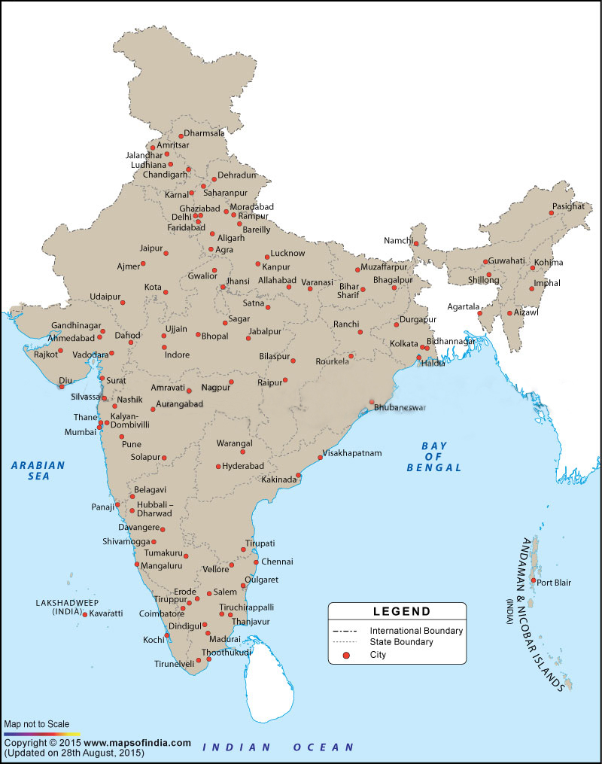
Total cities:
100 (60)
Population range:
11,201 –
12.4 million
Total Population:
130 million
35 % urban
Mix of business,
Industrial, capitals,
Culture, tourism,
Port cities
SCPs prepared
(online portal &
Social media used)
SPVs set up
India’s
5 Years:
2015-16
2019-20
Centre:
480 billion
State/Local:
Equal Amt.
Smart Cities Mission
USA
USA
JAPAN
GERMANY
USA
60 Cities selected in the
first round
States / UTs yet to enter implementation phase
‘Make your City
Smart’ contest
GERMANY
GERMANY

Slide 15
Smart City Projects
Slum rehabilitation, street & pedestrian walkway, modern buses with alternative
Fuels, traffic demand modeling, common mobility card
Sewage treatment plant, housing, river front garden, supervisory control & data
Acquisition system for water supply, traffic signals, WiFi, smart LED streetlights,
City surveillance
Waste to energy, multi-level car parking, rooftop solar power plant, public bike
Sharing, GSM based monitoring of MSW vehicles
City command & control centre

Slide 16
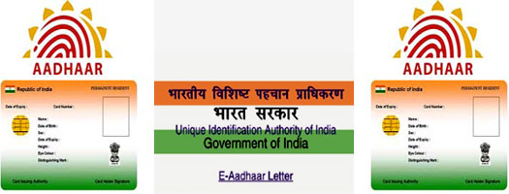
National Citizen Database

Slide 17
Key Areas of Concern
Lay down a comprehensive IT infrastructure (broadband penetration is low @ 7 % & needs to be increased; technical skill building)
Provide affordable, faster internet, free wi-fi services; increase smart phone ownership
Map all buildings & infrastructure above & below ground
Protect privacy of citizens in online databases
Organise discussion forums where knowledge is shared & administration can discuss problems with IT entreprenuers

Slide 18
Thank You For Your Attention

