Slide 1
Indian Cities – Governance Challenges
Tikender Singh Panwar
Deputy Mayor, Municipal Corporation of Shimla

Slide 2
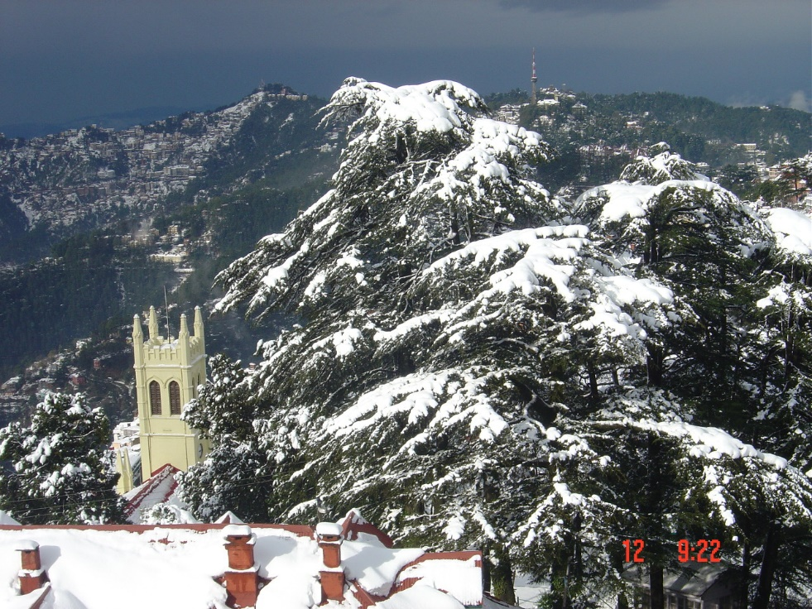
Context and Contests
Animosity towards the city
Gandhi “India lives in it’s villages"
Land
State owns the land
Open spaces
The challenges of a hill town
Relationship:
State (Province/Region) and
City Administrator (Commissioner)
Town and Country Planning Organisation
Executive hold over power.
Financial, functional domain restricted.

Slide 3
Challenges:
From being managerial outposts to playing entrepreneurs.
Attracting capital – Transformative or Sustainable?
Withdrawal of the state.
Capacities in utilities.
Withdrawal of the state.
Informal workforce is being affected
Some solutions:
Shimla Environment Management and Beautification Society

Slide 4
Spatial Justice – Vision for the city
Spaces
Open & green space
Heritage
Utilities & Space
Ghettoisation
Water and Sewerage
Amended bylaws to provide water
and sewerage to all

Slide 5
Indian Mayor Vs Global Mayor
Issue of capacities
Financial empowerment
Executive Powers
Need to structure power again

