Slide 1
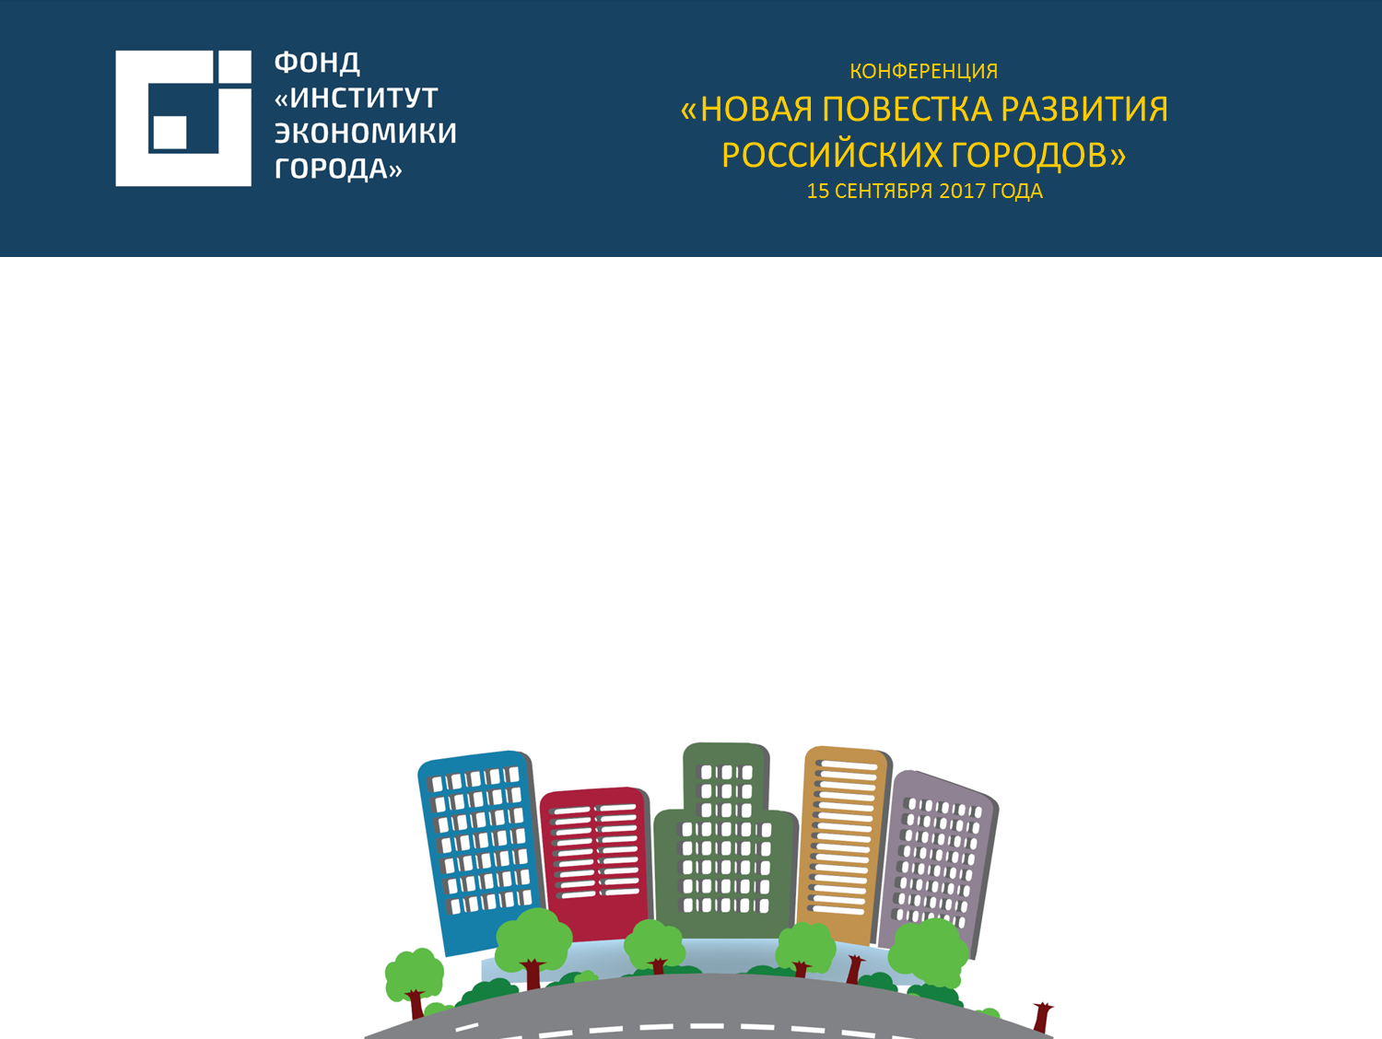

The Institute for Urban Economics
НАЗВАНИЕ
МЕРОПРИЯТИЯ
ДАТА, ГОРОД
Housing for the next European social model
27-30 August 2019
Workshop 11: Housing Market Dynamics
THE AFFORDABILITY OF HOUSING
IN RUSSIA AND OTHER COUNTRIES
Tatiana D. Polidi
PhD, Executive Director of The Institute for Urban Economics (Russia, Moscow)

Slide 2


Russian Housing Stock: property and tenure status
Housing Stock: 65.9 mn dwelling units with the total floor space of 3.8 bn sq. m
Housing Conditions: 449 units per 1000 persons, 25 sq. m per capita
Distribution of housing stock
by tenure type, 2018
Distribution of housing stock
by property type, 2018
70% of housing stock – condominiums as a result of free unit-based housing privatization
Source: Russtat

Slide 3
Housing price to income ratio:
housing affordability is rising
Source: Institute for Urban Economics (Russia) using data of Russtat

Slide 4
Housing Affordability in Russia:
substantial growth for 10 years
Source: Institute for Urban Economics (Russia) using data of Russtat and Bank of Russia

Slide 5
Housing Construction in Russia:
increase in volumes after the economic recovery of 2000th
Self-built housing – housing constructed by people for their own use on their own land plots
Source: Russtat

Slide 6
Housing Mortgage Market Development:
rapid growth over 10 years
Source: Bank of Russia

Slide 7


Housing Construction Finance:
domination of a consumer-based financing model in professional development
(till the reform of 2018)
Apartment building (condominium)
Bank
Bank provides to developer a little CONSTRUCTION LOAN usually only for buying the land or make other spending prior to construction permit is obtained
~10-15% of project costs
Bank provides to purchasers a SPECIAL CREDIT with collateral:
Construction stage –
right of requirement by the contract
After construction completion –
conventional mortgage
Developer constructs a house and then transfer flats to purchasers
~85-90% of project costs
Purchasers pay any part of a flat price (up to 100%) at the early stage of construction
Purchasers of flats in condominium
Each purchaser concludes a SHARED-FINANCING CONTRACT with a developer
Developer

Slide 8
Housing Mortgage Market Development:
the share of non-conventional loans secured on SFC rights doubled only for 4 years
SFC – shared-financing contract
Source: Bank of Russia, Rusreestr (State Cadastral and Registration Office)

Slide 9
Housing in Russia can be considered affordable on average
Housing price to income ratio targets for the “Providing Affordable and Comfortable Housing and Utility Services to Russian Citizens” national program
Indicator | 2016 | 2017 | 2018 | 2019 | 2020 | 2021 | 2022 | 2023 | 2024 | 2025
HPI, years | 2.6 | 2.6 | 2.5 | 2.5 | 2.4 | 2.4 | 2.4 | 2.3 | 2.3 | 2.3
Source: “Housing price to income ratio targets for the ‘Providing Affordable and Comfortable Housing and Utility Services to Russian Citizens,’” national program (as amended on 30 December 2017)
Classification of housing markets based on affordability according to UN Habitat
Market category based on housing affordability | HPI value
Affordable | Under 3 years
Moderately unaffordable | 3 to 4 years
Seriously unaffordable | 4 to 5 years
Severely unaffordable | Over 5 years
Source: www.demografia.com

Slide 10
The housing price to income ratio was at 2.6 years in 2017, according to the National Program data – lower than the average HPI value in the UK, which was 4.5 in 2017
Housing price to income ratio in certain foreign countries (ratio of median housing price to median household income) in 2017
Country | Housing price to income ratio
China (Hong Kong) | 19.4
Australia | 5.9
New Zealand | 5.8
Japan | 5.8
Singapore | 4.8
United Kingdom | 4.5
Canada | 3.9
United States | 3.7
Ireland | 3.7
Source: 14th Annual Demographia International Housing Affordability Survey: 2018.

Slide 11
Although average prices in the housing market have increased slightly in nominal terms (from $157.000 by PPP to $161.000 by PPP for a standard 54 sq. m flat), nominal household incomes grew much greater. Whereas, if inflation is taken into account, housing prices in real terms decreased to a greater extent than real per capita income.
Impact of various factors on the proportion of households that can afford to buy housing that conforms to housing provision standards, using their own funds and borrowing (PoH) across Russia, p.p.
Period | PoH variation factors |  |  |  |  | Total PoH variation
 | Mortgage interest rate | Mortgage maturity | Mortgage amount | Per capita income | Inequality between household incomes
2016-2017 | 5.40 | 0.00 | 0.56 | 1.45 | -0.16 | 7.26
2015-2016 | 2.44 | 0.00 | 1.52 | 0.49 | 0.08 | 4.54
2014-2015 | -2.17 | 0.00 | -0.75 | 4.37 | -0.24 | 1.20
2013-2014 | -0.02 | 0.00 | -1.94 | 3.79 | -0.13 | 1.69
2013-2017 | 5.64 | 0.00 | -0.60 | 10.10 | -0.45 | 14.69
Source: author’s calculations based on Rosstat and Bank of Russia data.

Slide 12
Increase in PoH can be attributed to reduced housing prices, which declined faster than per capita income
Source: authors ‘calculations based on Rosstat data.

Slide 13
Decreasing real housing prices in Russia is a comparatively new trend (past 10 years), as prices mainly continued up until 2008
Source: authors ‘calculations based on Rosstat data.

Slide 14
The current policy of targeting inflation (on the level of 4%) requires a further reduction in mortgage interest rates, however, the high degree of uncertainty in the Russian economy prevents definitive conclusions
Source: Bank of Russia.

Slide 15
7 out of 17 housing markets in select urban agglomerations can be classified as affordable housing markets, which enable housing to be purchased while saving all household income in less than 3 years
Housing price to income ratio and its trend in Russian urban agglomerations from 2010 through 2016
No. | Agglomeration | Housing price to income ratio, years, 2016 | Growth from 2010 through 2016, years | Housing affordability in 2016 | 2010-2016 Trend
1 | Moscow | 5.3 | -2.2 | Severely unaffordable | Significant increase in housing affordability
2 | Saint Petersburg | 4.4 | -2.0 | Seriously unaffordable | Significant increase in housing affordability
3 | Novosibirsk | 3.6 | -1.8 | Moderately unaffordable | Significant increase in housing affordability
4 | Vladivostok | 3.4 | -1.3 |  | Moderate increase in housing affordability
5 | Krasnoyarsk | 3.2 | -0.4 |  | Moderate increase in housing affordability
6 | Kazan | 2.9 | -0.4 |  | Moderate increase in housing affordability
7 | Nizhny Novgorod | 2.9 | -0.7 |  | Moderate increase in housing affordability
8 | Volgograd | 2.9 | -0.7 |  | Moderate increase in housing affordability
9 | Ufa | 2.9 | 0.0 |  | Insignificant increase in housing affordability
10 | Samara (Togliatti) | 2.8 | -0.8 |  | Moderate increase in housing affordability
11 | Yekaterinburg | 2.6 | -0.5 | Affordable | Moderate increase in housing affordability
12 | Saratov | 2.6 | -0.5 |  | Moderate increase in housing affordability
13 | Perm | 2.4 | 0.0 |  | No change in housing affordability
14 | Chelyabinsk | 2.4 | -0.1 |  | Insignificant increase in housing affordability
15 | Rostov | 2.4 | -0.8 |  | Moderate increase in housing affordability
16 | Voronezh | 2.2 | -1.1 |  | Significant increase in housing affordability
17 | Krasnodar | 1.8 | -0.9 |  | Significant increase in housing affordability
Source: authors ‘calculations based on Rosstat data on household incomes, data of the web-portal www.domofond.ru on real estate offerings for sale located in municipalities of each metropolitan area published.

Slide 16
The transition to estimating the affordability of buying a more spacious residential unit (in all selected urban agglomerations the current housing provision per capita exceeds 18 sq. m) leads to a higher housing price to income ratio, which is higher in areas with relatively high housing provision and lower in areas with relatively low housing provision
Adjusted housing price to income ratio in Russian urban agglomerations in 2016 (residential unit area equal to average housing provision in the urban agglomeration, multiplied by 3), years
Agglomeration | Adjusted housing price to income ratio, years
Moscow | 5.7
Saint Petersburg | 6.1
Samara (Togliatti) | 4.3
Yekaterinburg | 3.8
Rostov | 3.5
Novosibirsk | 4.9
Nizhny Novgorod | 3.9
Kazan | 4.0
Chelyabinsk | 3.4
Ufa | 3.7
Volgograd | 3.7
Krasnoyarsk | 4.3
Voronezh | 3.4
Perm | 3.2
Krasnodar | 2.7
Saratov | 4.1
Vladivostok | 4.2
Source: authors ‘calculations based on Rosstat data on household incomes, data of the web-portal www.domofond.ru on real estate offerings for sale located in municipalities of each metropolitan area published.

Slide 17
The level of housing affordability in London and Hong Kong is lower than in Russian cities, while in New York and Singapore it is comparable to the degree of housing affordability in the Moscow and Saint Petersburg areas.
Housing price to income ratio in foreign urban agglomerations in 2016 and 2017
Urban agglomeration | Housing price to income ratio, 2016, Demographia¹ | The ratio of a residential unit price to annual household income, 2017, Numbeo²
New York | 5.7 | 9.47
London | 8.5 | 21.52
Singapore | 4.8 | 22.31
Dubai | – | 4.52
Poznan | – | 10.10
Nuremberg | – | 6.98
Almaty | – | 12.48
Hong Kong | 18.1 | 40.01
Delhi | – | 15.32
Rio de Janeiro | – | 20.11
^{[1]} The peculiarity of the Demographia calculations is that they are oriented towards the average household, and do not take into account the most expensive urban districts (Belgravia in London, Upper East Side in New York). Read more: http://demographia.com/dhi.pdf, page 43.
^{[2]} https://www.numbeo.com/property-investment/indicators_explained.jsp.
«Price to Income Ratio is the basic measure for apartment purchase affordability (lower is better). It is generally calculated as the ratio of median apartment prices to median familial disposable income, expressed as years of income (although variations are used also elsewhere). Our formula assumes and uses:
net disposable family income, as defined as 1.5 * the average net salary (50% is assumed percentage of women in the workforce)
median apartment size is 90 square meters
price per square meter (the formula uses) is the average price of square meter in the city center and outside of the city center».
Source: Cox W., Pavletich H. (2017) “13th Annual Demographia International Housing Affordability Survey: 2016”; Numbeo database on cities and countries worldwide.

Slide 18
The adjustment dramatically reduces housing affordability in Russian urban agglomerations
Adjusted housing price to income ratio in Russian urban agglomerations in 2016 (residential unit area equal to average housing provision in the London area, multiplied by 3 (95.4 sq. m), years
Housing price to income ratio and its trend in foreign agglomerations from 2010 through 2016
Agglomeration | Adjusted housing price to income ratio, years
Moscow | 9.4
Saint Petersburg | 7.8
Samara (Togliatti) | 5.0
Yekaterinburg | 4.7
Rostov | 4.3
Novosibirsk | 6.3
Nizhny Novgorod | 5.1
Kazan | 5.1
Chelyabinsk | 4.3
Ufa | 5.0
Volgograd | 5.1
Krasnoyarsk | 5.7
Voronezh | 3.9
Perm | 4.3
Krasnodar | 3.1
Saratov | 4.6
Vladivostok | 6.1
Urban agglomeration | 2010 | 2011 | 2012 | 2013 | 2014 | 2015 | 2016
New York | 6.1 | 6.2 | 6.2 | 6.2 | 6.1 | 5.9 | 5.7
London | 7.2 | 6.9 | 7.8 | 7.3 | 8.5 | 8.5 | 8.5
Singapore | - | - | 5.9 | 5.1 | 5 | 5 | 4.8
Hong Kong | 11.4 | 12.6 | 13.5 | 14.9 | 17 | 19.0 | 18.1
Source: Demographia International Housing Affordability Survey for 2011 through 2017. Link: http://demographia.com
Source: authors ‘calculations based on Rosstat data on household incomes, data of the web-portal www.domofond.ru on real estate offerings for sale located in municipalities of each metropolitan area published.

Slide 19
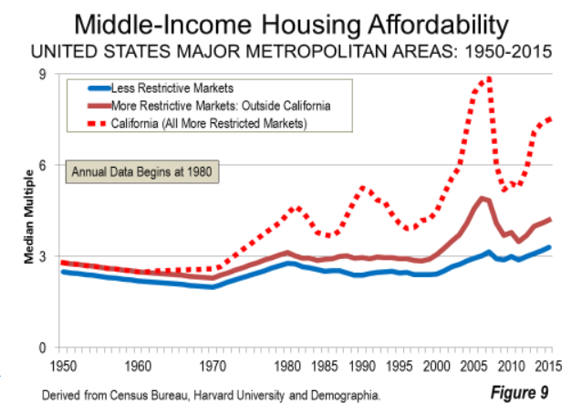
Within 65 years, housing affordability has decreased in major U.S. metropolitan areas, and most dramatically in areas with tight urban construction policies, although housing affordability increased during periods of sharp increases in the availability of mortgages in the 2000s
Source: http://demographia.com/dhi2016.pdf

Slide 20
The largest Russian metros displayed over 2010-2016 the relatively high leveled of housing construction as well as sustainable population growth
Source: authors ‘calculations based on Rosstat data.

Slide 21
New York, London, Singapore have comparable population growth rates in 2010-2016 with such Russian metros as Yekaterinburg, Ufa, Kazan which have twice as much housing construction volumes about 11 units per 1000 inhabitants
Population growth in 2010-2016 and the number of newly built housing units per 1000 inhabitants, 2016, in metropolitan areas with over 1 million people
City | Population growth in 2010-2016 | Newly built housing units per 1000 inhabitants
Dubai | 63% | 4.37
Singapore | 5.8% | 3.86
New York | 7.1% | 3.25
London | 5.9% | 3.25
Nuremberg | 5.5% | 0.42
Sources: New York: www.census.gov/construction/nrc; London https://data.london.gov.uk/dataset/housing-london/resource/27e10d40-bb04-4028-95a6606bd13d7777; Singapore: www.singstat.gov.sg/docs/default-source/default-document-library/publications/publications_and_papers/reference/sif2017.pdf; Dubai: www.dsc.gov.ae/Report/Copy%20of%20DSC_SYB_2016_02%20_%2002.pdf; Nuremberg: www.regionalstatistik.de

Slide 22
Different Forms of Housing Provision
and Budget Subsidies: Weak Support
Social municipal housing provision through waiting lists
Up-front subsidies and housing vouchers in federal/regional support programs (young families, war veteran, etc.)
Housing provision for those living in dilapidated housing
Housing cooperatives (public employees, etc.)
Temporary program for mortgage interest rates subsidies (2014 – 2016)
Personal income tax deduction for housing purchase and mortgage interest rate payment
Total public expenditures and tax losses amounts to about €10 bn or 1% of GDP every year*
* Estimated as of 2012

Slide 23
Social Housing
Russian social housing - housing provided by public authorities under a social rental agreement and allocated through waiting lists
Public authorities regulate admission to waiting lists by setting ‘low-income’ criteria (since 2005) and intake housing norms
Currently 5% Russian households are on waiting lists (2.6 mn households)
Annually only about 5% of them acquire housing and improve their housing conditions (130 thousand households) – average stay in a waiting list is close to 20 years
Up to 60 percent of households from waiting list acquire not social housing but housing in ownership under various federal/regional support programs (young families, war veterans, etc.)
Source: Russtat

Slide 24
Affordable Housing:
Recent policy for inducing legal rental housing market development
2014
Adoption of federal legislation about 2 types of rental housing (RH):
- Market RH
- Regulated RH
2015-2016
Adoption of regional legislation on regulated RH including rules of setting caps on rent levels
2017 - …
Formulating regional policies on regulated and market RH development
The key barriers preventing rental housing development:
Lack of long-term investment capital
Lack of bank financing (both project and mortgage)
Lack of public financing (both for production and consumption support)
Strong opposition of housing construction lobby to new form of housing
Competition from the informal rental sector
The regions plan to attract only €1 bn in rental housing till 2024, including 20% of public recourses
Source: web-site of USHDI

Slide 25
Affordable Housing:
Case of the federal program «Home for Russian Family» (2014-2017)
Key goal of the Program is to create a new supply of affordable housing (25 mn sq. m. for approx. 5 million families)
The program was based on the public-private partnerships: developers provide affordable housing in exchange for government support
Results:
As of the 1 of January 2017 the key performance indicator reached only 3,3% from the target value
Affordable housing withing the Program is housing by price no more than the least of two values: 80% of a market average price in the locality or € 500 per sq. m. of floor space
Source: Institute for Urban Economics (Russia)

Slide 26
The Institute for Urban Economics
IUE is a non-government and non-profit organization
established in Moscow in 1995
IUE MISSION: analysis and assistance to cities and regions in social and economic development
The IUE experts contributed to development of over 100 Russian legislative and regulatory legal acts, including:
IUE has 3 research departments:
On State Registration of Real Estate Rights and Transactions (1997)
On Mortgage (1998)
Land Code of the Russian Federation (2001)
On Mortgage-Backed Securities (2003)
Housing Code of the Russian Federation (2004)
Town Planning Code of the Russian Federation (2004)
Real Estate Market Department
Urban Economy Department
Municipal economic development Department
IUE enters the world ranking Global Go To Think Tank Index (University of Pennsylvania):
TOP50 of think tanks in the area of social policy
TOP50 of think tanks in Central and Eastern Europe
www.urbaneconomics.ru

Slide 27




The Institute for Urban Economics
CONTACT US
125009 Russia, Moscow
Tverskaya str., 20/1
www.urbaneconomics.ru
Tel/fax: +7 (495) 787 45 20
+7 (495) 363 50 47
mailbox@urbaneconomics.ru
www.urbaneconomics.ru

