Slide 1
Opportunities for young Muscovites to influence the situation in the capital and to participate in urban governance
Creative team of Moscow Metropolitan Governance University

Slide 2
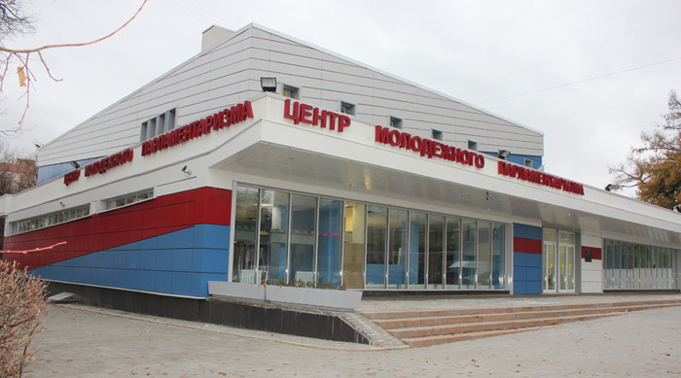
Youth and political life
2004 – Moscow City Duma (Parliament) adopted the law of the city of Moscow “On youth policy”
2012 – the first Centre for Youth parliamentarism opened its doors to let the young Muscovites be involved in social and political life of the capital

Slide 3
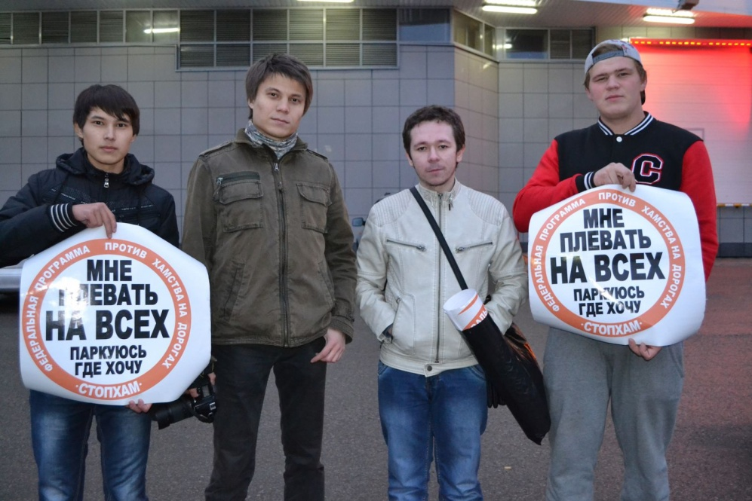
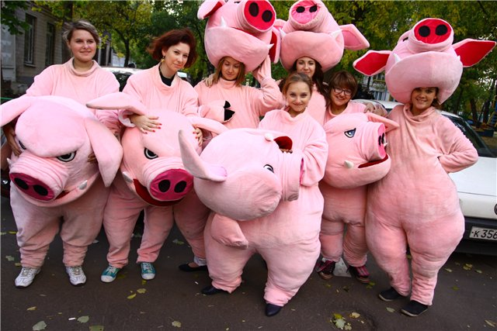
“Marginal” youth social movements
StopBoors – aimed at compliance with traffic rules, regardless of the driver position
Piggies Against – social struggle against selling expired products and providing services of poor quality

Slide 4
“Marginal” youth social movements
StopDrugs – aimed at combating the legal synthetic drug trafficking
LionVersus – aimed at combating smoking and drinking alcoholic beverages in public places

Slide 5
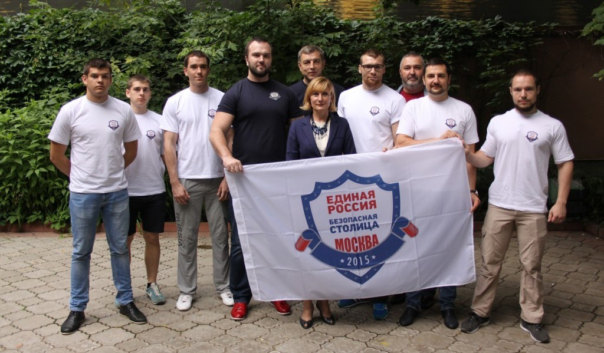
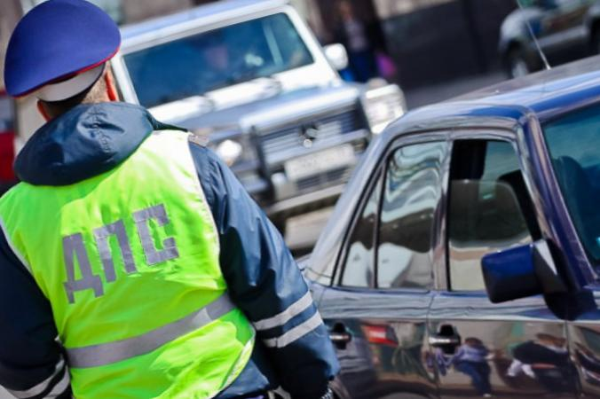
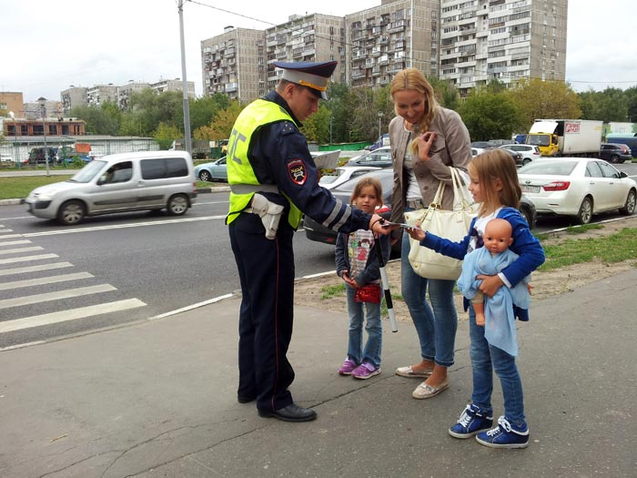
Youth regional chambers by local governments
Lawful raids “Safe Metropolis”
the purpose is:
to prevent crimes on the roads
to eliminate abuses in servicing public utility systems
to give social support for the population
2. Campaign “Drunk Driver”
the purpose is to take preventive measures to protect people from the drunken drivers
3. Campaign “Little Pedestrian” the purpose is to raise the level of literacy among children and to demonstrate them safe behaviour on the roads

Slide 6
Volunteers
2014 – the Resource Center “MosVolunteer” by the Public Relations Committee of Moscow gets young people involved with their volunteer activity
Projects:
socialization of orphans
recruitment and training of volunteers for sports and other events
advocacy and promotion of blood donation
search of homes and families for homeless animals
helping to protect the environment, etc.

Slide 7
“Active Citizen” & “Our City”
1,3 mil. people participate in a project
1 667 votings held
850 city dwellers’ decisions realized
4. 47 mil. city dwellers’ opinions scrutinized
5. Smart City Award-2015
Popular topics:
Management of health services
Management of public transportation system
Improvement of Moscow central streets
Tree planting within the program “Million of trees”
Hot topics:
Engineering systems exploit
Vandalism
Cleanup problems

Slide 8
Universities and Government
Establish:
projects
competitions
coaching courses
business-incubators
research centres, science and technology parks
Mission:
to bring young people onto the right organized track
to favour qualitative changes to the world
to consolidate innovative values
Support:
one’s ‘-self’ acquirement
individuality
youth
tendency to the future

Slide 9
Internship “Moscow through my eyes”
to start a career at the Government of Moscow
to solve large-scale and ambitious tasks
to gain a wide range of regular business contacts
to make Moscow city much more comfortable
young people under 30 y.o.
higher education
great scores for the core subjects
love to Moscow and its citizens
Internship – per year
Salary – 25 000 roubles a month
Post – chief analyst to the Mayor and Government Office

Slide 10
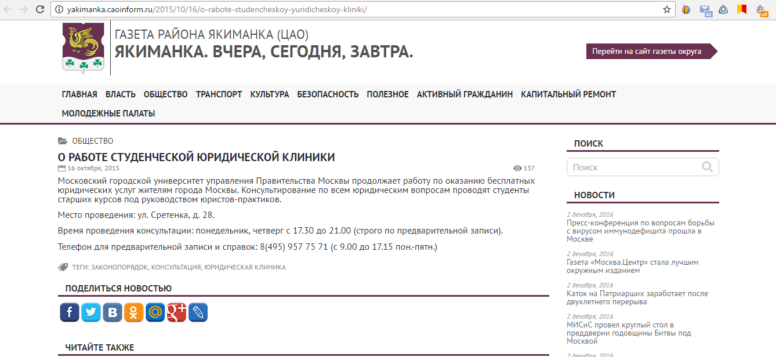
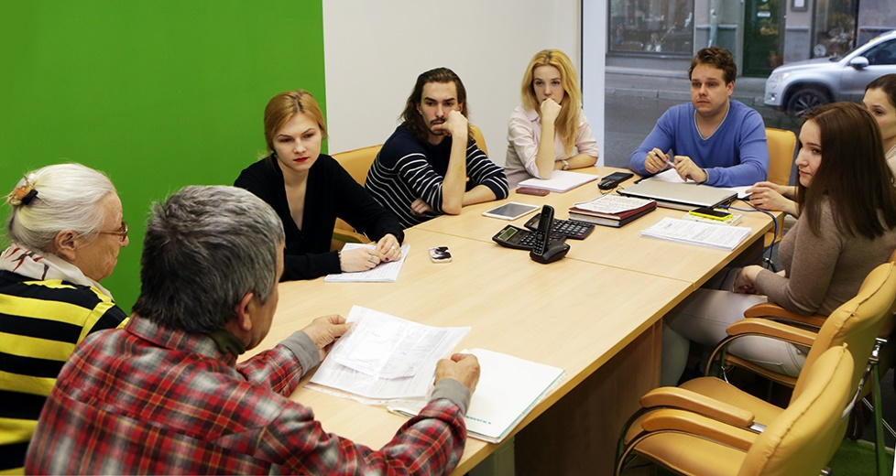
The Law School Clinic
Overall Results:
8,5 years of work experience
about 3000 officially registered applications
almost 800 urgent cases “out of turn”
more than 300 statements of action, including to the European Court
approx. 250 actions to executive authorities and public prosecutor’s office

Slide 11
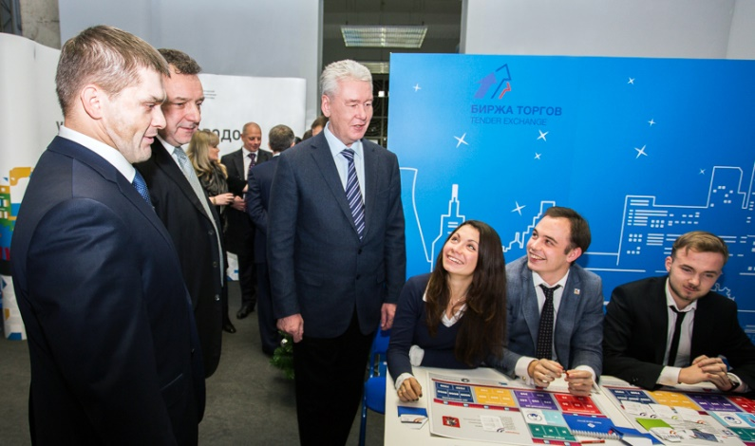
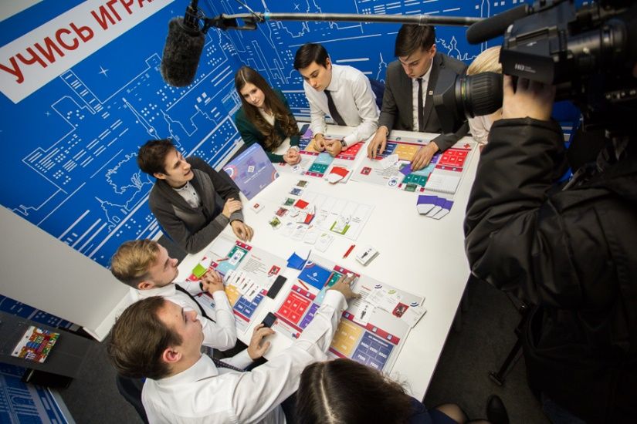
“Public purchase exchange” Project
The project is committed:
to create an attractive investment environment on the public procurement market
to increase interest among the representatives of business community to conduct business with the state
to implement assistance programs and incentives for small businesses
Young scientists of the Department, master degree and post-graduate students conduct educational activities to explain business stakeholders the entire mechanism:
of public purchase (procurement)
of choosing suppliers
of protection of participants’ interests

Slide 12
Thanks and Appreciation
Creative team of the Moscow Metropolitan Governance University expresses thanks and appreciation to the Government of Moscow, the administration of the Moscow Metropolitan Governance University and BRICS+ City Lab II organizing Committee for their full cooperation and transparency that contributed to the success of the report.

Slide 13
Creative Team, Moscow Metropolitan Governance University
Supervisor: Irina P. Gladilina, Professor, Chair for State and Municipal Purchase Management, PhD (Pedagogy), Professor
Speaker: Anna A. Nistarova, Associate Professor, Chair for Social-Humanitarian Disciplines and History of Law, PhD (Social Philosophy), Master Degree (International Relations)
Participants: Elena Yu. Koletvinova, Department Head, Department for Research Scientific Work and Projects, PhD (Economics)
Olga V. Gorbulina, Director, Centre for International Education Programs and European Cooperation at International Relations Bureau
Ekaterina O. Tumanova, Associate Professor, Chair for Social-Humanitarian Disciplines and History of Law, PhD (Philology)
Maksim A. Konaykov, Expert, Chair for State and Municipal Purchase Management
Students: Evgeniy A. Nikolaev
Julia M. Mamedova
Tatiana S. Baranova
Natalia A. Kozorezova
Aleksandra V. Skovorodina

Slide 14
Thank You for Your attention!

