Slide 1
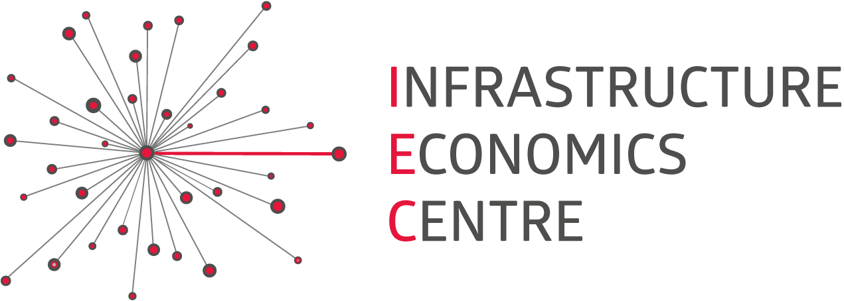
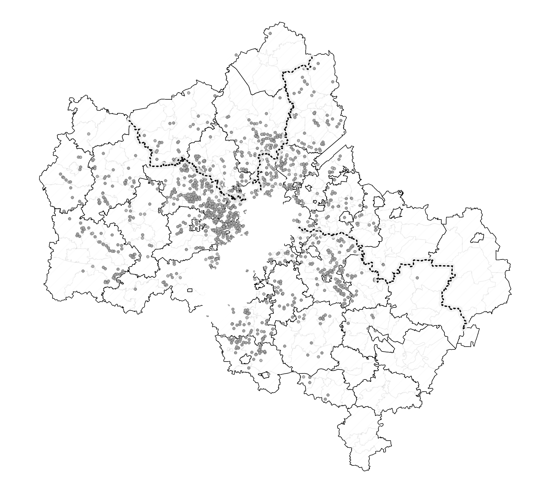
Диагностика
Changes of Spatial Behavior Patterns in Moscow Metropolitan Area
Проектные предложения
Commuting
“Daching”
Shopping

Slide 2
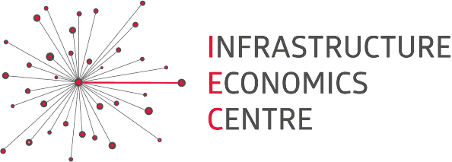
SURVEYS
More than 5k people in Moscow and Moscow region in 2014 were asked about their spatial behavior (same in 2016)
Field works at bus stations in Moscow
STATISTICS
Central PPK (major railway carrier in the region)
IEC’s Suburban Real Estate database
BIG DATA
Data from mobile phones on traffic between Moscow and selected territories of Moscow region
MAJOR SOURCES OF DATA

Slide 3
CHANGES IN COMMUTER’S SPATIAL BEHAVIOR ARE WEAK AND
DEPEND ON DISTANCE TO MOSCOW
Commuters from Moscow region who works/studies in Moscow
(travel to Moscow 3 times a week and more often)
 | People, 2016 | % of 18+ pop. in 2016 | 2016/14 | Drivers
Moscow region, total | 1 012 749 | 16,8% | +1,4%
First belt (< 30 km from Moscow ring road) | 508 889 | 26,4% | +3,1% | Residential development continues, families from Moscow seek for the cheaper homes
Middle belt (30-60 km) | 400 691 | 14,5% | -0,8% | Created jobs redirect commuting (Domodedovo, Solnechnogorsk, etc..)
Far belt (> 60 km) | 103 170 | 7,4% | +2,6% | Distant second houses suitable for living during the whole year emerges (Ruza, Mozhaysk); Recession of some local economies
Source: IEC sociologic researches

Slide 4
NUMBER OF PEOPLE WHO LIVES IN MOSCOW REGION AND TRAVELS TO MOSCOW NOT REGULARY REDUCED DRAMMATICALLY
 | People, 2016 | % of 18+ pop. in 2016 | 2016/14 | Drivers
People who goes to Moscow for business occasionally | 233 280 | 3,8% | +25,5% | More students from Moscow region studies in Moscow due to reduction of small universities’ branches
People who goes to Moscow for other purposes occasionally, including… | 2 602 595 | 43,4% | -21,7% | Real income decrease and transport tariffs growth Modern shopping molls emerged in the largest cities of Moscow region (Mytishi, Podolsk, Balashikha, etc.) Lower-income groups made a major contribution to the traffic drop.
…leisure | 819 548 | 13,5% | -23,5%
…shopping | 337 641 | 5,6% | -64,1%
People who have not visited Moscow during the year, including… | 1 933 765 | 31,8% | +65,0%
…elderly (retired) people | 635 380 | 10,8% | +31,0% | Moscow region government has abolished subsidies for elderly people’s journeys by Moscow public transport
Source: IEC sociologic researches

Slide 5
MORE OFFICES TO MOVE TO OUTSKIRTS AND LESS PEOPLE TO VISIT MOSCOW REGION
People who dwells in Moscow permanently
 | People, 2016 | % of 18+ pop. in 2016 | 2016/14 | Drivers
Commuters from Moscow who works/studies in Moscow region (travel 3 times a week and more often) | 427 713 | 2,9% | +50,1% | Migration of offices to suburbs accelerates and gradually equalizes inbound and outbound traffic to Moscow at peak hours. Speed trains and highways are preferable
Owners of “dacha” or cottage in Moscow region | 3 501 276 | 34,5% | +3,3% | Continuing “dacha” and cottage development especially at the middle belt of Moscow region (the highest demand for land plots without buildings)
Travelers to Moscow region with other purposes and doesn’t have dacha | 3 342 127 | 33,5% | -9,0% | Income decrease and transport tariffs growth. Lower-income groups made a major contribution to the traffic drop.
People who have not visited Moscow region during the year | 2 959 175 | 27,3% | +10,4%
Source: IEC sociologic researches

Slide 6
1351mln JOURNEYS BETWEEN MOSCOW AND the REGION in 2016
WHICH IS 98,2% to 2014
Number of journeys, by types of spatial behavior
Modal split of journeys between Moscow and the Region
Source: IEC analysis
Source: IEC analysis

Slide 7
PATTERNS OF MOBILITY BETWEEN MOSCOW AND THE REGION DURING THE YEAR, THE WEEK and THE DAY
Seasonal trends in traffic between Moscow
and the Region (example of Noginsk and Orekhovo-Zuevo)
Tuesday-Thursday average traffic during the day (example of Noginsk)
To Moscow
To Noginsk
2,85*X
1,66*X
Saturday average traffic
To Moscow
To Noginsk
Source: IEC analysis on Beeline data

Slide 8
POLICY TO BALANCE MOBILITY AND LIFE
Targeting peaks
– flexible working hours and work from home
– flexible tariff policy
Reduce commuting
– preferences for offices in Moscow Region
– inhibiting of house construction in the first belt
Switch to public transport
– HSR development
– LRT development

Slide 9
Please, don’t hesitate to contact me
Pavel Chistyakov
pachistyakov@infraeconomy.com
+79164615151

