Slide 1
The Gauteng City-Region Observatory: providing the evidence for evidence-based policymaking
BRICS+ City Lab II Colloquium 8 December 2016
Jesse Harber
Gauteng City-Region Observatory (GCRO)
Author’s Name

Slide 2
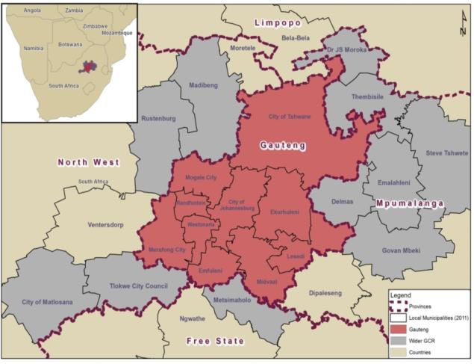
The Gauteng City-Region (GCR)
Context
An actually-existing urban reality, with dynamics (spatial, economic, social, environmental, etc. that need to be understood)
Cluster of conurbations
Holds roughly a quarter of the South African population and a third of the national economy
An academic proposition: from 2000s. Scott; Storper
One formulation: a city and the region surrounding it
More generally: conurban interdependency and institutional fragmentation
A function of particular institutional arrangements
A political proposition: improved intergovernmental co-ordination
What institutional arrangement fits the GCR?
Given the city-region’s challenges and opportunities, shape the right government agenda
Extreme (degenerate?) case: such integration that the city-region becomes a city
Notes:
Holds roughly a quarter of the South African population and a third of the national economy
Idea of city-region = innovative: outward looking ‘competitive’ on global stage and inward looking ‘best governance agenda’ for integrated region

Slide 3
The Gauteng City-Region Observatory (GCRO)
Context
A case study of an effort to generate scholarly work to inform public sector decision-making and policy.
GCRO is an institutional collaboration between:
University of Johannesburg (UJ),
University of the Witwatersrand (Wits),
Gauteng Provincial Government, and
Organised local government in Gauteng
A purpose-designed vehicle for policy-oriented research.
GCRO helps to build the knowledge base that government, business, labour, civil society and residents all need to shape appropriate strategies that will advance a competitive, integrated, sustainable and inclusive Gauteng City-Region.
Notes:
innovation hub that drives social and economic development
GCRO helps to build the knowledge needed to shape appropriate strategies that will advance a competitive, integrated, sustainable and inclusive Gauteng City-Region.

Slide 4
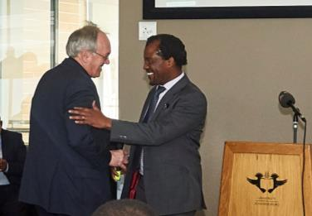
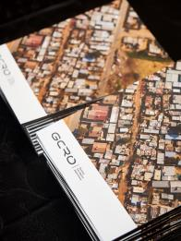
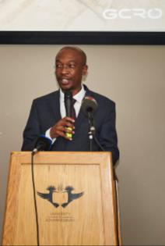
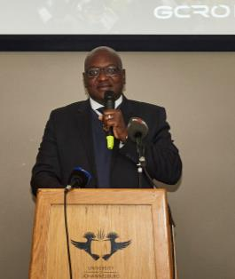
GCRO as a research partnership
Gauteng City-Region Observatory (GCRO)
Core funding from provincial government
In-kind support from the universities incl. space
Guaranteed academic freedom
Primary “client” is provincial government
Most outputs to be fully publicly available
Specific Roles
On-request policy support work
Government – academia portal
Data, data infrastructure
Medium to longer-term applied research (on request or self-initiated)
Academic contributions
Partnership and network building

Slide 5
The quandary
Gauteng City-Region Observatory (GCRO)
Bridging the divide
How do we address intensely political issues without becoming positioned (and sunk) politically?
How do we inform debates and draw (evidenced) conclusions without being seen to be “playing politics”?
How do we play to both authorities – the scholarly and the governmental?

Slide 6
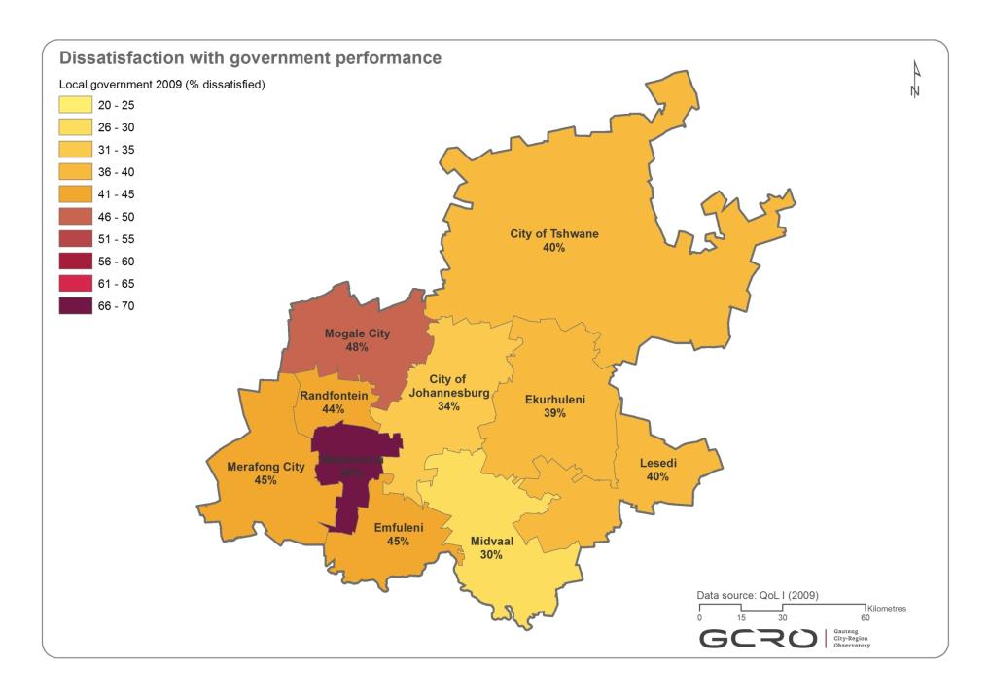
Notes:
Some examples of mapping “dissatisfaction with government performance” from 4 years of QoL
EG – accessible: On the website. Digestible: highly technical GIS, major survey data & attitudinal information combined in easy to digest visual manner;
Reflective: offers reflective insight for government and the public

Slide 7
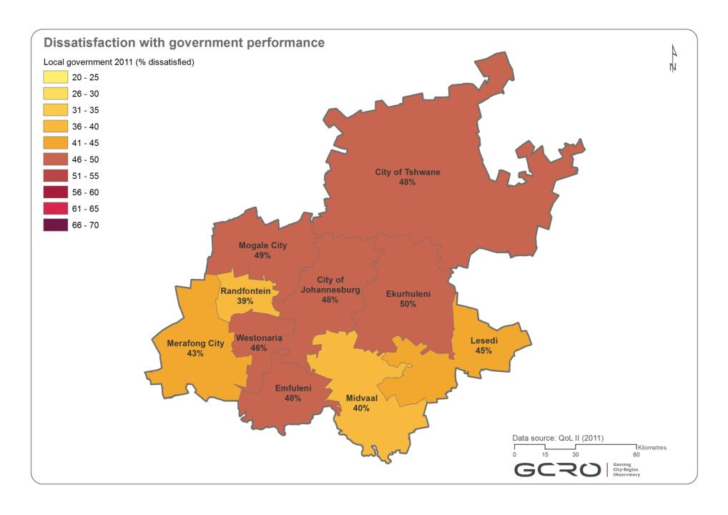

Slide 8
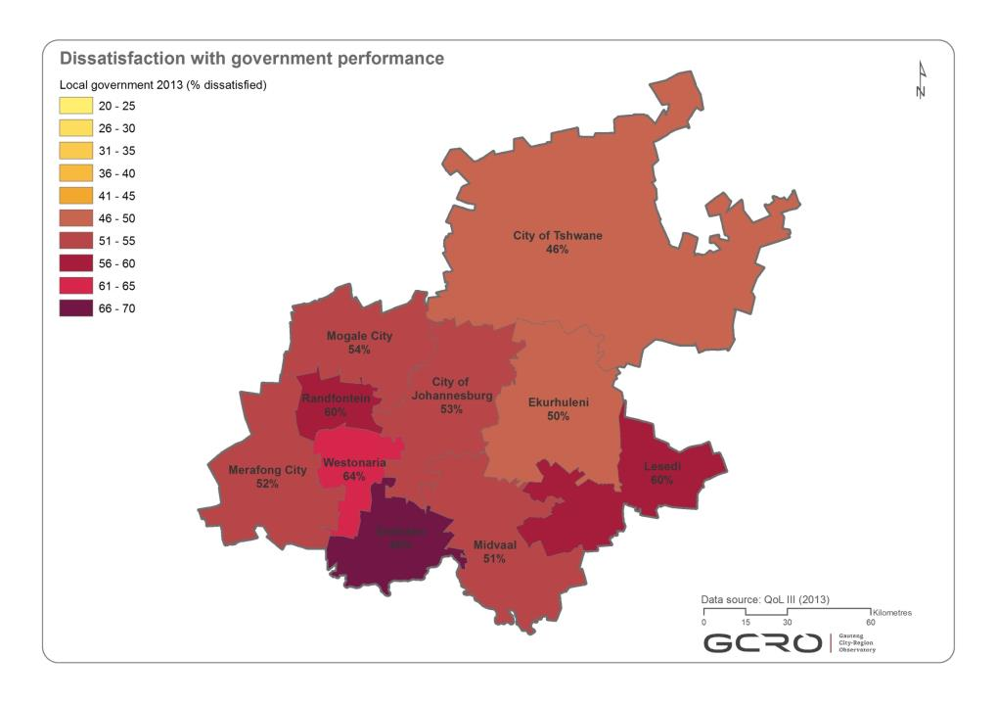

Slide 9
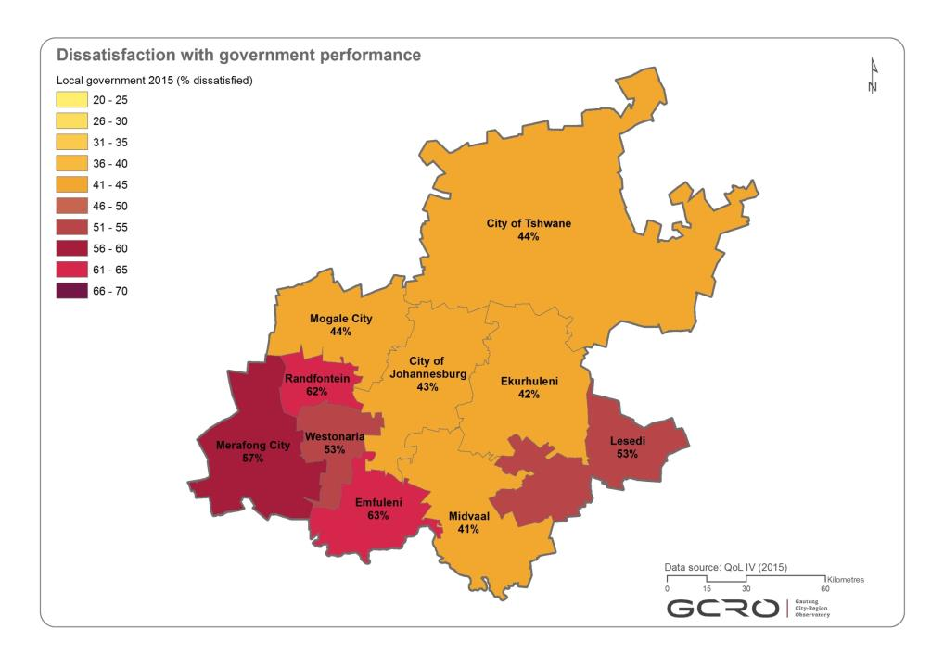

Slide 10
Open access via GCRO website
Innovation accessibility
Notes:
Making research publically available –
>academy: free downloads, maps of the month, quick outputs

Slide 11
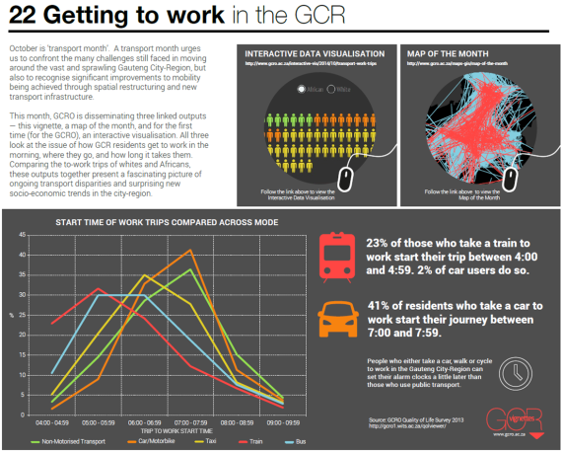
Interactive visualisations and Vignettes
The Gauteng City-Region Observatory – Innovative outputs
Notes:
This style encourages a more immediate uptake of information which remains coherent across possible barriers of specialized language.

Slide 12
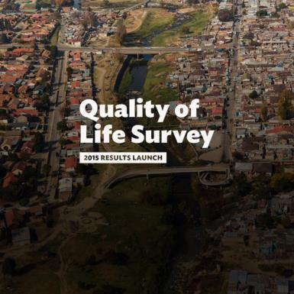
Innovative data collection
The Gauteng City-Region Observatory
Biennial Quality of life survey
Mobile app-based mobility mapping
Ethnographies of the state
CityLabs
Indicators and benchmarking
Spatial statistics modelling
Surveys
Photo essays
Notes:
MyJoziMoves- new way of collecting data in this field.
Not a survey asking people – app that literally tracks how and where people move.
Giving us more detailed information than ever accessible before
Ethnographies of the state - CoJ
QoL
Content – combines material household infrastructure survey with attitudinal questionnaire – fuller picture of life in the GCRO
& technical details – Quality checks on who and where the information is coming from refining – SurveyToGo software on the Dooblo, Track Locate devices,

Slide 13
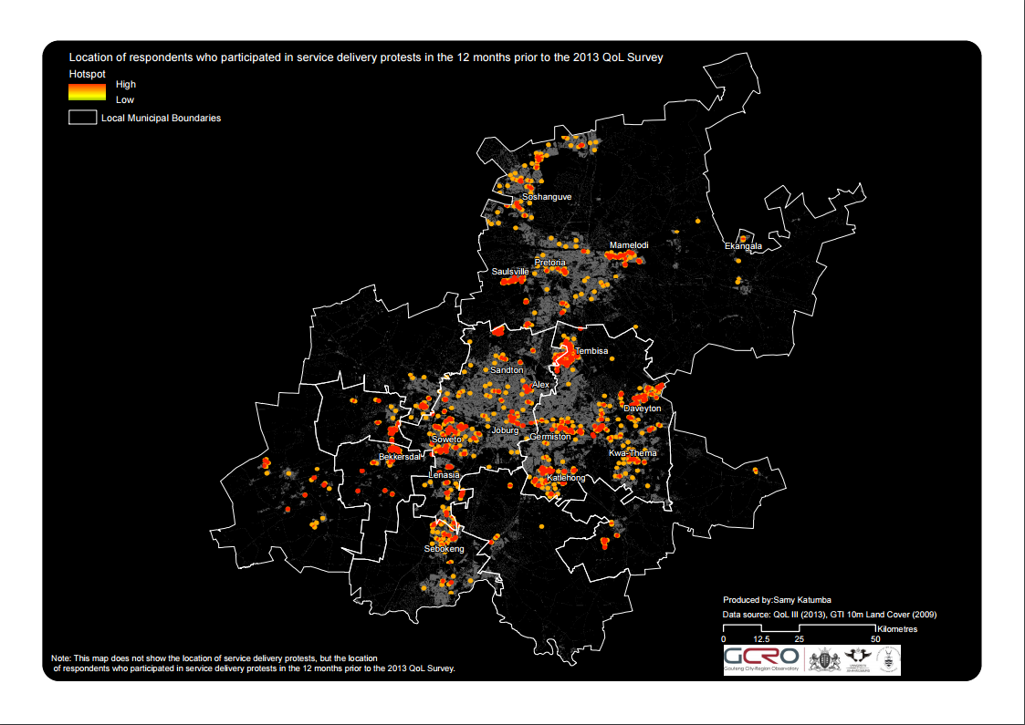
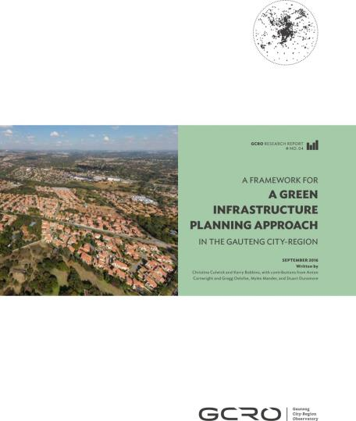
Innovative Research Solutions
The Gauteng City-Region Observatory
Pilot new approaches
What do we want to know
Adaptive thinking
Different modes of action
Capitalizing on emerging tech innovation
to develop innovation cities
SMART cities
Green Infrastructure
MyJozi Moves
QoL
Notes:
Pilot new approaches – try never tested/ Risk – eg MyJozi Moves
Ask the questions government wants to know: where are we now – QoL
Research & multidiscplinary thinking - Innovative solutions:
EG: Green Assets for with Pollution buffer. Given the current situation actually we don’t have a buffer zone, so prescribed policy solution doesn’t apply…So how can we adapted what we do have? GI new way of thinking about infrastructure and
Typically GCR can grow into a hub of innovation thanks to tech advancements and innovation
EG:Tshwane has embarked on transforming itself into a “Smart City”

Slide 14
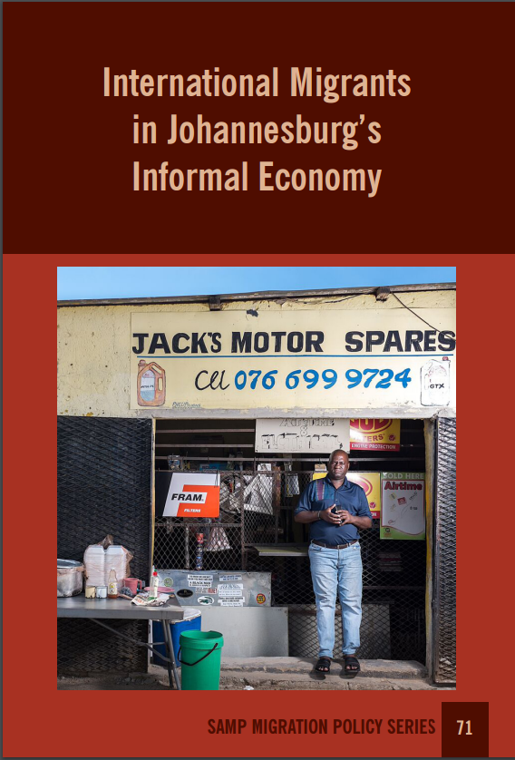
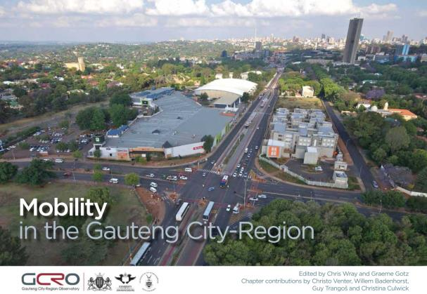
Promote innovative thinking for the GCR
Notes:
The innovative research offers the GCR and governance structures new ways to think about the problem and solutions.
EG: learning that green infrastructure can replace and do more than grey infrastructure – economic and social justice imperative
Reconceptualising notion of economy to take stock of how integral informal economy is; and recognising that Gauteng relies on patters of migration and trade that stretch from Maseru to Nairobi; this is part of what builds and constitutes the city-region not necessarily a problem that must be swept away.
How can the region better understand itself, its options and
These options, these new modes of knowledge and understanding, present alternatives: novels way for the city-region to innovate itself

Slide 15
Do we influence government?
Gauteng City-Region Observatory (GCRO)
However
Many direct contributions to government frameworks;
Influencing high-level positions on key issues;
Brokering dialogue between government agencies;
Increasing appetite for GCRO work
Do we reach street-level bureaucrats?
No linear, cause-and-effect relationship between research and policy or decision-making;
Multiple intervening variables – endogenous and exogenous factors;
GCRO aims to ‘saturate’ the public sphere: a ‘knowledge ecology’.
Notes:
Repeat.
EG where GCRO studies have had direct resonance with development of African cities as hubs of innovation?
Informal economy & QoL – informed the Premier
QoL data informed COJ Social Cohesion planning
QoL data used as performance indicator for CoJ
Framework for GI aprouch in Mogale City Local Municipality

Slide 16
An example from 2015 QoL IV

Slide 17
An example from 2015 QoL IV

Slide 18
An example from 2015 QoL IV

Slide 19
An example from 2015 QoL IV

Slide 20
An example from 2015 QoL IV
Internet access
Notes:
Repeat.
EG where GCRO studies have had direct resonance with development of African cities as hubs of innovation?
Informal economy & QoL – informed the Premier
QoL data informed COJ Social Cohesion planning
QoL data used as performance indicator for CoJ
Framework for GI aprouch in Mogale City Local Municipality

Slide 21
An example from 2015 QoL IV
Internet use to find public transport information
Notes:
Repeat.
EG where GCRO studies have had direct resonance with development of African cities as hubs of innovation?
Informal economy & QoL – informed the Premier
QoL data informed COJ Social Cohesion planning
QoL data used as performance indicator for CoJ
Framework for GI aprouch in Mogale City Local Municipality

Slide 23
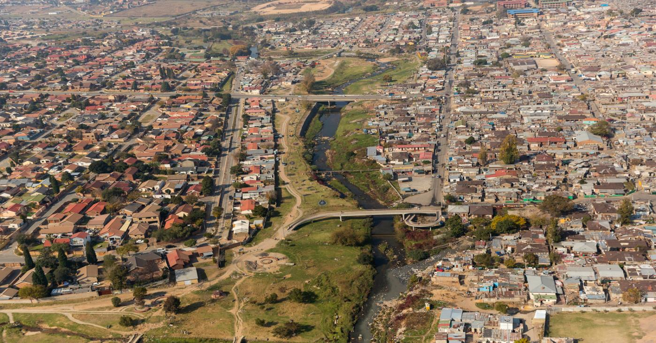

Slide 24
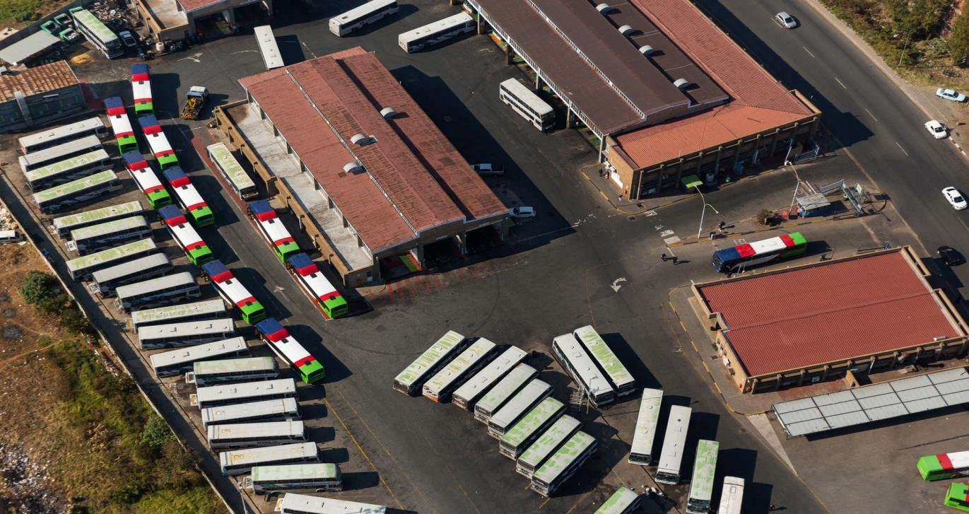

Slide 25
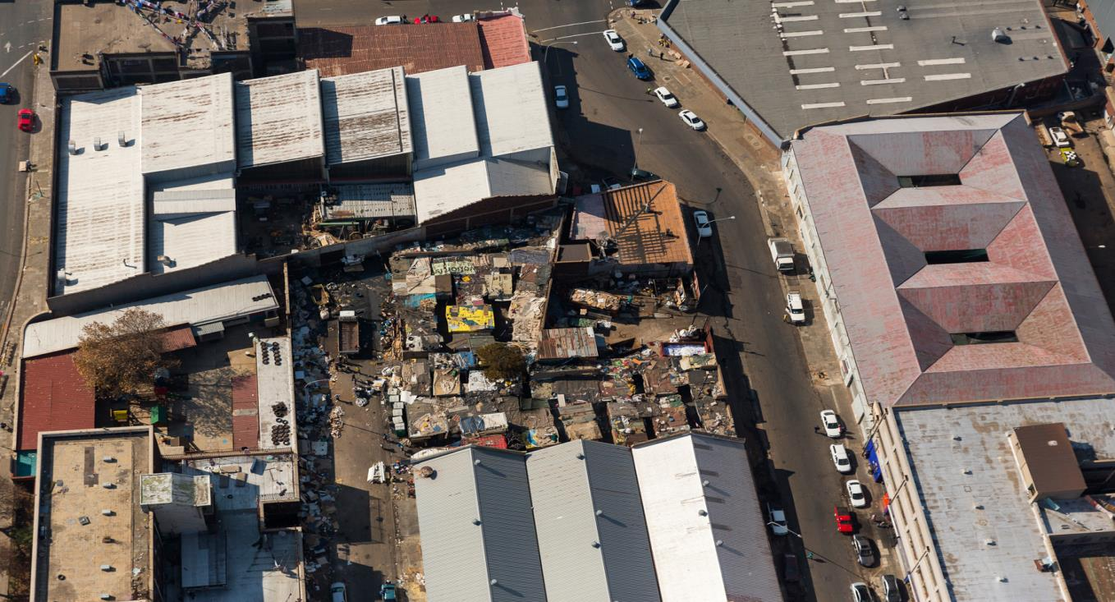

Slide 26
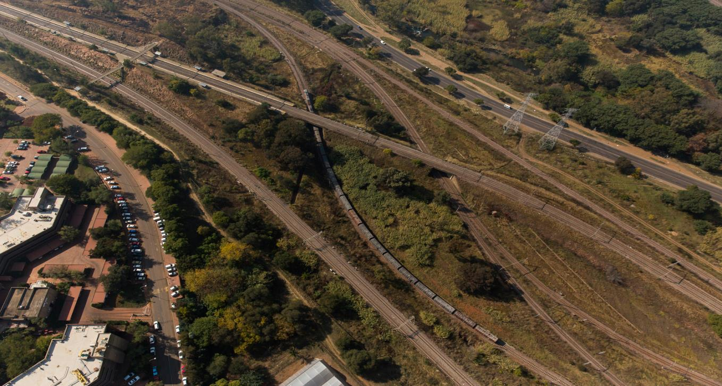

Slide 27
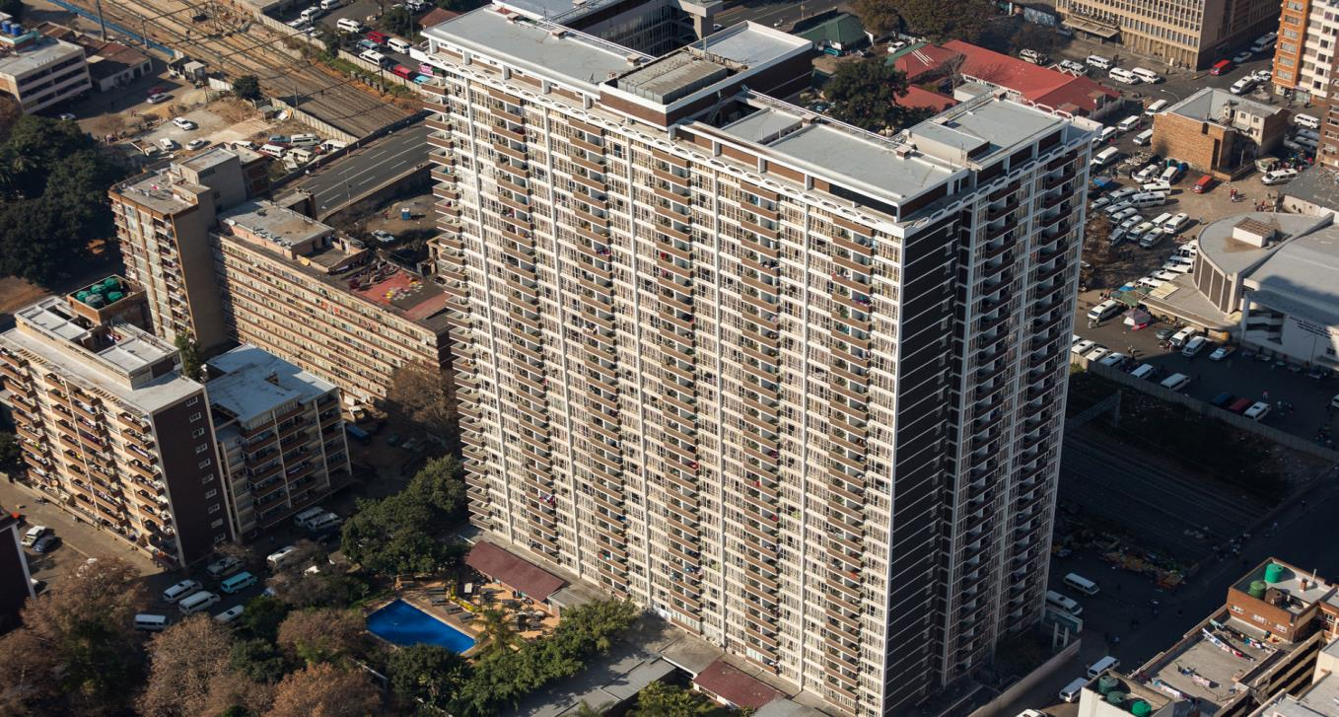

Slide 28
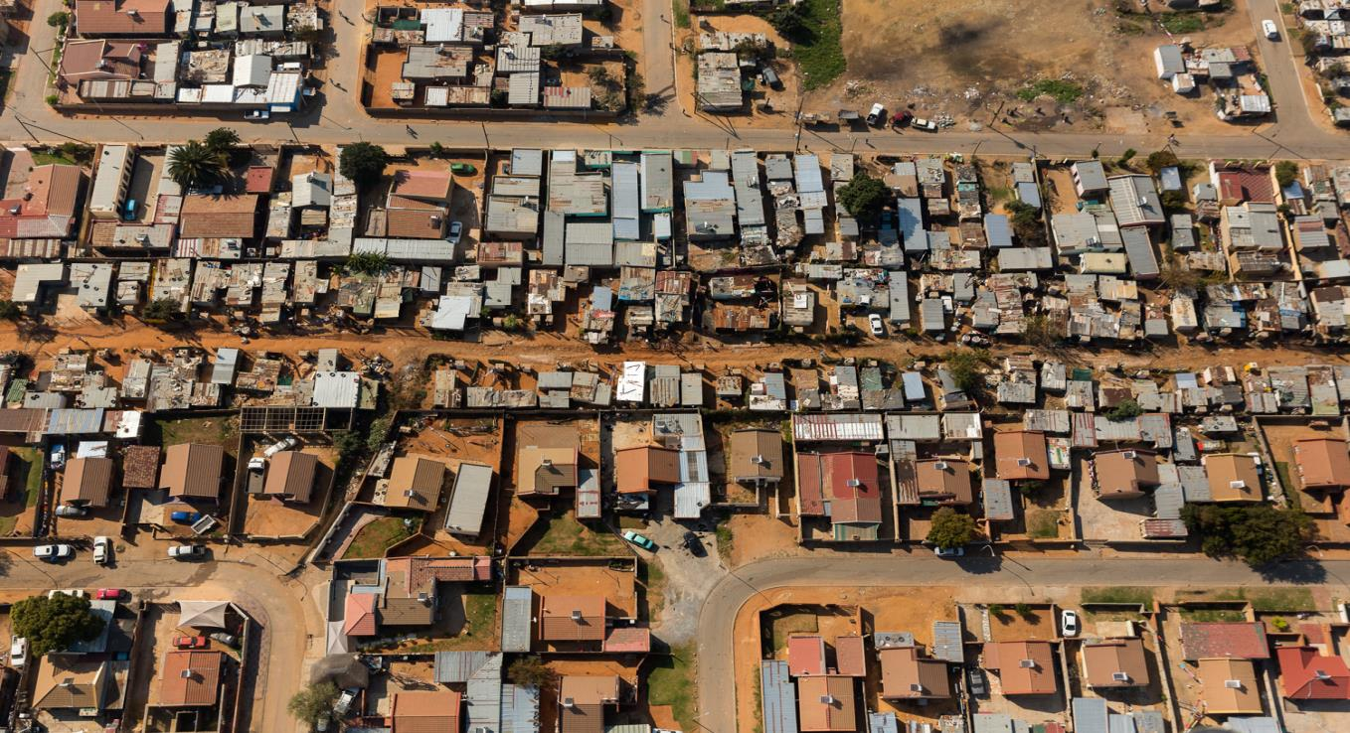

Slide 29
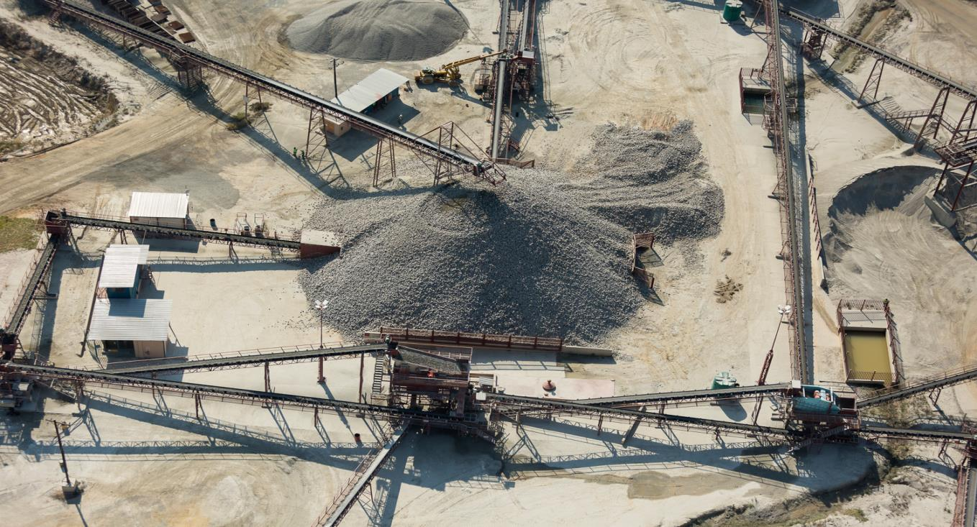

Slide 30
