Slide 1
Governing Complex Urban Agglomerations
Clusters of cities and city-regions
BRICS + City Lab International Colloquium
Moscow: Russia
Josiah Lodi: Gauteng Planning Division

Slide 2
Outline
Introduction
Complex Urban Agglomeration
GCR governance and coordination challenges
Reflections on the current landscape
Planned Action
GSDF 2030 Implementation (Integrated Strategic Spatial Planning)
Regional Spatial Development Frameworks (RSDFs)
Consolidation of the role of Gauteng Planning Division (GPD)
Conclusion

Slide 3
Introduction

Slide 4
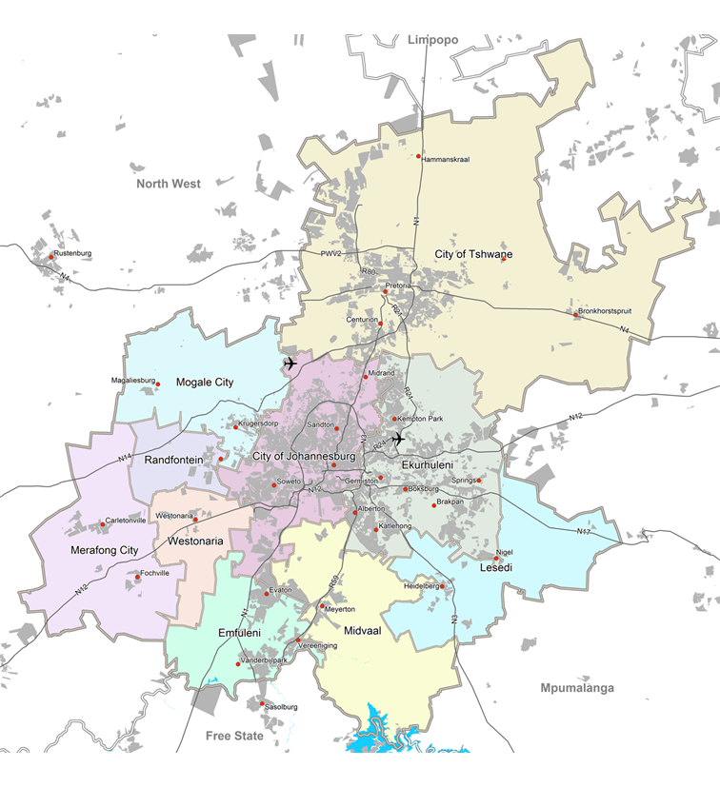
Introduction: Population Statistics
4
4

Slide 5
Complex Urban Agglomeration
- Current GCR Governance and Coordination Challenges

Slide 6
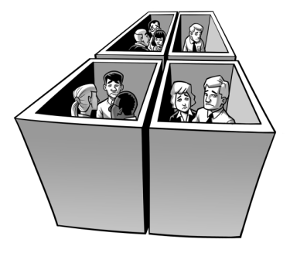
Current GCR governance and coordination landscape
Ambiguity in interpretation of powers and functions
Silo planning, budgeting, and implementation across spheres
Compliance-driven IGR; rubber stamping; too many centres
Political ideological differences
Notes:
1) Sovereign provinces, 2) Regional governance not catered for in constitution

Slide 7
Interpretation of powers and functions
Economy and Infrastructure
Planning
Concurrent National & Province govt.
Industrial promotion
Tourism
Urban and rural development
Public transport
Concurrent National & Province govt.
Regional Planning and Development
Exclusive Provincial govt.
Provincial roads
Exclusive Provincial govt.
Provincial Planning
Local govt. (Schedule 4B)
Local tourism
Municipal public transport
Elec. & Gas reticulation
Storm water mgt. In built-up
Potable water supply
Domestic waste water & sewage disposal
Local govt. (schedule 4B)
Municipal Planning
Housing and Social Facilities
Concurrent National & Province govt.
Housing
Health services
Education at all levels (excluding tertiary)
Local govt. (Schedule 5B)
Markets
Street trading
Municipal roads
Solid waste disposal
Local govt. (Schedule 4B)
Municipal health services
Local govt. (Schedule 5B)
Municipal parks and recreation
Public places

Slide 8
Silo planning, budgeting, and implementation
Municipal Sphere:
Community needs are gathered annually
Sector plans (road, water, etc.) + expenditure estimates are compiled into annual IDPs & SDBIPs
SDBIPs are rolled out in line with community needs + long-term spatial vision (i.e. MSDFs)
Service delivery targets and KPAs + Output & outcome info. + Finance & output info. submitted to Province
Provincial Sphere:
Political pronouncements + service delivery agreements with national ministers combines to inform departments’ APPs + Budget
APP projects and programmes seldom drawn to respond directly to IDP needs
APP targets implemented in municipalities often without regard for any spatial logic (MSDFs/ PSDF)
Performance info. submitted to premier’s office; financial info. submitted to national treasury via provincial treasury; policy outcome info. submitted to line ministers

Slide 9
Existing coordination mechanisms: Structures
Key IGR Structures:
Political
Provincial Executive Council
Premier’s Coordinating Forum (PCF)
MEC MMC Forum (per sector)
Gauteng Infrastructure Coordination Council
Administration
Head of Departments (HoD) Forum
Chief Financial Officer’s (CFO) Forum
Chief Information Officer’s (CIO) Forum
Gauteng Infrastructure Coordination Committee
Gauteng Transport Technical Steering Committee
Gauteng Planning Forum
Gauteng GIS Forum
Gauteng SPLUMA Implementation
Planning Monitoring & Evaluation (PME) Forum etc.
What is lacking?
A legitimate planning and coordination nerve centre to provide strategic leadership

Slide 10
Existing coordination mechanisms: “Sector” Plans
Key Plans:
Gauteng Spatial Development Framework 2030
GCR Economic Development Plan
25 Year Gauteng Transport Master Plan
Gauteng 2055
Social Development Strategy
What is lacking?
A legitimate planning and coordination nerve centre to provide strategic leadership

Slide 11
Courts’ guidance on interpretation of powers & functions
Concurrent National and Provincial (Schedule 4A)
National govt. provides legal and policy framework
Provincial govt. directly implements
Local govt. matters (Schedule 4B)
National govt. provides legal and policy framework
Provincial govt. may provide legal and policy framework which may not conflict with the national framework
Local govt. directly implements
Local govt. may pass by-laws and make policies which may not conflict with national/provincial framework
Provincial govt. monitors
Growth management, and land use/ land development management is fundamental to municipal planning
Provincial powers to make regulations on local govt. matters in Schedule 5B does not extend to the where? but limited to the how? of such matters
Exclusive Provincial (Schedule 5A)
Provincial govt. provides legal and policy framework and implements
Local govt. by-laws and policies may not be in conflict
Local govt. matters (Schedule 5B)
Provincial govt. may provide legal and policy framework
Local govt. implements
Local govt. may pass by-laws and make policies which may not conflict with provincial framework

Slide 12
Reflections on the current landscape

Slide 13
Reflections and lessons
Gauteng Planning Division best located to drive and coordinate
Too many centres and no LEADER
Everyone wants to coordinate within their sector/silo
Politics drives the development agenda
limited appetite to evidence based agenda setting (human settlements, Syferfontein)
Ad hoc interaction with the private sector

Slide 14
Reflections and lessons
A mismatch between articulated aspirations and practice (make everyone happy, scream the loudest)
Disregard (little to no appetite) to exercise legal powers
Failure of IGR structure to yield real coordination
Chasing quick results in the urban planning/development arena
Two centres of power: who do politicians listen to?

Slide 15
Lessons and good practises: how it works elsewhere
Lessons from the Western Cape province:
Master the planning and budgeting cycle of government
Joint (spheres, political, others) priority setting, resource allocation (money and people) and implementation
Targeted investment
Willingness to realign and reprioritise resources
A “healthy” balance between top down and bottom up approaches
Systematic approach and thinking
Collective accountability, progress and feedback

Slide 16
Planned Action:
Consolidation of the role of Gauteng Planning Division (GPD)
GSDF 2030 Implementation (Integrated Strategic Spatial Planning)
Regional Spatial Development Frameworks (RSDFs)

Slide 17
Consolidation of GPD’s Role
Development Planning
Performance M&E
GPD
(Office of the Premier)
Theoretical nerve centre to drive planning in the GCR
Fuzzy legal authority
Authority currently derived by proxy
Adaptive governance to amend and inform current policy
Clear authority and mandate in terms of legislation (PFMA etc.), national policy, and guidelines
Seek impact (service delivery and spatial transformation)
Progressive consolidation of planning, monitoring, and evaluation at the centre

Slide 18
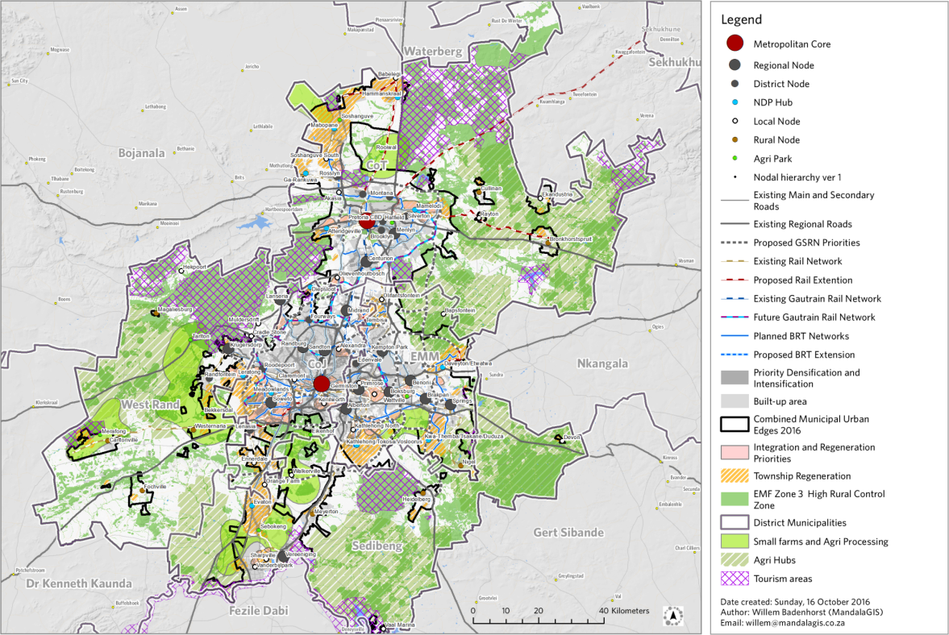
Opportunities for Gauteng: how it could work
Use the Gauteng Spatial Development Framework (GSDF) to:
Foster joint (spheres, political, others) priority setting, resource allocation (money and people) and implementation
Pursue targeted investment in space
Realign and reprioritise resources
Ensure collective accountability, track progress and provide feedback

Slide 19
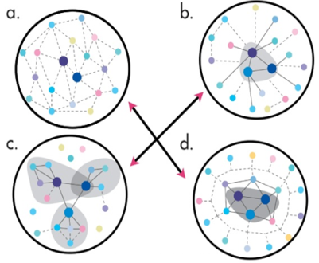
Regional spatial development frameworks
Compiling Regional Spatial Development Frameworks (RSDFs) for areas straddling sovereign jurisdictions
RSDFs will be used as instrument for engendering:
Adaptive governance
GCR agenda through coordination of land development and socio-economic investment
There are legislative challenges yet; however we have begun discussions regarding the review of existing legal provisions on RSDFs
Adaptive governance
Collaborative, flexible and learning-based approaches to governance, to
Improve the responses of urban agents to the continual challenges of complexity, uncertainty and fragmentation
Notes:
1) Legal effect of RSDFs vis a vis MSDFs and MPT decision unclear; 2) RSDFs institutional and implementation arrangement unclear 3) adoption process unclear 4) SPLUMA Regulations required

Slide 20
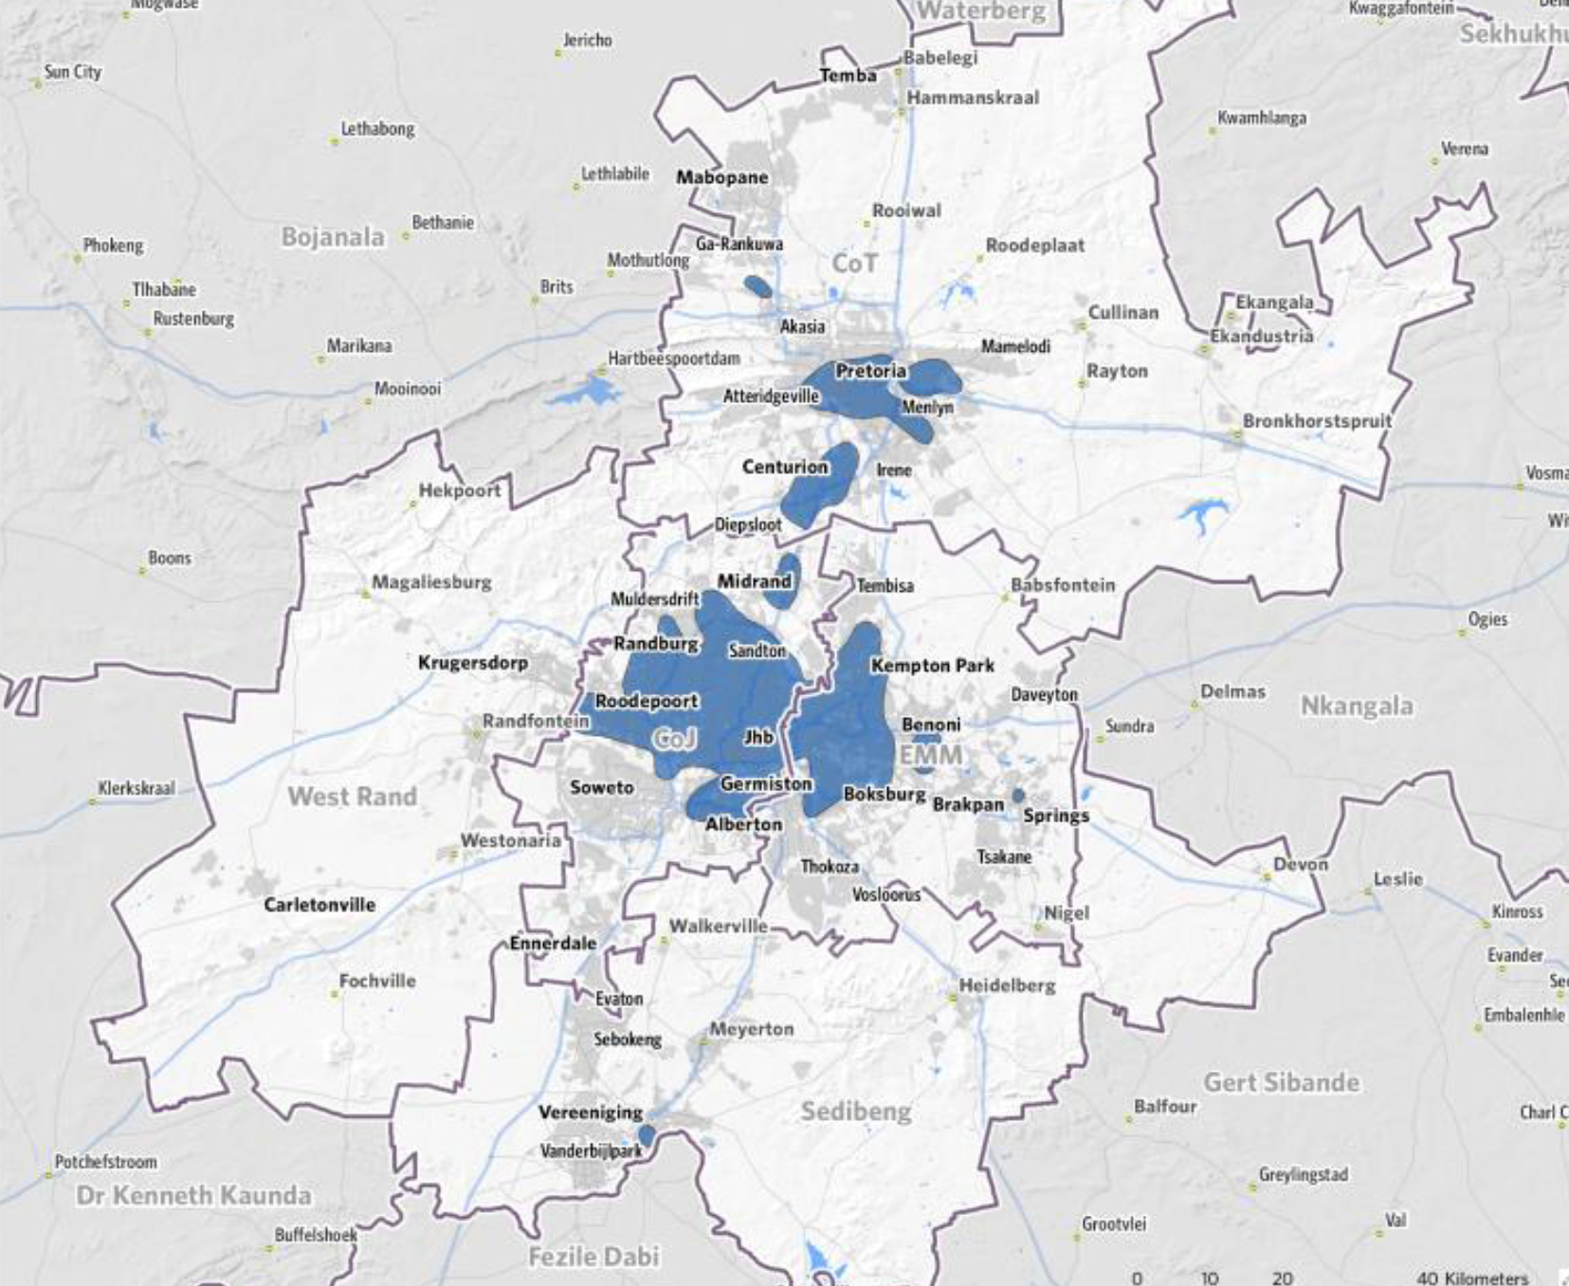
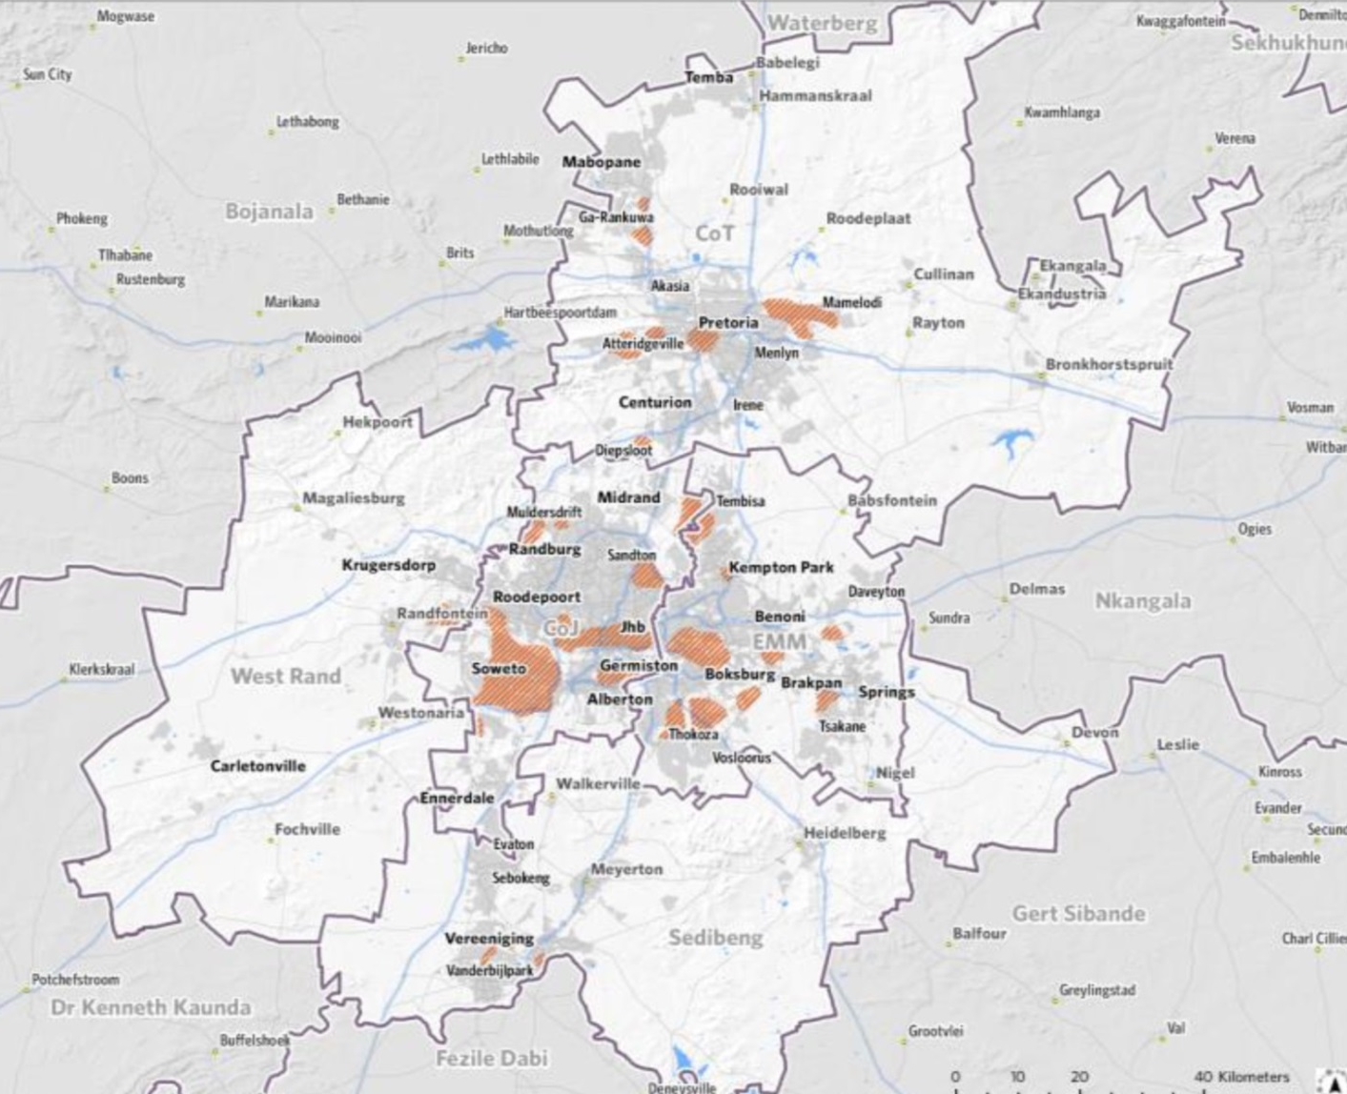
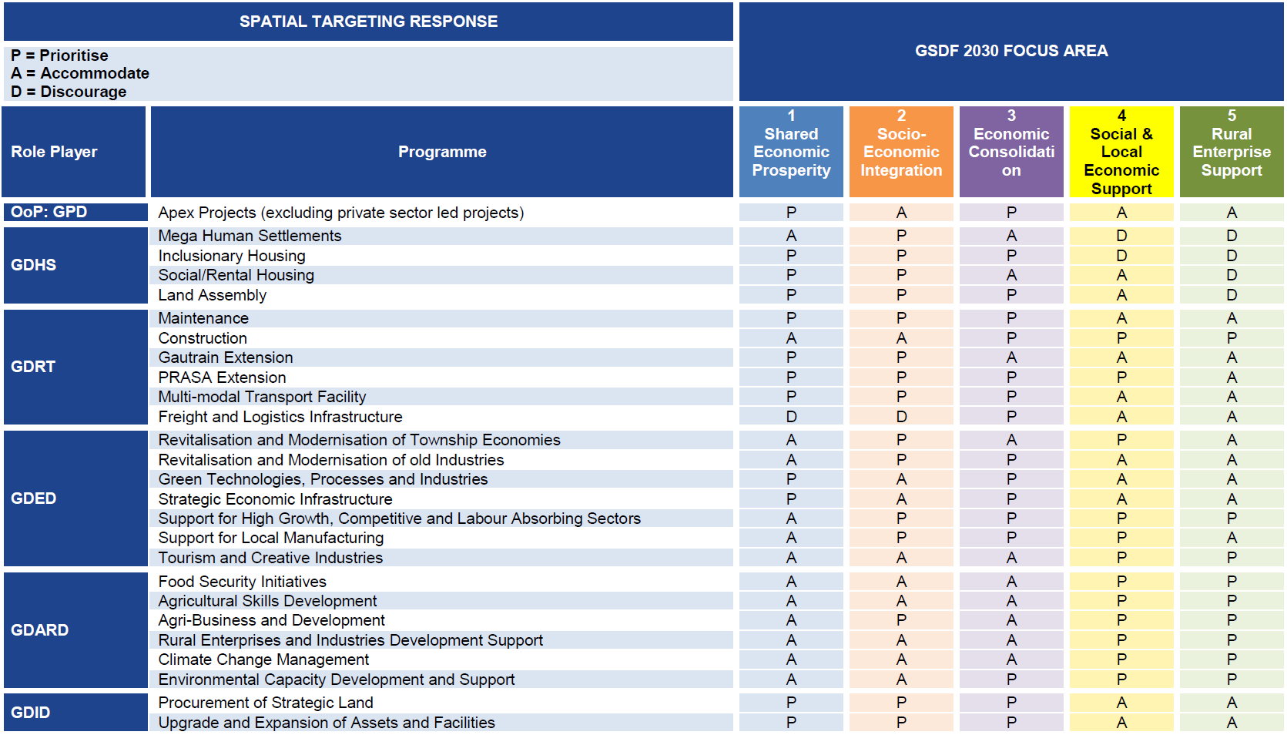
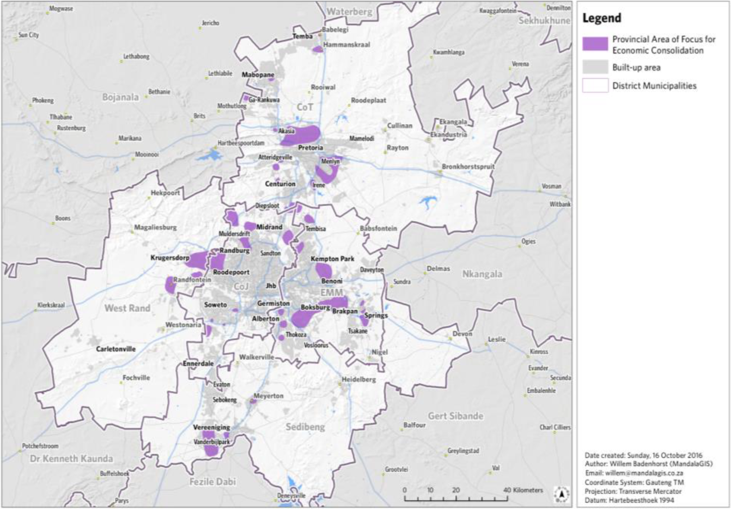
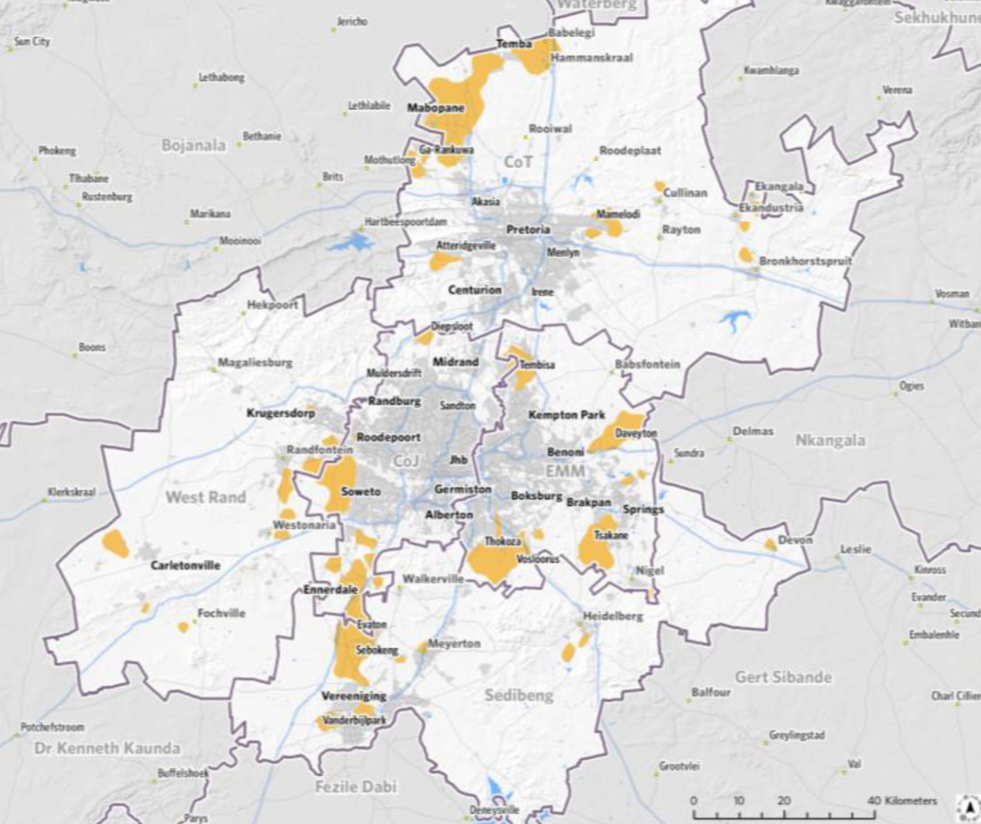
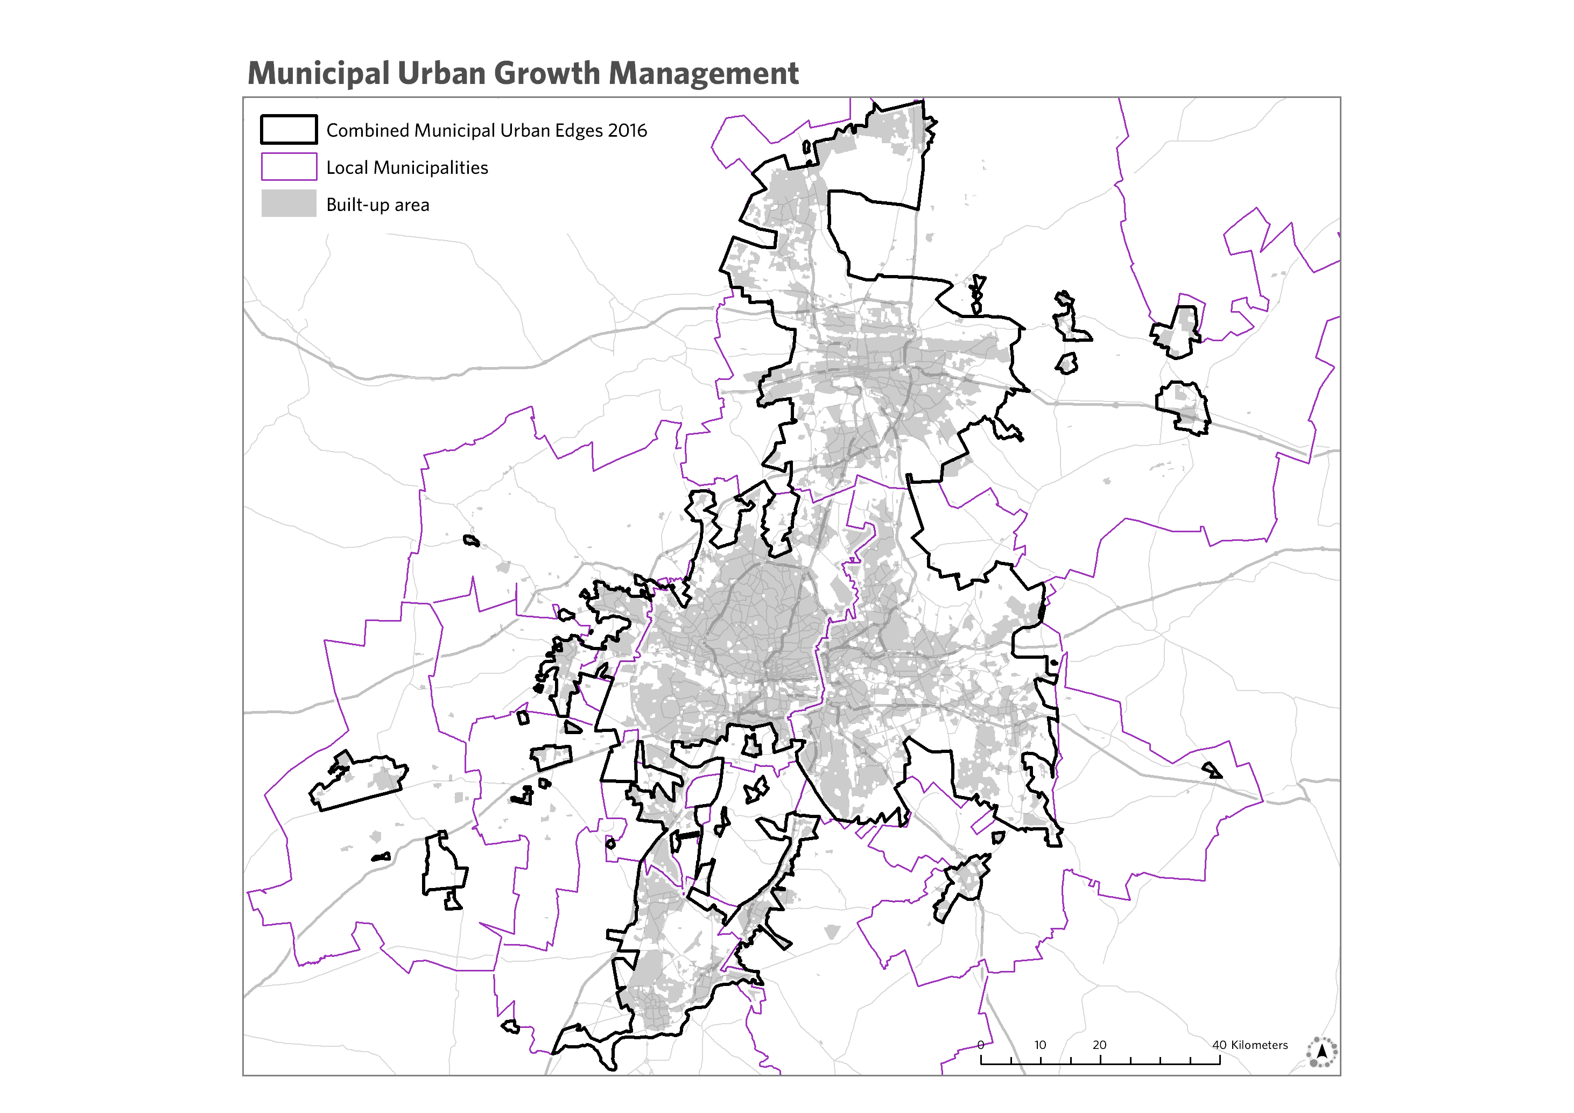
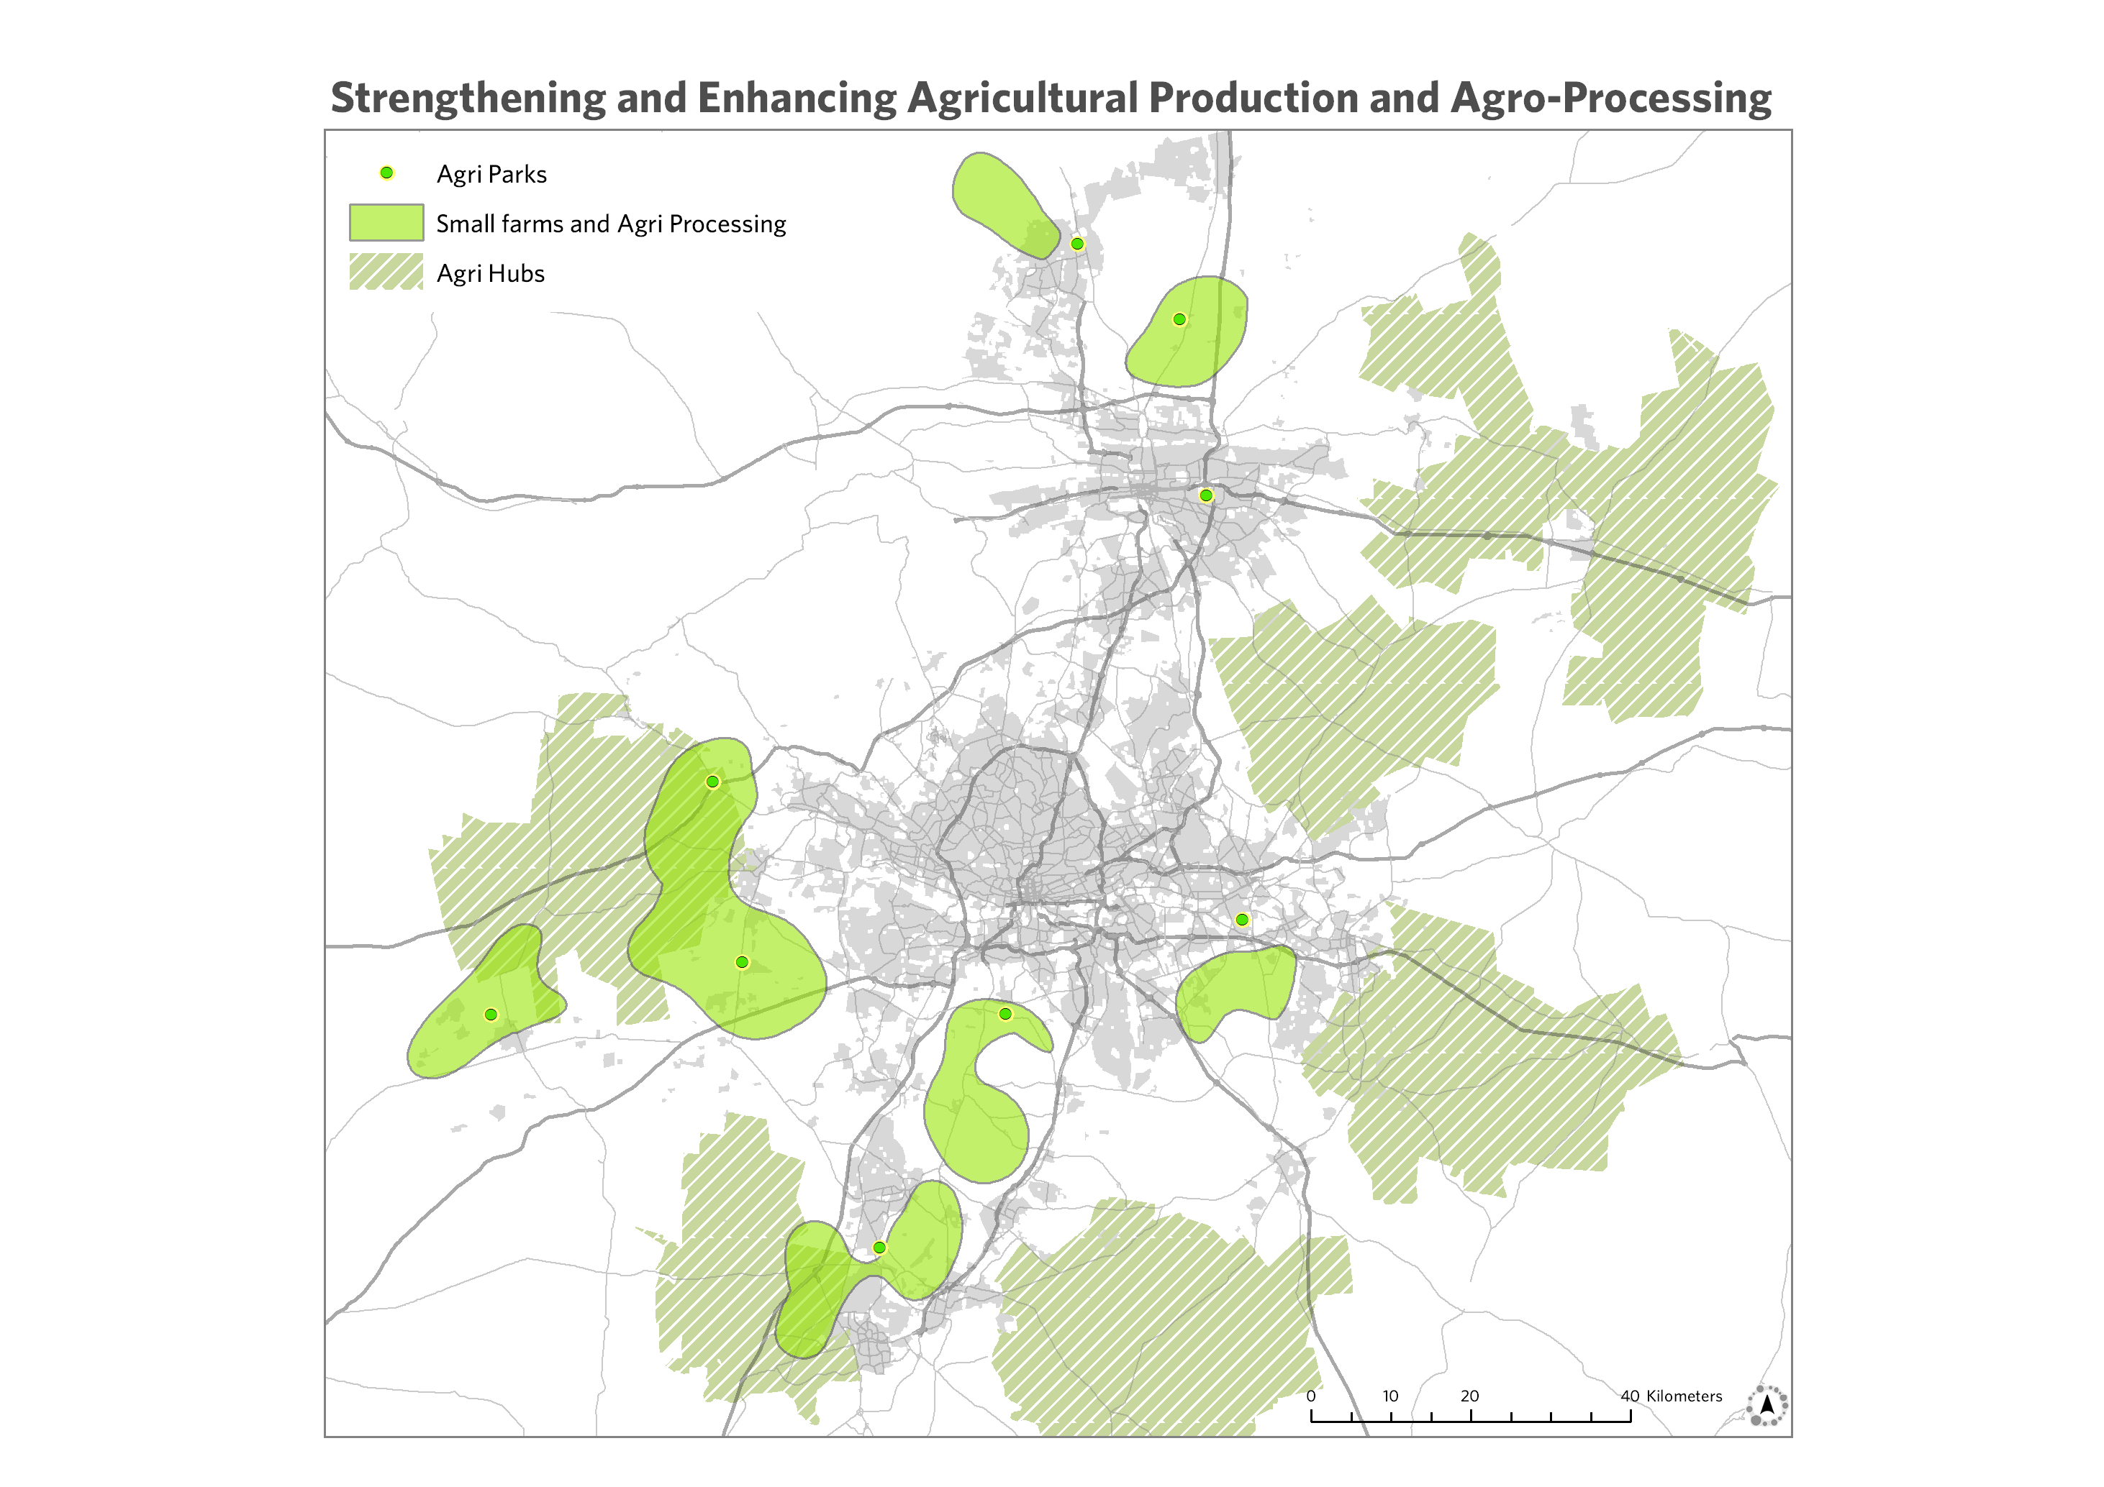
Implementation of the Gauteng Spatial Development Framework 2030
Identification of focus areas based on spatial evidence of need and potential
Overlapping with key municipal nodes and corridors
Aligned to provincial budget programme structure
Draft APPs + Budgets to be assessed annually for alignment with IDPs needs + Focus Areas
Opportunities for joint implementation of programmes/project identified and facilitated
Monitor sector regard for municipal (UDB)
GIS support for spatially integrated Provincial M&E
Focus Area for Shared Economic Growth
Focus Area for Socio-economic Integration
Focus Area for Economic Consolidation
Focus Area for social and Local Economic Support
Focus Area for Rural Enterprise
Support

Slide 21
Spatial Development Interventions
Strategy 1: Building an Economic Network
1 – Spatial integration and township regeneration
2 – Expanding and integrating municipal BRT
3 – Municipal nodal development, maintenance, enhancement
Strategy 2: Capitalising on Proximity
4 – Supporting municipal growth management
5 – Intensification of nodes, public transport routes & stations
Strategy 3: Managing New Settlement Development
6 – Major road and rail network enhancement
7 – Providing multi-pronged sustained support to outlying settlements
8 – Strengthening & enhancing agricultural production and Agro-Processing
Strategy 4: Creating a Viable & Productive Hinterland
9 – Actively pursuing environmental management and eco-system protection
10 – Boosting and optimising provincial tourism opportunities
7

Slide 22
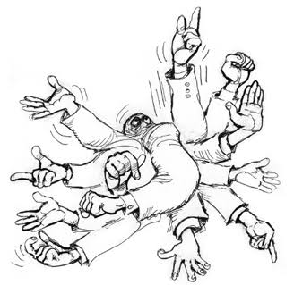
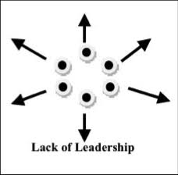
Conclusion: Who is watching where we are going?
“Anyone can say all the right things but still do nothing or do the opposite thereof if you don’t keep the big picture in mind “

