Slide 1
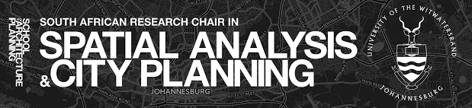
Assessing the Role of Urban Form on Youth Unemployment in South Africa
Kwanda Lande
BRICS+ CITY LAB II COLLOQUIUM

Slide 2
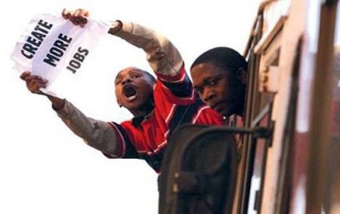
Introduction
High youth unemployment rate is not only a pressing socioeconomic problem - its a ticking time bomb.
Urban youth unemployment is estimated at 36.6%.
Youth unemployment in South Africa have been attributed to a combination of challenges facing labour market participants.
The focus is on the role of “spatial constraints” experienced by young people from poor neighborhood

Slide 3
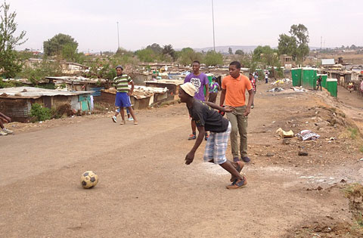
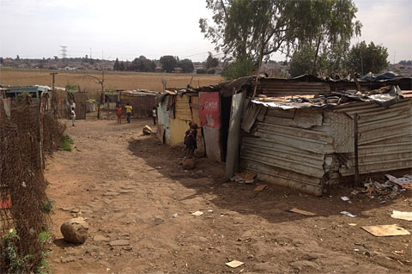
Accessibility and Unemployment
Young people from poor neighborhood experience accessibility issues to places of employment.
The greatest proportion of growth in employment opportunities are taking place at a distance from the residential location of poor neighborhoods.
Young people from poor neighborhoods live in communities with weak or non-existence of public transportation. Hustle

Slide 4
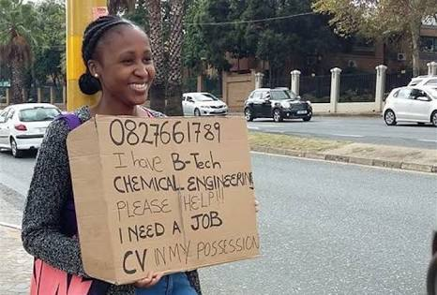
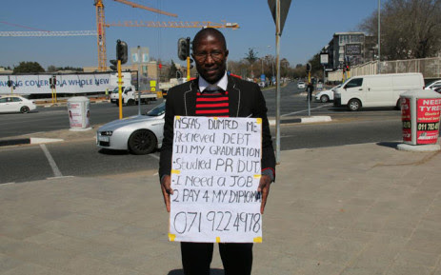
Local Networks and Unemployment
The struggle of developing local networks to link with job opportunities, to provide knowledge of where the best locations are to look for work.
Local networks are important since businesses recruitment strategies, especially small business, rely heavily on referrals.
Privileged youth groups – which have more access to transportation and connections with people who are employed – “spatial constraints” to them are insignificant.

Slide 5
Looking ahead: Youth in Governance
Youth should not only be addressed as a specific category, it should also be addressed as different groups because youth challenges are experienced differently.
To better align difference in experiences, the incorporation of youth participation in planning processes is significant.
In South Africa there has been a focus on youth, for example, the establishment of the National Youth Development Agency (NYDA).
The attention to youth is not translating into meaningful changes in the lives of a significant proportion young people.
Finding case experiences, internationally of youth participation in planning to be explored for good practice that might be applied in the South African context.

Slide 6
Thank You!!!!!

Slide 7
Reference
Harrison (2013) South Africa’s “cities of hope”: Assessing the role of cities in creating opportunity for young people, Paper prepared for the Centre for Development and Enterprise, commissioned for Cities of Hope project, June 2013.
Holzer, H. J., Ihlanfeldt, K. R., and Sjoquist, D. (1994) Work, Search, and Travel among White and Black Youth, Journal of Urban Economics, 35, 320-345.
Hinks, T. (2008) Poverty, Networks and Location Determinants of Job Search in South Africa. Journal of International Development, 20, 117-131.
Banerjee, A., Galiani, S., Levinsohn, J., McLaren, Z., and Woolard, I. (2008). Why has Unemployment Risen in the New South Africa? The Economics of Transition, 16(4), 715–740.
Hoekman, G. (2015) The Spatial Mismatch Hypothesis and the use of social networks for job search in Cape Town, A minor dissertation submitted in partial fulfilment of the requirements for the award of the degree of Master of Philosophy in Development Studies, Faculty of the Humanities University of Cape Town.
Rospabe, S. and Selod, H. (2003) Does City Structure cause Unemployment ? The case study of Cape Town, Paper presented at the World Bank Urban Research Symposium, Urban Development for Economic growth and Poverty Reduction, December 15-17, 2003, Washington, D.C., USA
Seekings, J. (2010) Race, class and inequality in the South African City. In The Blackwell Companion to the City, Bridge, G. and Watson, S. (eds), (new edition, Blackwell
Martin, R. (2004). Can Black workers escape spatial mismatch? Employment shifts, population shifts, and Black unemployment in American cities. Journal of Urban Economics, 55, 179-194.
Gobillon, L., Selod, H. and Zenou, Y. (2007). The mechanisms of spatial mismatch, Urban Studies, 44, 2401-2427.
Hellerstein, J., Neumark, D. and McInerney, M. (2008). Spatial mismatch or racial mismatch? Journal of Urban Economics, 64, 464-479.

