Slide 1
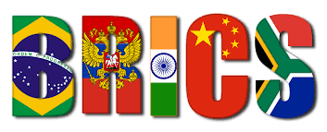
Beyond Creative Consumption and Destruction in South Africa’s Marginalised Urban Areas: Lessons from the Izikhothane Youth Movement’s Aspirations
Adaptive and Transformative Governance for Large City Development
Youth Component
Thembani Mkhize
Gauteng City-Region Observatory (GCRO)

Slide 2
In the postcolony, magnificence and the desire to shine are not the prerogative only of those who command. The people also want to be ‘honoured’, to ‘shine’ and to take part in celebrations … [I]n their desire for a certain majesty, the masses join in the madness and clothe themselves in cheap imitations of power to reproduce its epistemology.
~Ousmane as cited in Thomas 2007: 155

Slide 3
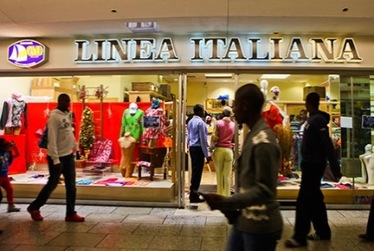
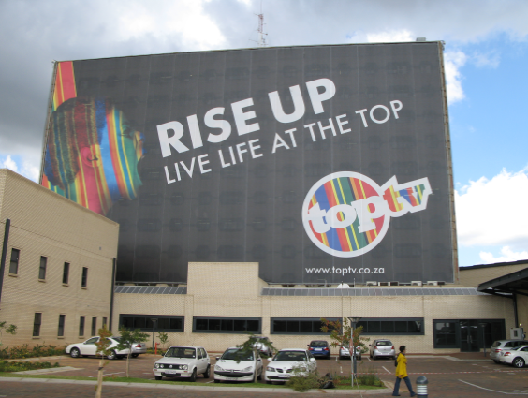
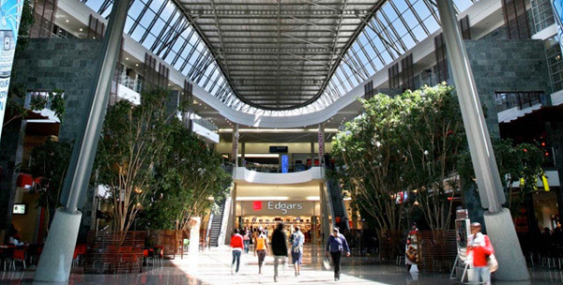
Inspiration for (case) study
Rise of ‘culture of consumption’ in SA cities
Ubiquity of billboards – esp fashion billboards - encouraging hyper-consumerism
Proliferation of mega-shopping malls in formerly marginalised areas
Influx of international high street and high end clothing brands since 2010
Izikhothane have emerged and gained momentum against this backdrop

Slide 4
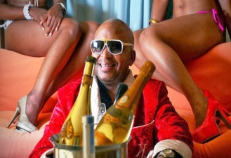
Who are Izikhothane? Defining Characteristics
Accumulation, consumption and intentional destruction
Burning of money and clothes; spilling of alcohol and fancy dessert
To show ‘who can afford more’, to determine which party is ‘wealthier’ and/or who is the better ‘cheese boy’
Winner elevates social standing - gains respect, (female) attention, superiority - albeit temporarily
Inspired by ‘Black Diamonds’, particularly Kenny Kunene (sushi King)
Zulu slang for ‘lickers’
Subculture usually comprised of young men from poor backgrounds who:
Adorn themselves in colourfully eccentric designer clothing
View showmanship, dandyism and ostentation as central day-to-day preoccupations
Are fatalistically obsessed with expensive designer labels, alcohol and food
Belong to dance ‘crews’ and partake in dance competitions/‘battles’ (Ukukhothana)
Social media and word of mouth to spread word of battles

Slide 5
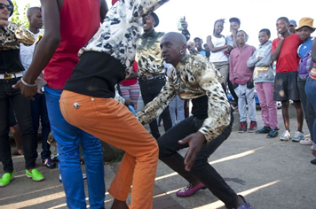
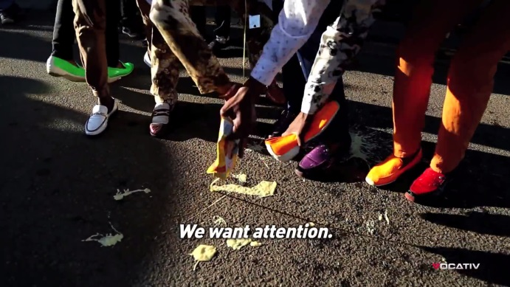
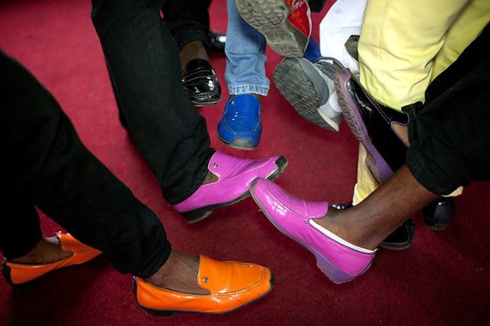
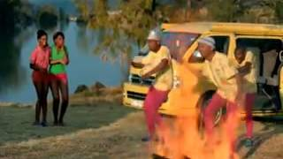
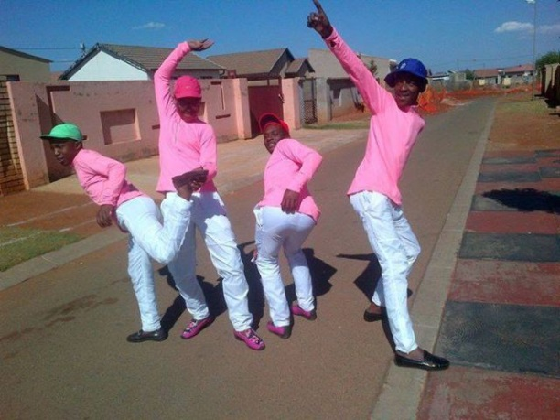
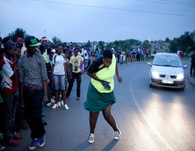
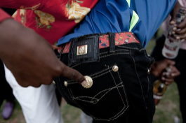
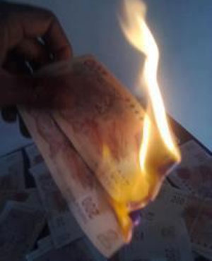
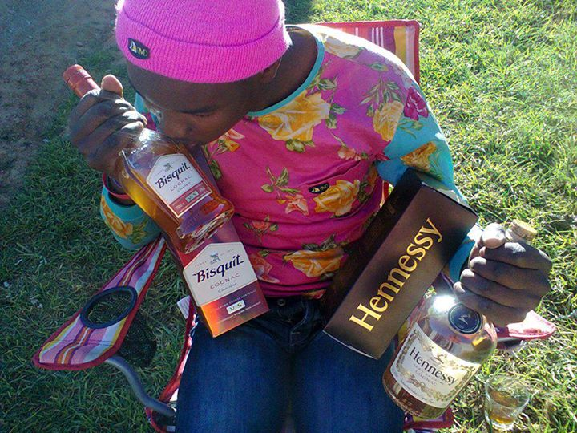
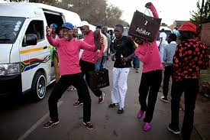
Who are Izikhothane? Defining Characteristics

Slide 6
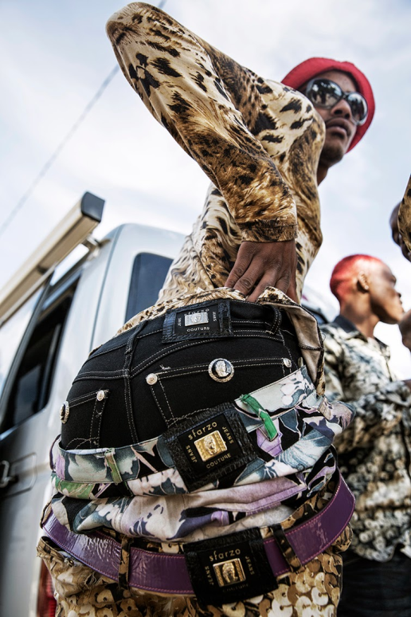
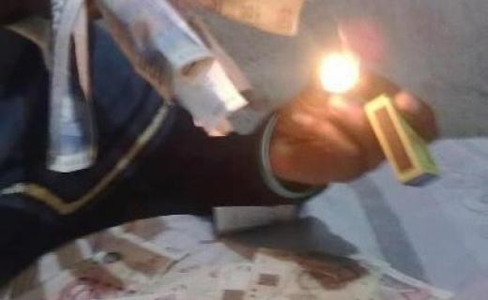
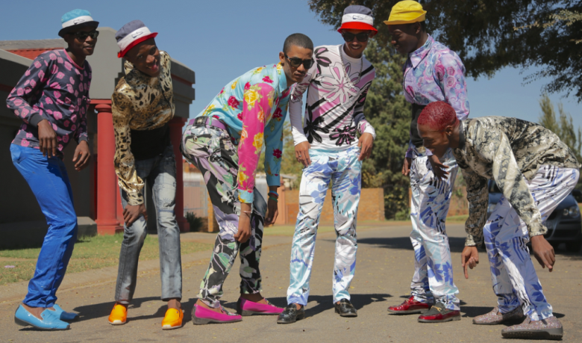
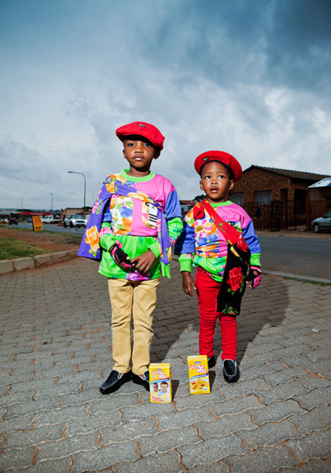
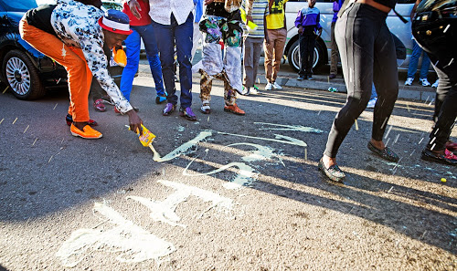
Who are Izikhothane? Defining Characteristics

Slide 7
Problematic Aspects; Portrayal in Community and Popular Culture
Dismissed by community as shallow, materialistic attention seekers
Demonised by media, perhaps due to subculture’s paradoxes and fatal consequences
‘Mad rush’ to keep up for youths from dire backgrounds
Financial and economic strain on families
Anomie: Member who committed suicide after being pressured by peers to keep spending money even though family did not have the means
Worries that sources of money might be socially unacceptable

Slide 8
Socio-political Messages and Aspirations
Form of escapism
From harsh realities of township life
Coping mechanism
A way of surviving amidst bleak circumstances of township life
Youth’s way of “locating itself in a post-apartheid urban space that is awash with consumerism” (Mchunu 2016: 2)
Subversion and excluding system that has excluded them
Deemed unnecessary by a skills-driven, knowledge-based urban market hence have created their own enclave(s)
Yet, paradoxically feed into this consumer-driven economy

Slide 9
Socio-political Messages and Aspirations (cont’d)
An attention seeking political statement to:
Politicians – “… when you listen to them – they want to act against politicians, whom they say are doing nothing for young people, and against Western products that symbolise White society”
Society at large – ‘We are as much citizens of this consumeristic global village as the rich; we belong whether you like it or not.’
“A potent means of articulating youth identity in settings seemingly left behind by the ‘new South Africa’” (Howell and Vincent 2014: 60)?

Slide 10
Concluding Remarks: Appropriate Adaptive Governance Response(s)
How can energy of these identity-driven aspirational outpourings be positively re-directed?
Close attention to real effects of affirmative action programmes for youths in previously marginalised areas?
Career guidance in contexts of poverty and/or inequality?

Slide 11
Thank You!

